Slide 1


Oddelenie biofyziky
Ústav experimentálnej fyziky
Slovenská akadémia vied
A novel approach for treatment of Alzheimer's disease
RNDr. Zuzana Bednáriková, PhD.
Súťaž mladých vedeckých pracovníkov ÚEF SAV do 35 rokov
Košice, 12.12.2018

Slide 2
Práce prihlásené do súťaže:
Pham H.D.Q., Thai N.Q., Bednarikova Z., Linh H.Q., Gazova Z., Li M.S.
Bexarotene cannot reduce amyloid beta plaques through inhibition of production of amyloid beta peptides: In silico and in vitro study
Physical Chemistry Chemical Physics, 2018, 20, 24329-24338, 10.1039/c8cp00049b.
Impact factor 2017: 3.906, Q1- 0 citácií
percentuálny podiel: 25%
Orteca G., Tavanti F., Bednarikova Z., Gazova Z., Rigillo G., Imbriano C., Basile V., Asti M., Rigamonti L., Saladini M., Ferrari E., Menziani M.C.
Curcumin derivatives and Aβ-fibrillar aggregates: An interactions’ study for diagnostic/therapeutic purposes in neurodegenerative diseases
Bioorganic and Medicinal Chemistry, 2018, 26 (14), 4288-4300, 10.1016/j.bmc.2018.07.027.
Impact factor 2017: 2.911, Q1 - 1 citácia
percentuálny podiel: 15%
Thai N.Q.*, Bednarikova Z.*, Gancar M., Linh H.Q., Hu C.-K., Li M.S., Gazova Z.
CID 9998128 compound is a potential multi-target drug for Alzheimer's disease
ACS Chemical Neuroscience, 2018, 9, 2588-2598, 10.1021/acschemneuro.8b00091.
*1.autor
Impact factor 2017: 4.211, Q1 - 0 citácií
percentuálny podiel: 25%
Bystrenova E., Bednarikova Z., Barbalinardo M., Valle F., Gazova Z., Biscarini F.
Insulin amyloid structures and their influence on neural cells
Colloids and Surfaces B: Biointerfaces, 2018, 161, 177-182, 10.1016/j.colsurfb.2017.10.054
Impact factor 2017: 3.997, Q1 - 0 citácií
percentuálny podiel: 20%
Huy P.D.Q., Thai N.Q., Bednarikova Z., Phuc L.H., Linh H.Q., Gazova Z., Li M.S.
Bexarotene Does Not Clear Amyloid Beta Plaques but Delays Fibril Growth: Molecular Mechanisms
ACS Chemical Neuroscience, 2017, 8(9), 1960-1969, 10.1021/acschemneuro.7b00107.
Impact factor 2016: 3.883, Q1 - 1 citácia
percentuálny podiel: 25%

Slide 3


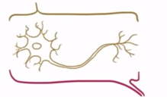


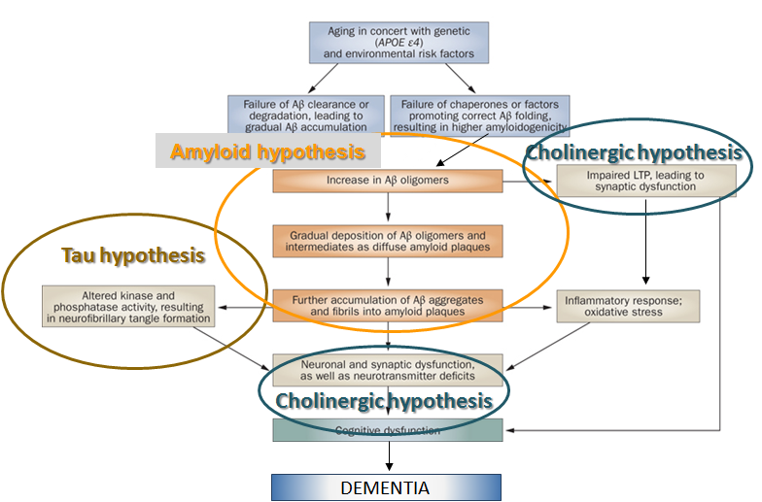
ALZHEIMER'S DISEASE (AD)
most common cause of DEMENTIA
NEURO DEGENERATIVE
Neuron
Loss
DEMENTIA
poor memory
difficulty learning
World Health Organization. http://www.who.int/chp/working_paper_growth%20model29may.pdf

Slide 4
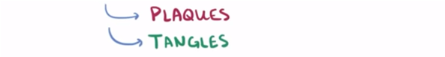
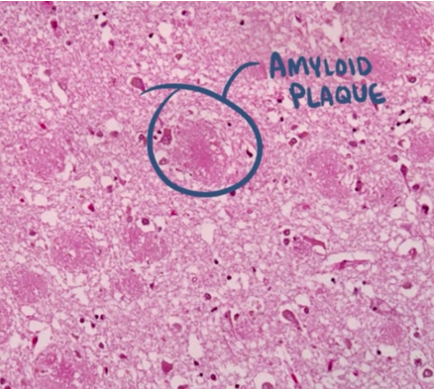
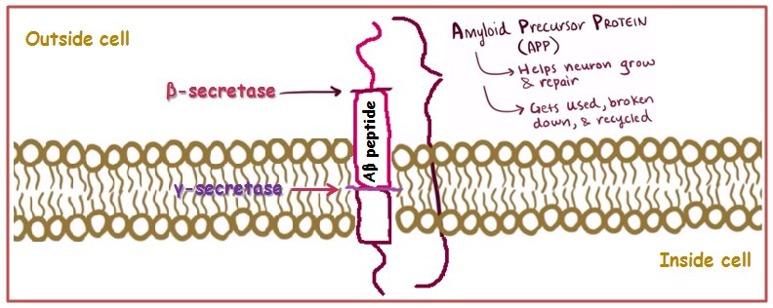
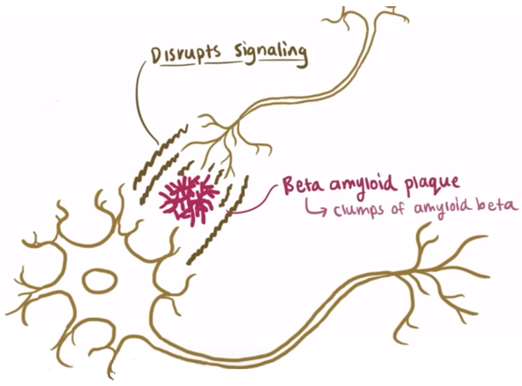
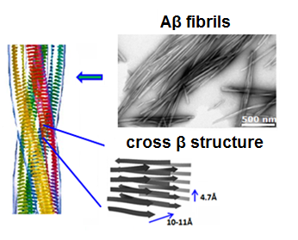
ALZHEIMER'S DISEASE
most common cause of DEMENTIA

Slide 5
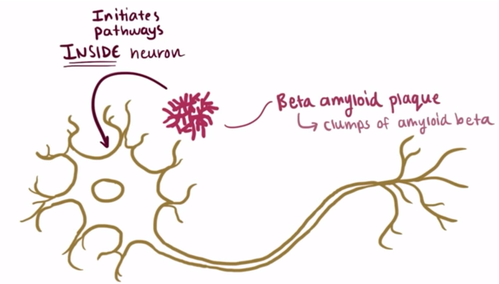
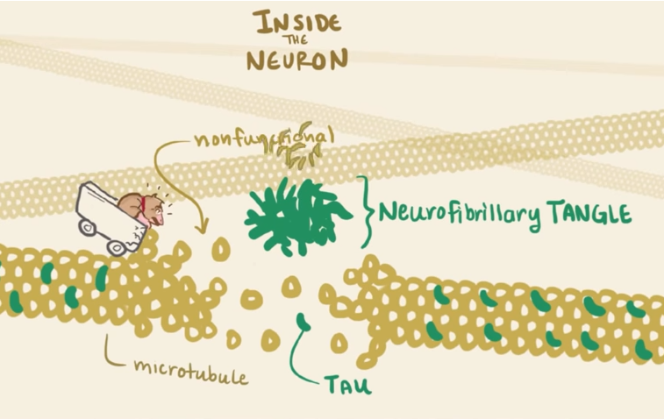
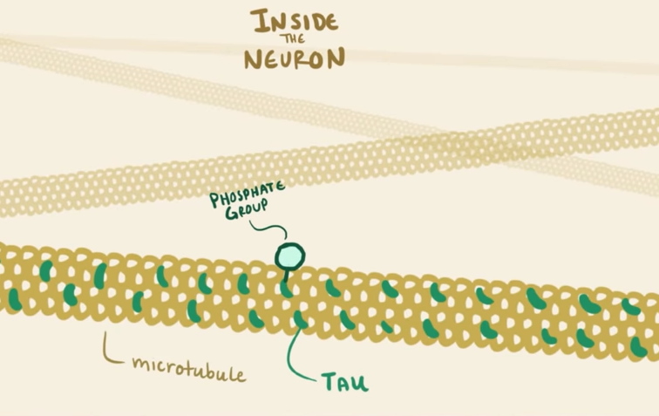
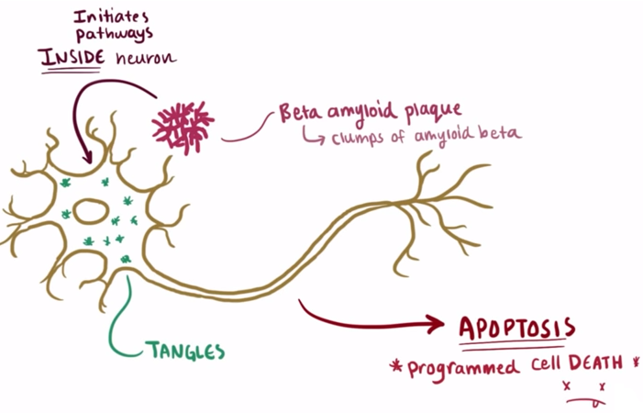
ALZHEIMER'S DISEASE
most common cause of DEMENTIA

Slide 6
APPROACHES in TREATMENT of AD
Identification of compounds with therapeutic potential → small molecules
DRUG
DRUG 1
DRUG2
Drugs
MTDLs
TARGET
TARGET 1
TARGET 2
Side effects
TARGETS
Side effects
Non-effective for AD
↑ body burden
↑ side effects
multi-target-directed ligands (1 drug for all)
multi-target-directed ligands
screening the large PubChem database for potential MTDLs candidates
rational design → combination of scaffolds with known beneficial activity against one of the AD targets (coumarin, tacrine, curcumin, quinazoline scaffolds)

Slide 7
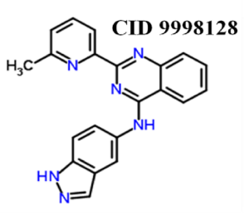

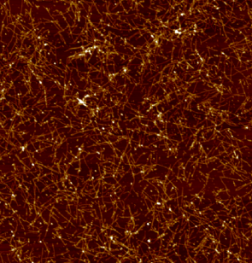
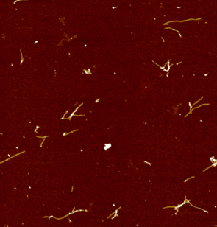
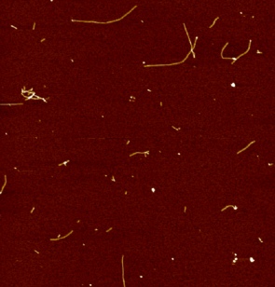
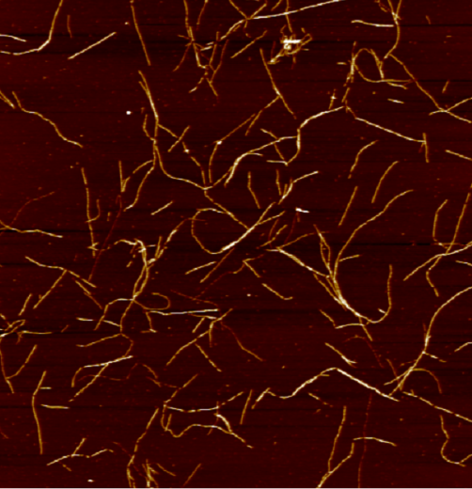
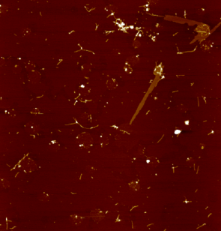
CID 9998128 hybrid molecule
quinazoline
Effect of CID 9998128 on Aβ42 amyloid aggregation
Inhibition of Aβ₁₋₄₂ fibrillization
Kinetic measurements
indazole
methylpyridine
β-secretase (BACE1) FRET Assay
Destruction of Aβ₁₋₄₂ fibrils
Destruction of Aβ₁₁₋₄₂ fibrils
Morphology of amyloid aggregates after treatment with CID 9998128 - Atomic force microscopy
Aβ₁₋₄₂ fibrils
Inhibition
Destruction
Aβ₁₁₋₄₂ fibrils
Destruction
Thai N. Q., Bednarikova Z., Gancar M., Linh H. Q., Hu C.-K., Li M. S., Gazova Z., ACS Chem Neurosci, 2018, 9, 2588-2598
1 μm

Slide 8
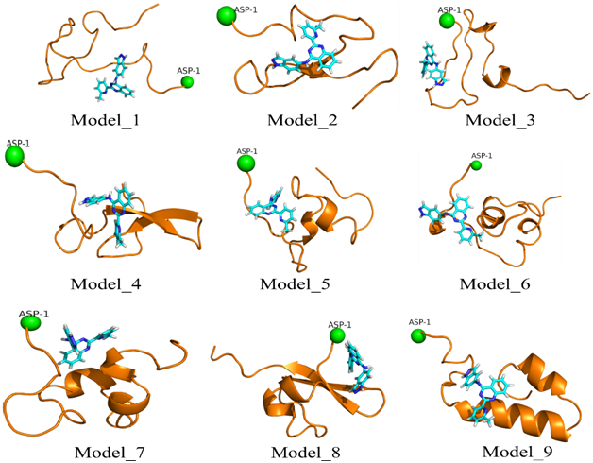
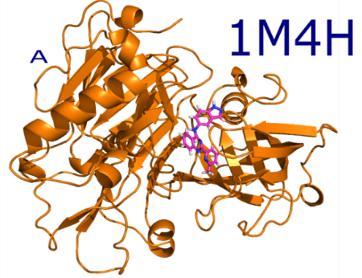
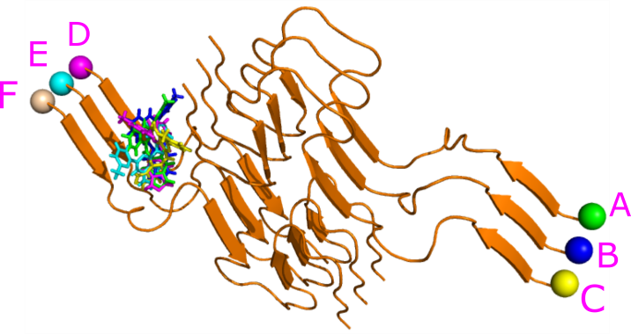

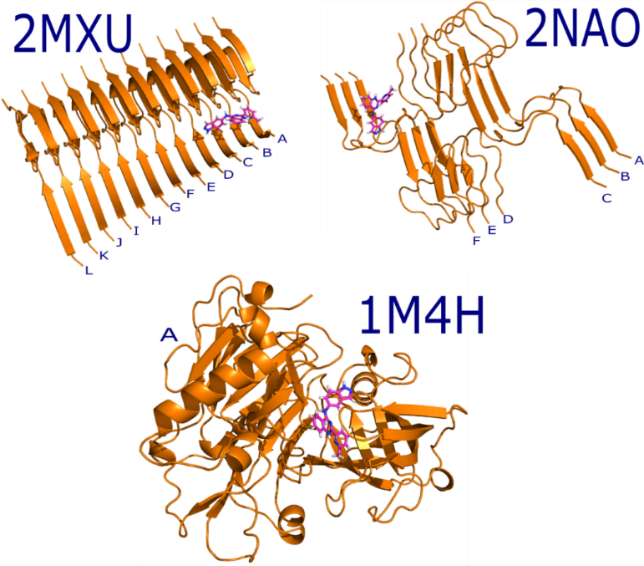
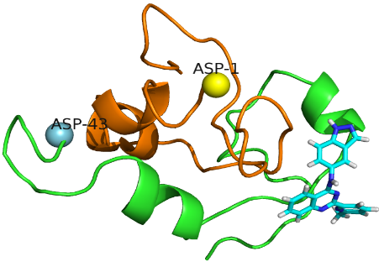
β-secretase
Aβ₁₋₄₂ fibrils
Aβ₁₋₄₂ monomer
Aβ₁₁₋₄₂ fibrils
Aβ₁₋₄₂ dimer
CID 9998128 | ∆E_{ele}* | ∆E_{vdw}* | ∆G_{PB}* | ∆G_{sur}* | -TΔS* | ΔG_{bind}*
Aβ₁₁₋₄₂ fibrils | -7.4 ± 0.8 | -43.2 ± 2.7 | 26.6 ± 2.2 | -6.0 ± 0.3 | 7.7 ± 1.1 | -22.4 ± 0.6
Aβ₁₋₄₂ fibrils | -9.1 ± 1.2 | -38.9 ± 5.0 | 21.6 ± 4.9 | -5.4 ± 0.6 | 8.4 ± 1.3 | -23.4 ± 1.8
β-secretase | -17.7 ± 1.2 | -32.8 ± 1.0 | 31.0 ± 0.8 | -5.6 ± 0.1 | 6.3 ± 0.5 | -18.8 ± 1.1
Aβ₄₂ monomer | -14.2 | - 34.0 | 20.1 | - 4.6 | 7.9 | -24.8 ± 1.8
Aβ₄₂ dimer | - 13.7 | - 26.6 | 17.0 | - 3.8 | 5.3 | -21.8 ± 2.9
strongly binds to all studied targets
confirm in vitro results
effective concentration with 50% activity is in micromolar range for all targets
* kcal/mol
CID 9998128 = quinazoline - methylpyridine hybrid - potential use as a novel multifunctional β-amyloid and β-secretase inhibitor
Thai N. Q., Bednarikova Z., Gancar M., Linh H. Q., Hu C.-K., Li M. S., Gazova Z. ACS Chem Neuroscience, 2018, 9, 2588-2598

Slide 9
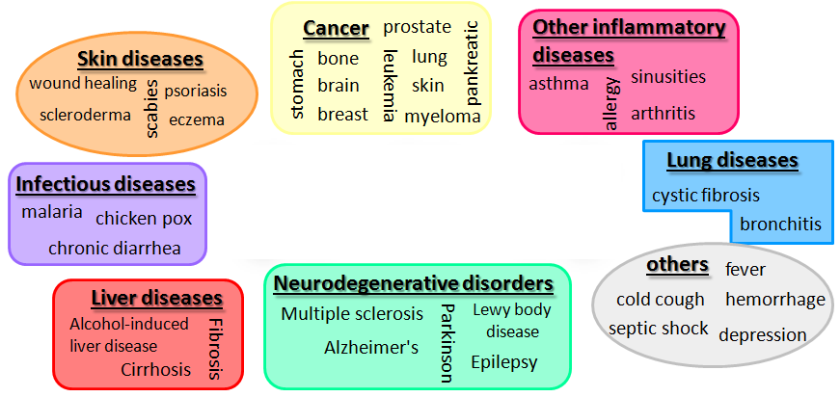
CURCUMIN derivatives – potential theranostic agents
PROBLEM:
low water solubility, high instability and low bioavailability
Orteca G., Tavanti F., Bednarikova Z., Gazova Z., Rigillo G., Imbriano C., Basile V., Asti M., Rigamonti L., Saladini M., Ferrari E., Menziani M.C. Bioorganic and Medicinal Chemistry, 2018, 26 (14), 4288-4300

Slide 10
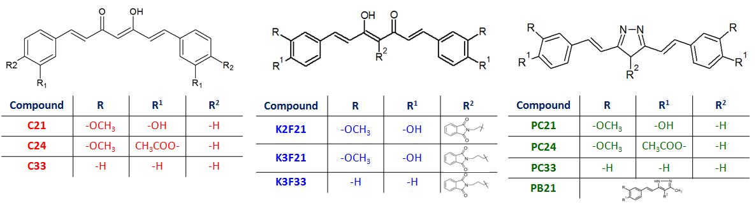
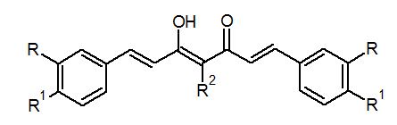
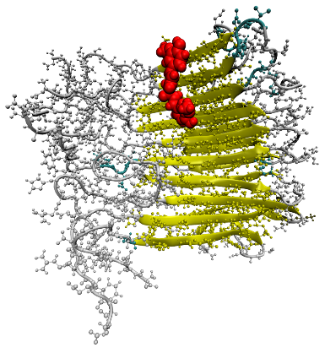
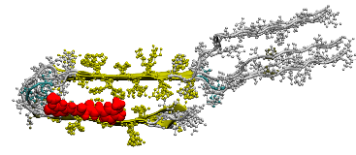
C series
K series
PC series
Aβ₄₀ fibrils + curcuminoids
Atomic Force Microscopy
In silico calculation
Important: high binding affinity
Important for activity:
- both aromatic rings
…AD diagnostic agents ?
- methoxy-acetate/hydroxy substitution patern
- rigidity and length of linker
Orteca G., Tavanti F., Bednarikova Z., Gazova Z., Rigillo G., Imbriano C., Basile V., Asti M., Rigamonti L., Saladini M., Ferrari E., Menziani M.C. Bioorganic and Medicinal Chemistry, 2018, 26 (14), 4288-4300

Slide 11
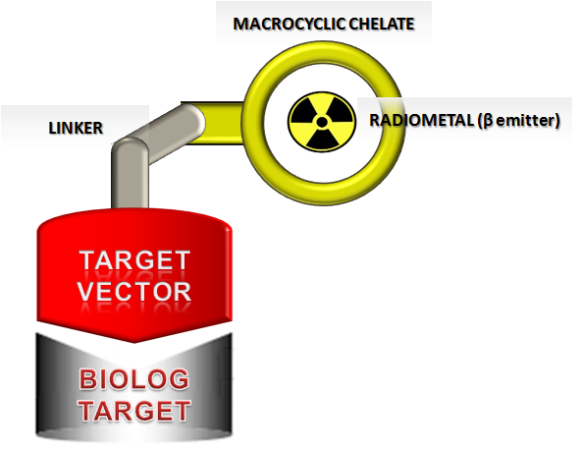
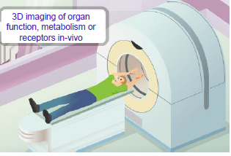

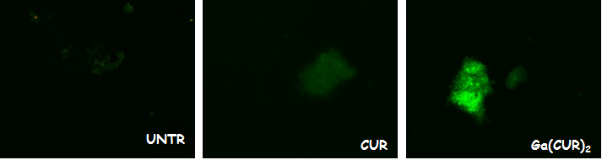
…AD diagnosis… …affinity to fibrils…
DOTA-CUR: a case study
Aβ FIBRILS
WORK IN PROGRESS:
finding a targeting vector (curcumin derivatives) with higher lipophilicity, stability and affinity to Aβ fibrils
radionuclide gallium-68 – possibility to use PET
in vivo study (cell and animal models)
Fluorescence Microscopy

Slide 12
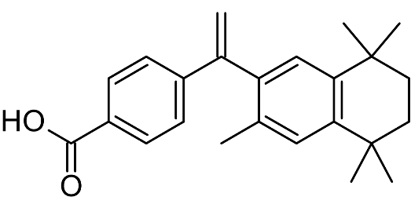
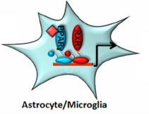

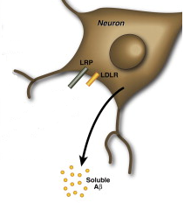






Bexarotene
Cramer et al. 2012 : BEXAROTENE reduces Aβ plaques in AD mice by ~ 50% within just 72 h
? MECHANISM ?
Impact on proccesing of Aβ peptide
Impact on clearence of Aβ peptide
ApoE4
+ cholesterol
Lipidated ApoE
HDL particles
Soluble Aβ
in vitro and in silico study
Pham H.D.Q., Thai N.Q., Bednarikova Z., Linh H.Q., Gazova Z., Li M.S. Physical Chemistry Chemical Physics, 2018, 20, 24329-24338
Huy P.D.Q., Thai N.Q., Bednarikova Z., Phuc L.H., Linh H.Q., Gazova Z., Li M.S., ACS Chemical Neuroscience, 2017, 8 (9), 1960-1969

Slide 13
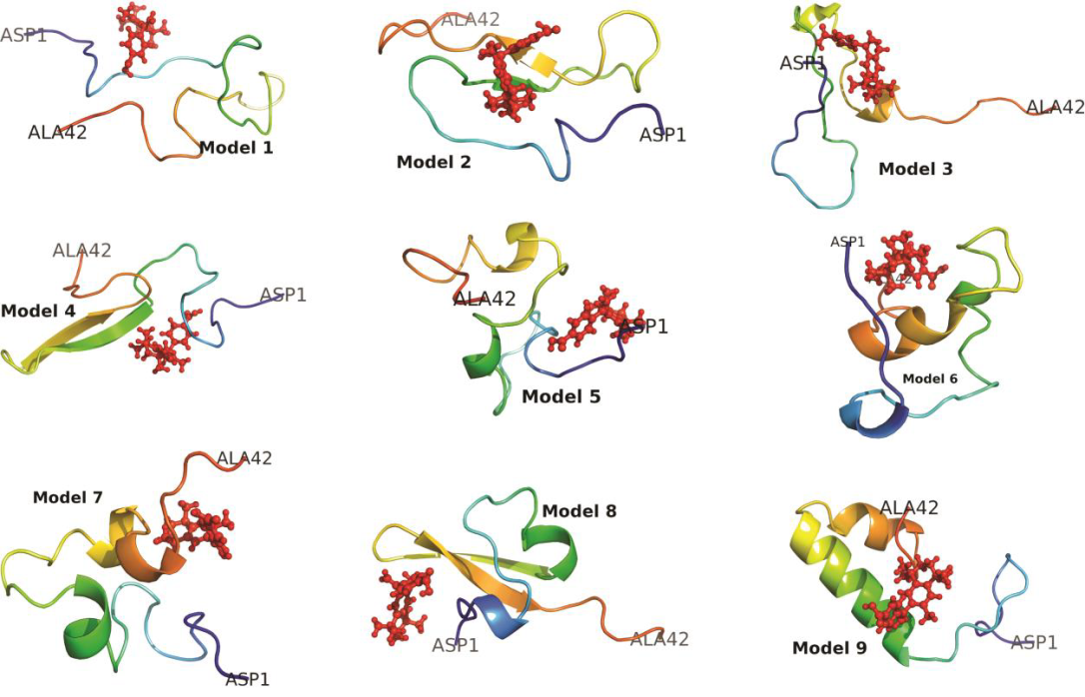
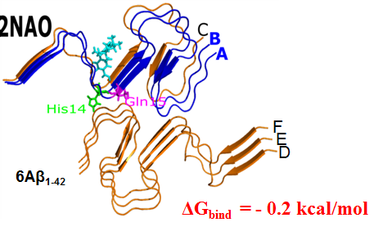
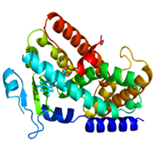
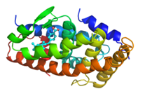
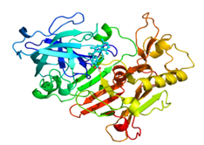
MD simulation of Aβ₁₋₄₂ monomer, Aβ₁₋₄₂ (2NAO) and Aβ₁₁₋₄₂ (MXU) fibrils, BACE1, PPAR-γ and RXR + bexarotene – binding affinity (ΔG_{bind})
Aβ₁₋₄₂ fibrils
PPAR-γ
RXR
Aβ₁₋₄₂ monomer
Bexarotene weakly binds to BACE1, Aβ₁₋₄₂ peptide and amyloid fibrils
bexarotene tightly binds to RXR-α and PPAR-γ
major role in binding plays van der Waals interactions
β-secretase
bexarotene | ΔE_{vdw}* | ΔE_{ele}* | ΔG_{PB}* | ΔG_{ur}* | -TΔS* | ΔG_{bind}*
Aβ₄₂ monomer | -26.5 | -7.7 | 18.4 | -2.9 | 17 | -1.8
Aβ₄₂ fibrils | -30.5 ± 6.1 | -7.3 ± 4.0 | 22.9 ± 4.4 | 3.4 ± 0.4 | 17.5 ± 1.8 | -0.7 ± 5.0
BACE1 | -31.0 ± 7.5 | -9.6 ± 3.5 | 28.0 ± 7.2 | -3.8 ± 0.6 | 16.6 ± 2.1 | 0.2 ± 6.0
RXRs | -53.6 ± 1.5 | -17.6 ± 2.3 | 38.7 ± 3.6 | -4.5 ± 0.1 | 20.1 ± 1.4 | -16.9 ± 3.0
PPAR-γ | -49.8 ± 0.9 | -16.5 ± 2.3 | 34.6 ± 2.9 | -4.6 ± 0.1 | 20.1 ± 1.4 | -16.2 ± 1.8
* kcal/mol

Slide 14
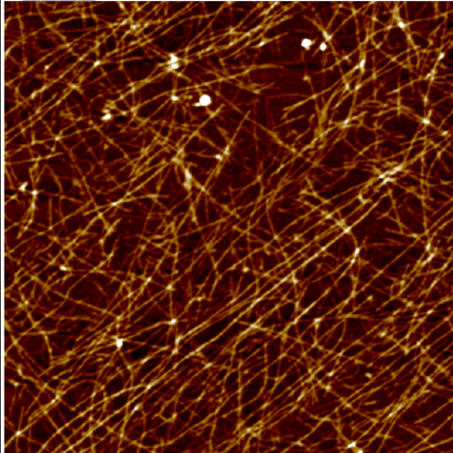
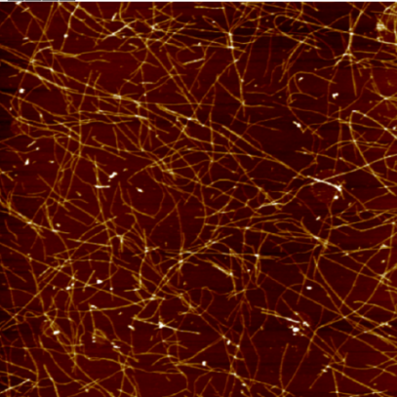
Binding of bexarotene to monomer
Interaction with β amyloid fibrils
Thioflavin T assay
Atomic force microscopy
Thioflavin T assay
Atomic force microscopy
Interaction with β-secretase
Bexarotene delays nucleation of Aβ₁₋₄₂ peptide
Bexarotene
is not able to destroy Aβ fibrils
is not able to inhibit formation of Aβ fibrils
does not influence the BACE1 activity
↓ β sheet in monomeric state = delay in self-assembly kinetics
→ decrease of plaques not associated with changes in proccesing of Aβ₁₋₄₂ peptide

Slide 15
CONCLUSIONS
multi-target-directed ligands → 1 compound for several targets
curcumin derivatives - potential use as a novel theranostic agents - multifunctional amyloid inhibitors and diagnostic tool for AD
CID 9998128 = quinazoline - methylpyridine hybrid - potential use as a novel multifunctional β-amyloid and β-secretase inhibitor
BEXAROTENE - MECHANISM of ACTION:
ApoE4
+ cholesterol
Lipidated ApoE
HDL particles
Soluble Aβ

Slide 16
ACKNOWLEDGEMENT
Dr. Zuzana Gažová's group – amyloid self-assembly of proteins
Department of Biophysics:
Zuzana Gažová
Diana Fedunová
Andrea Antošová
Erna Demjén
Jozef Marek
Katarína Uličná
Miroslav Gančár
Co-workers:
I.S.M.N. CNR Bologna, Italy UNIMORE, Modena, Italy
Eva Bystrenová Erika Ferrari
Francesco Valle Giulia Orteca
Cristiano Alboneti Monica Saladini
Marianna Barbalinardo
University „Carola Davila“ Bucharest, Romania
Maria-Magdalena Mocanu
Constancea Ganea
Polish Academy of Sciences, Warsaw, Poland
Prof. Ma Suan Li and colleaugues
Bose Institute, Kolkata, India
Anirban Bhunia
School of Pharmacy, ECUST, Shanghai, China
Prof. Rui Wang and colleaugues
Financial support:
We were financially supported by SAV-MOST JRP2015/5, APVV SK-CN-2015-0023, VEGA 0145, COST 083/14 action BM1405, Narodowe Centrum Nauki in Poland (grant no. 2015/19/B/ST4/02721) and Department of Science and Technology at Ho Chi Minh City, Vietnam.

Slide 17


Thank you !!!

