Slide 1

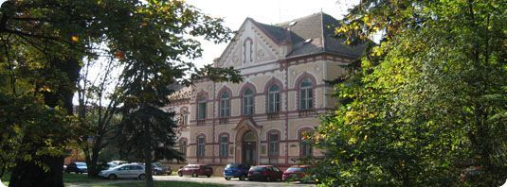
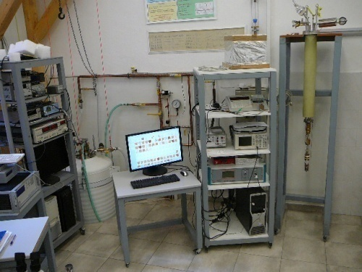
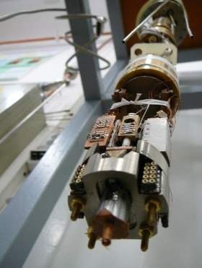
On the origin of the quasiparticle states in
the superconducting gap of homogeneously
disordered ultrathin films. MoC case.
M. Kopčík, V. Hašková, P. Szabó, T. Samuely, P. Samuely
Centre of Low Temperature Physics, Košice
@ Slovak Academy of Sciences & P.J.Šafárik University, Slovakia
thin film MoC samples made by
M. Grajcar and M. Žemlička
Comenius University, Bratislava, Slovakia
Notes:
Sss

Slide 2
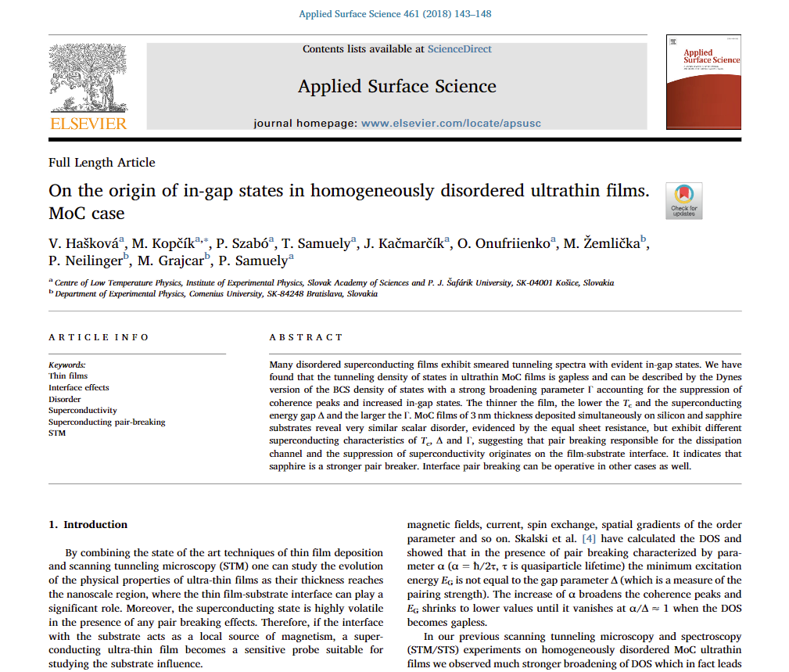
On the origin of the quasiparticle states in
the superconducting gap of homogeneously
disordered ultrathin films. MoC case.
Notes:
Sss

Slide 3

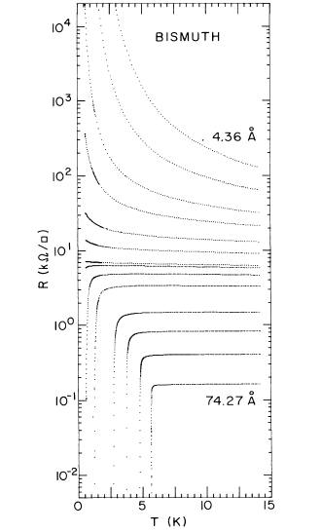
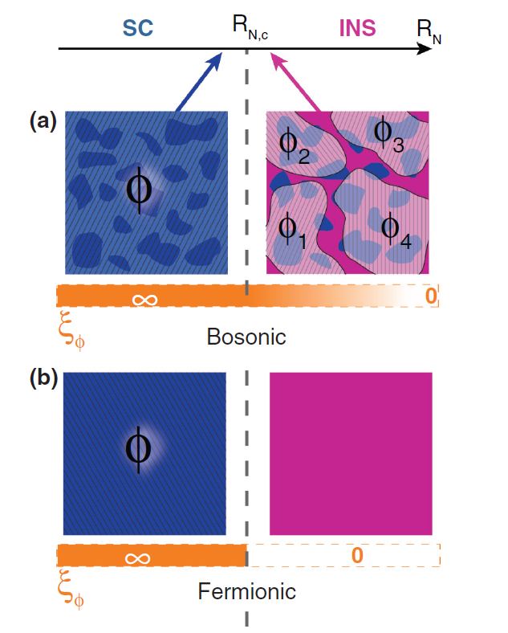
Superconductor-Insulator Transition
Control parameters
disorder (lattice defects, impurities)
dimensionality (3D->2D)
charge carrier concentration
external magnetic field
...
Superconductor
Insulator
Superconductivity
macroscopic wave function
Bosonic scenario
Phase fluctuations of Ψ
Gradual loss of the macroscopic long range coherence
Direct transition
Fermionic scenario
Amplitude fluctuations of Ψ
Gradual reduction of the order parameter Δ down to 0
Intermediary metal phase
3D to 2D S-I transition in Bi thin films

Slide 4
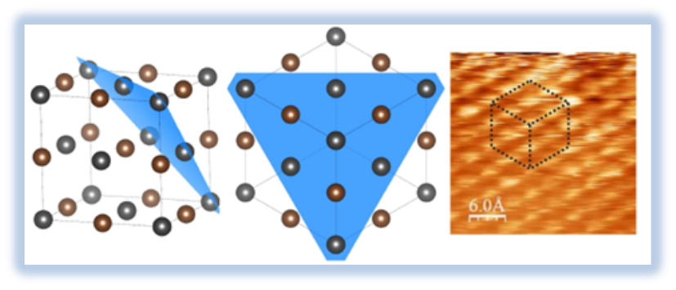
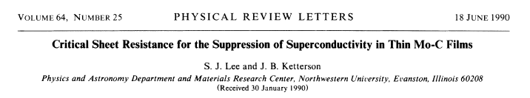
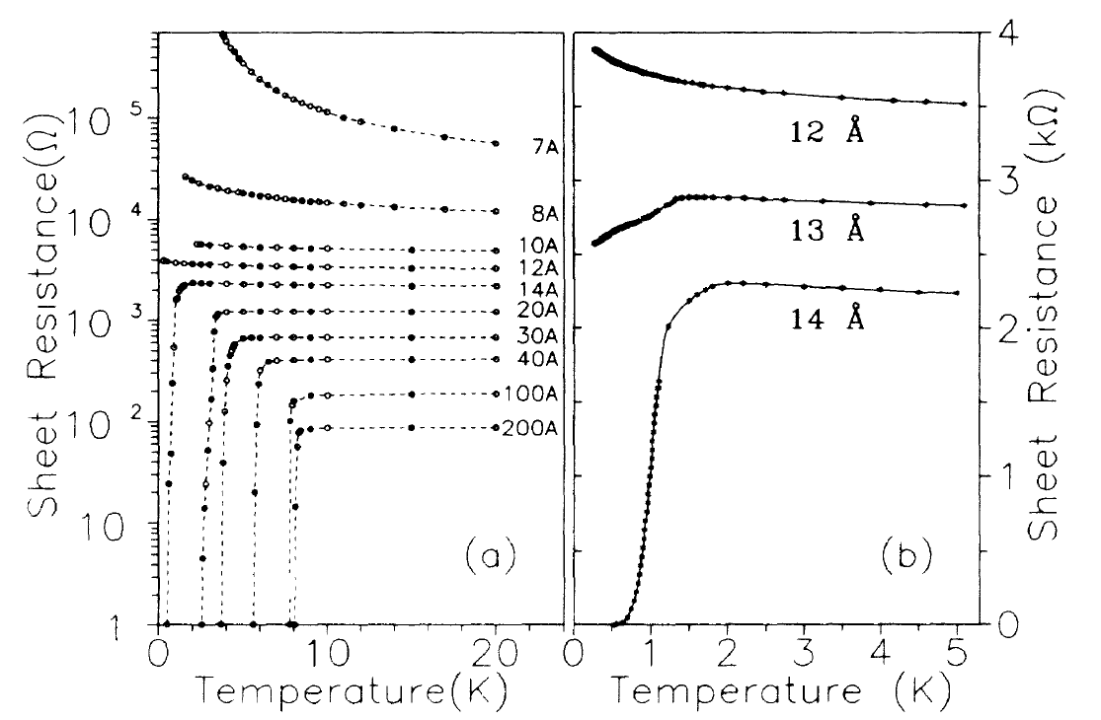
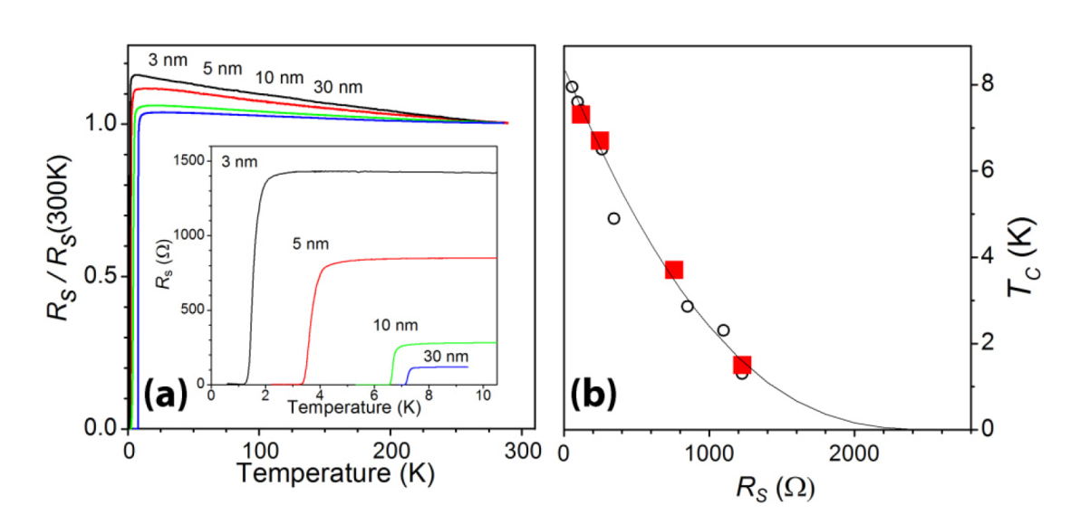
Thin films of MoC
Cubic B1 lattice
STM scans reveal the (111) plane with lattice constant a₀ = 0.42 nm
prepared by the reactive magnetron sputtering
on single-crystal sapphire substrates ( at 200 ºC)
in a mixture of Ar and acetylene gas
t = 10 nm R_{s} (10 K) = 344 Ω, T_{c} = 6.7 K, k_{F}l = 2
t = 5 nm R_{s} (10 K) = 850 Ω, T_{c} = 3.3 K, k_{F}l = 1.8
t = 3 nm R_{s} (10 K) = 1227Ω, T_{c} = 1.3 K, k_{F}l = 1.3

Slide 5
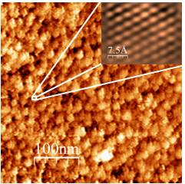
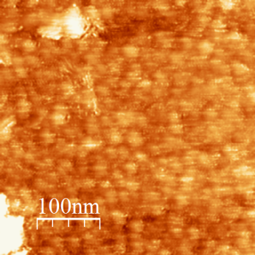
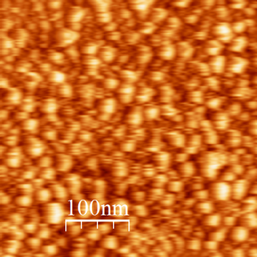
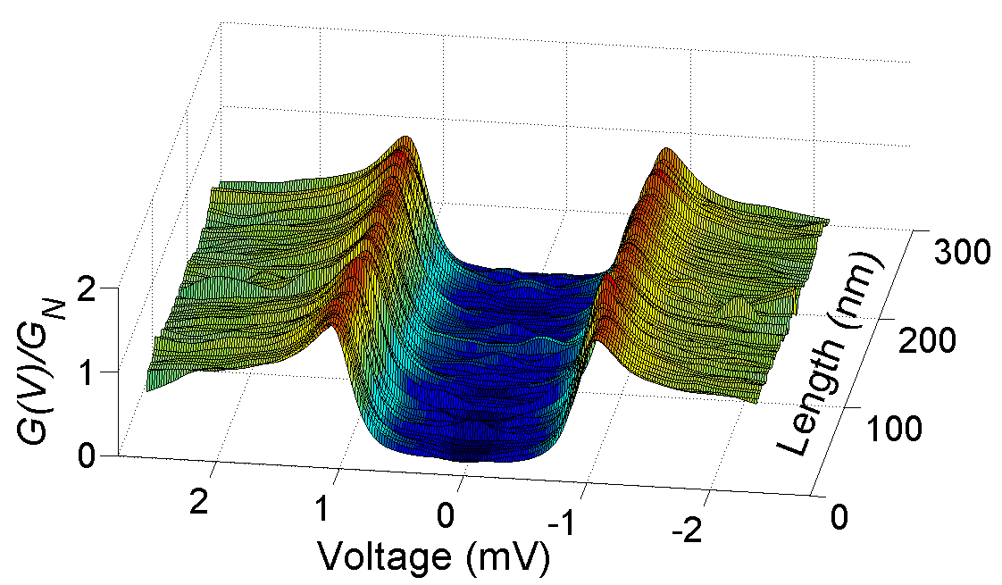
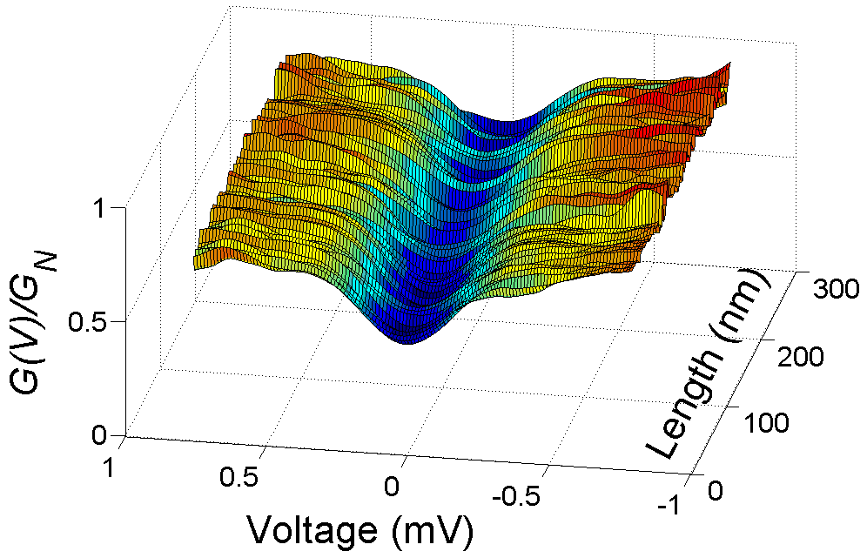
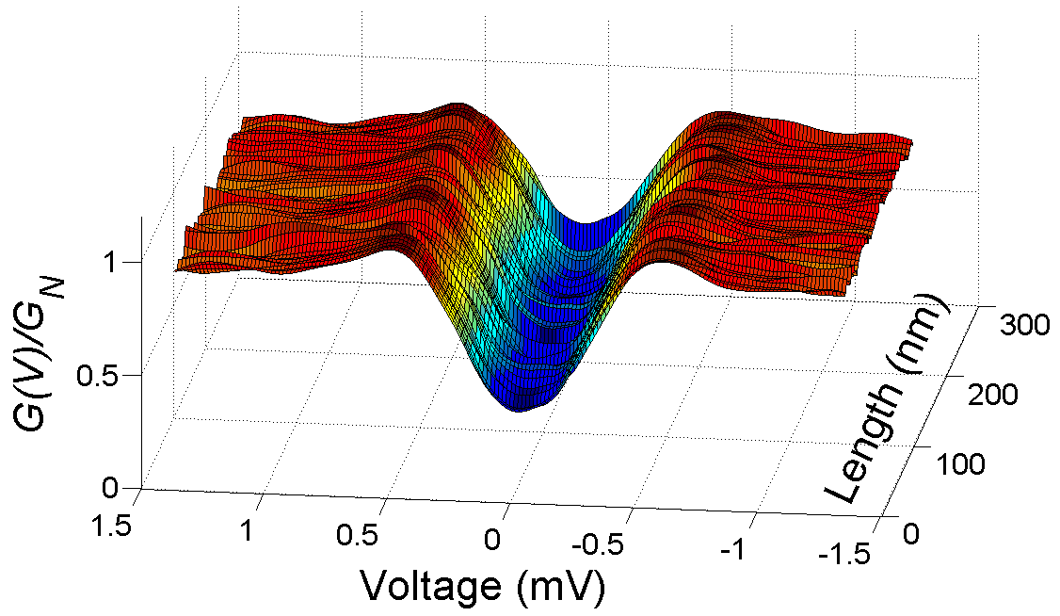
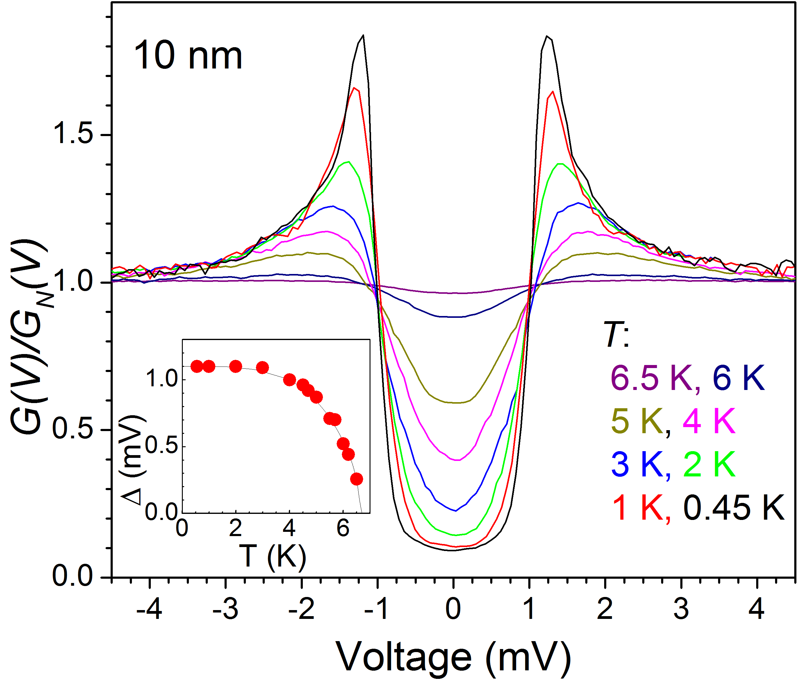
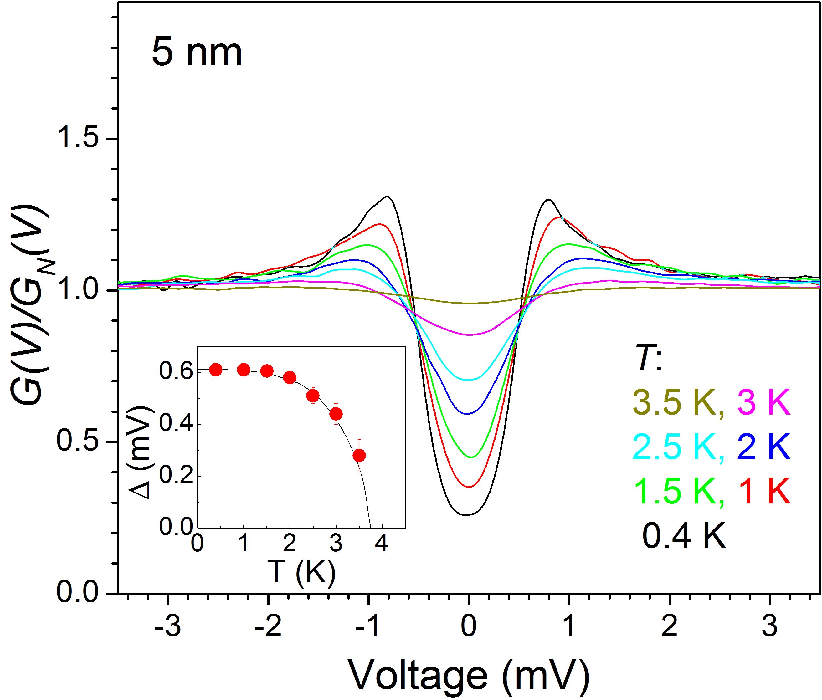
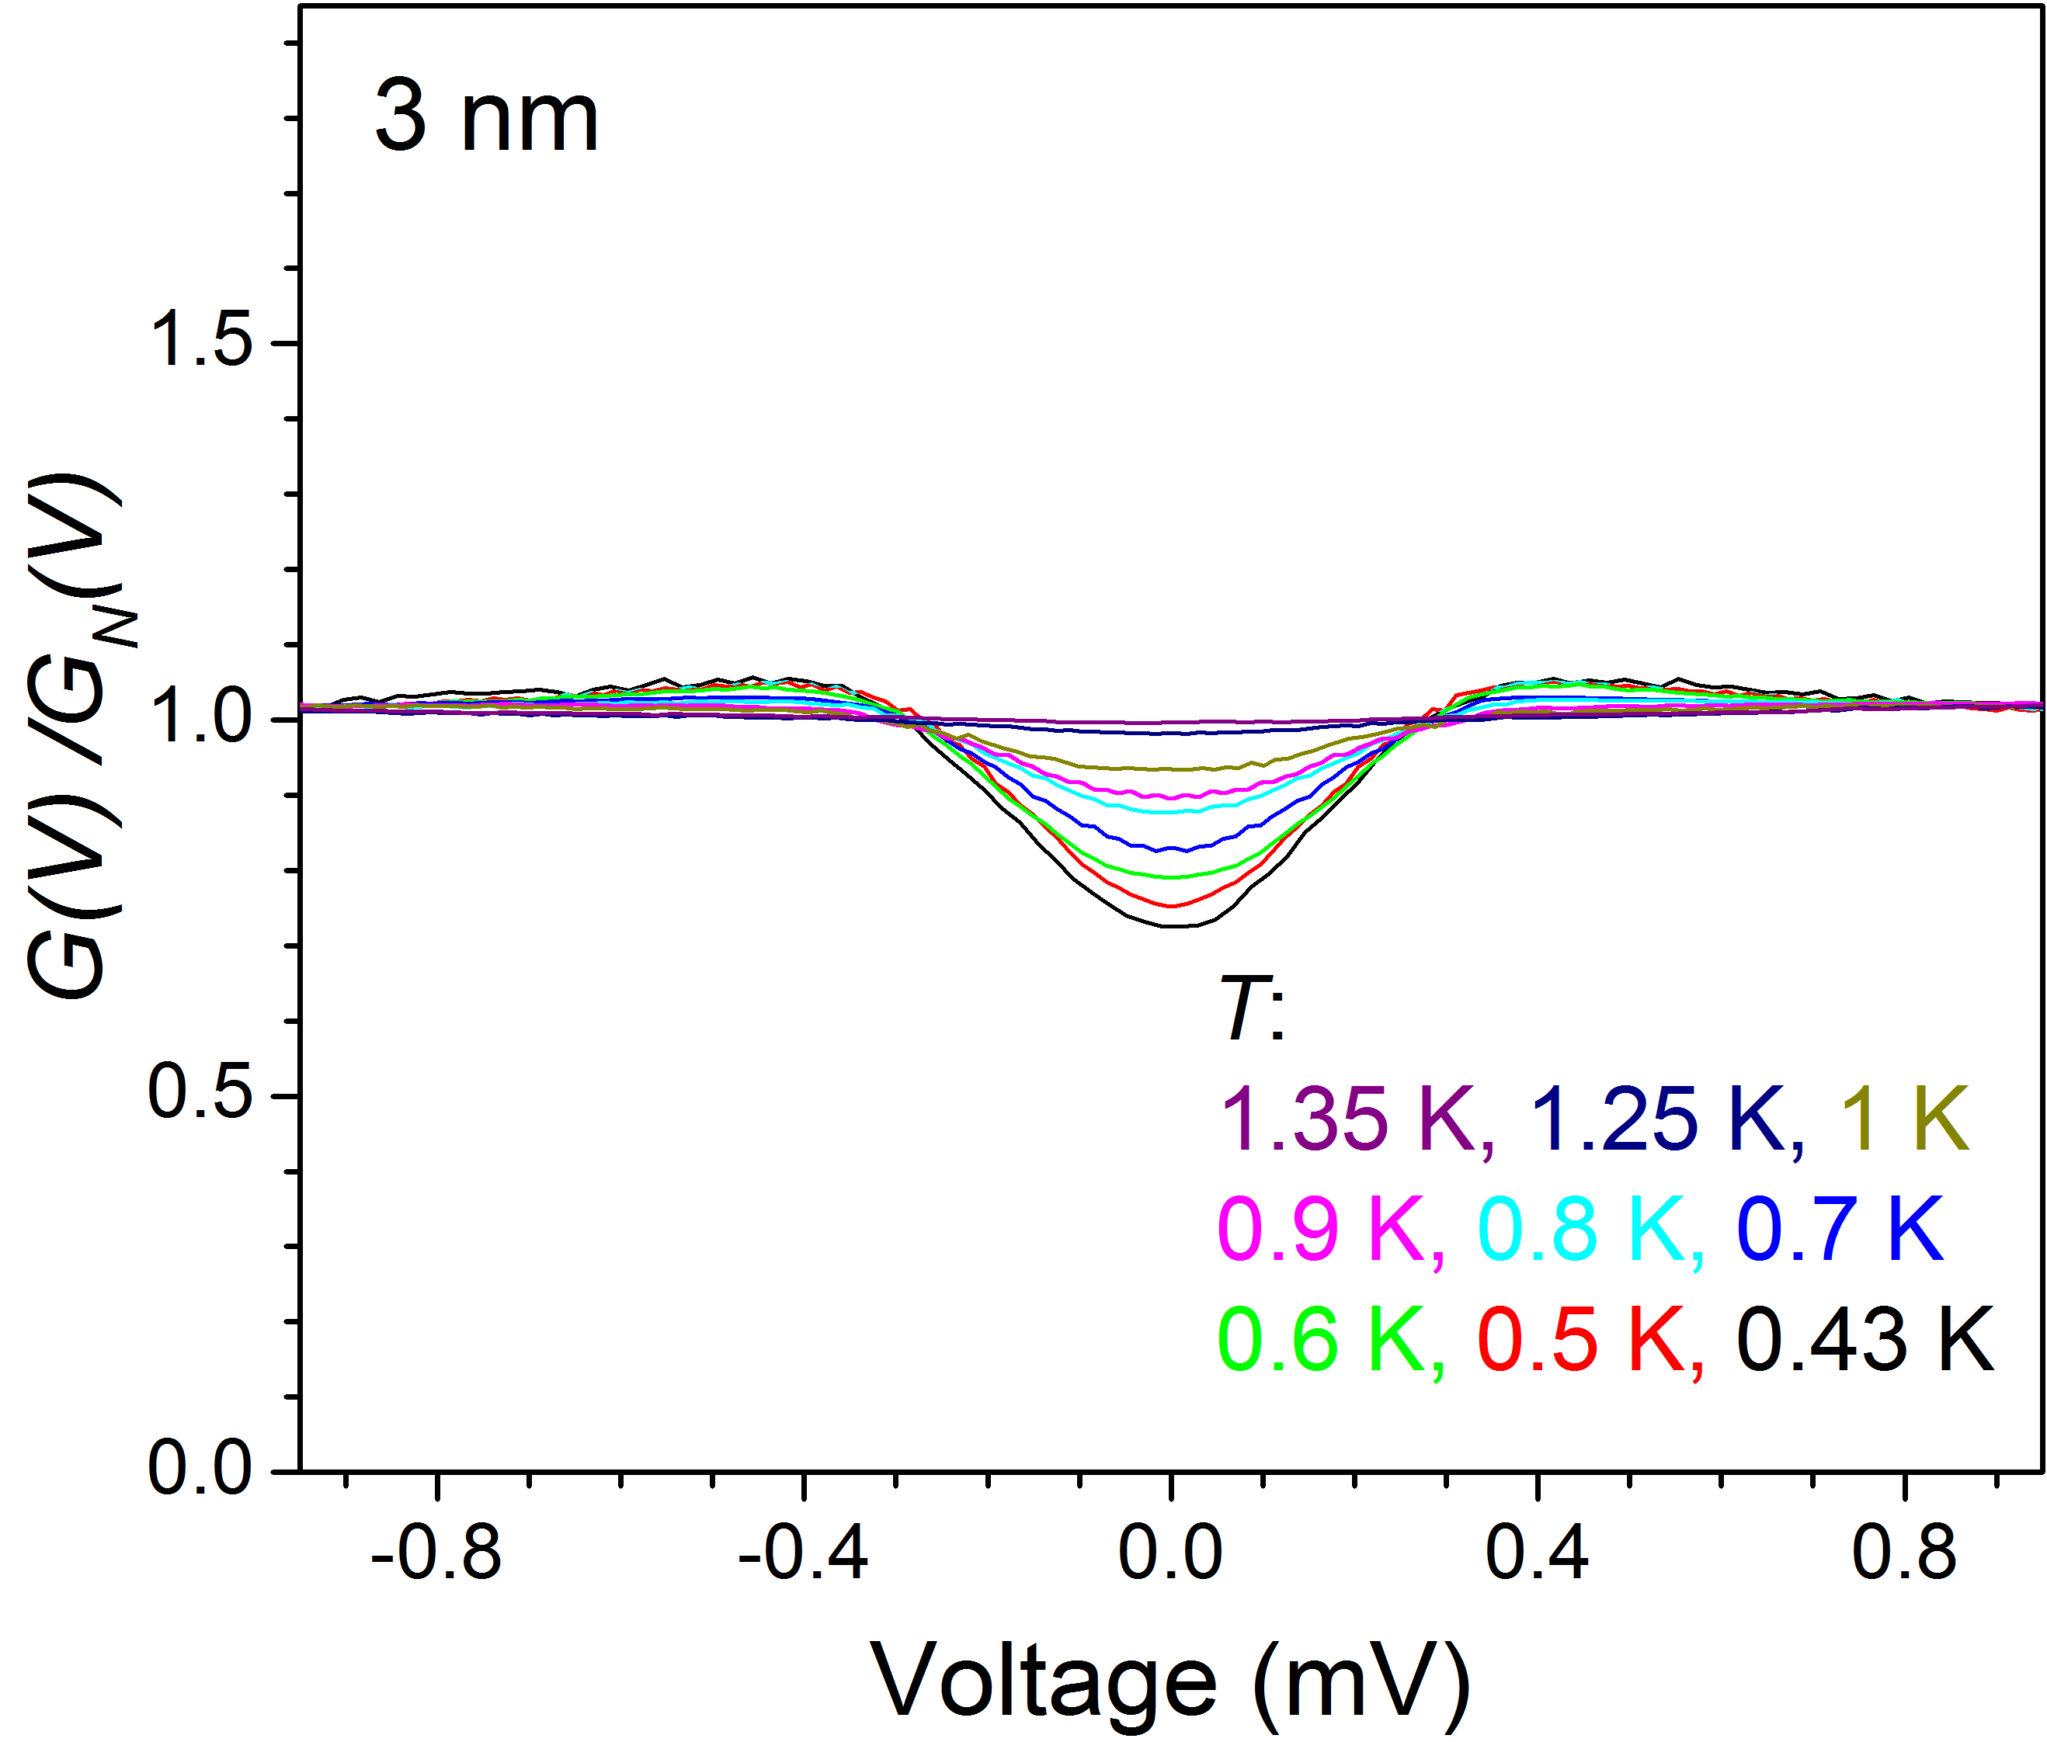
10 nm 5 nm 3 nm
Fitting to
Dynes DOS:
Γ/Δ = 0.1 Δ , Tc = 6.5 K,
2Δ/k_{B}T_{c} = 3.85
Γ/Δ = 0.3 Δ , Tc = 3.5 K,
2Δ/k_{B}T_{c} = 3.87
Γ/Δ = 0.9 Δ , Tc = 1.35 K,
2Δ/k_{B}T_{c} = 3.7-4

Slide 6
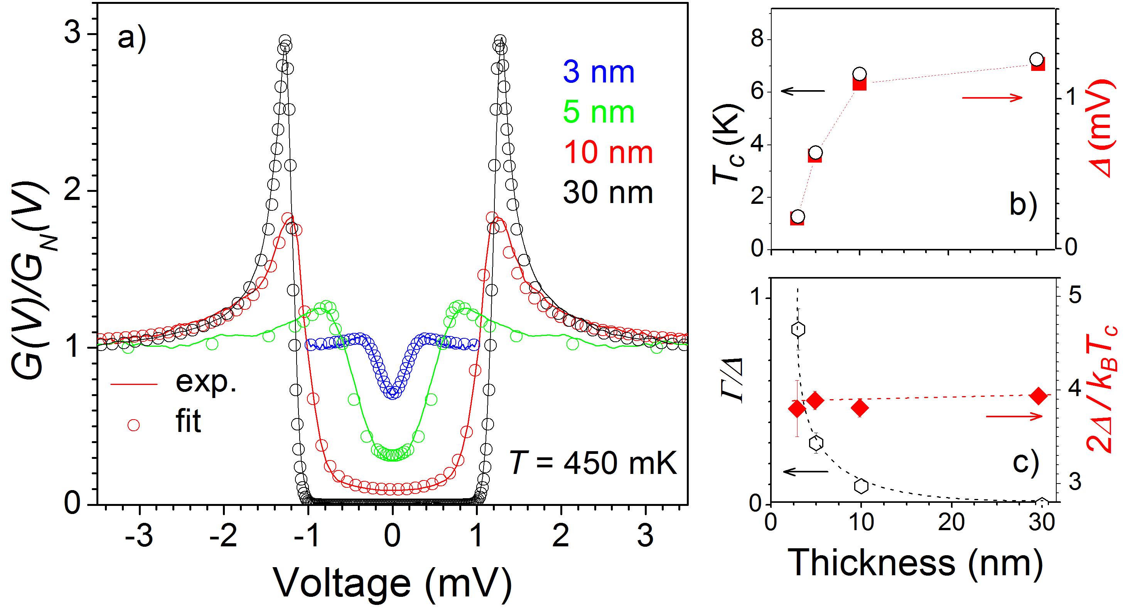
Fermionic SIT in MoC
Bosonic insulator scenario:
T_{c} and Δ decrease
2 Δ / k_{B}T_{c} increase
Δ inhomogeneity on scale of ξ
pseudogap appearance
Fermionic scenario:
T_{c} and Δ decrease together
2Δ / k_{B}T_{c} almost not changing
No Δ fluctuations
no pseudogap
the bosonic picture is not universal
increased disorder – increased spectral smearing - increase of in-gap states disorder leads to pair-breaking or interface effect (new theory?)
[1] P. Szabó, et al., Phys. Rev. B 93, 014505 (2016).
[2] M. Žemlička, et al., Phys. Rev. B 92, 224506 (2015.)

Slide 7
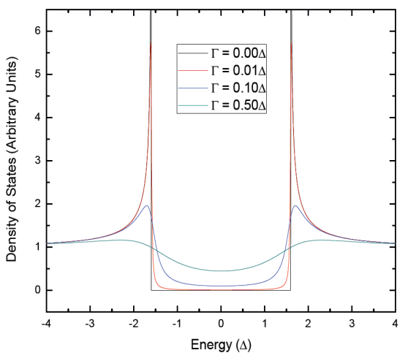
Fermionic SIT in MoC
Finite lifetime effect (Dynes formula):
Parameter Γ can account for broadening if necessary
via substitution of complex E’ = E- iΓ instead of E in N_{S}^{BCS}

Slide 8
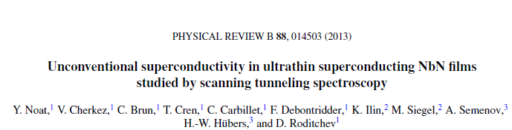
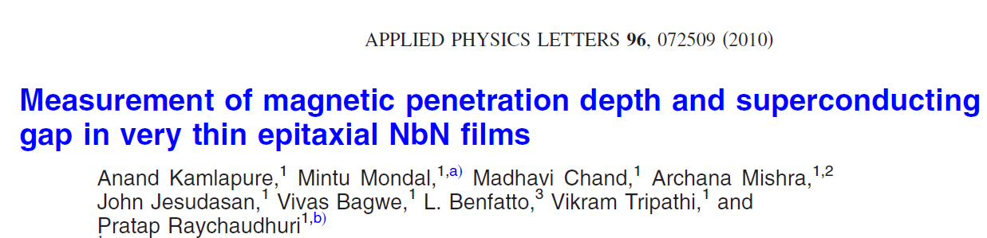
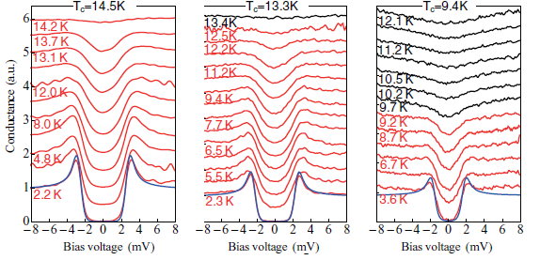
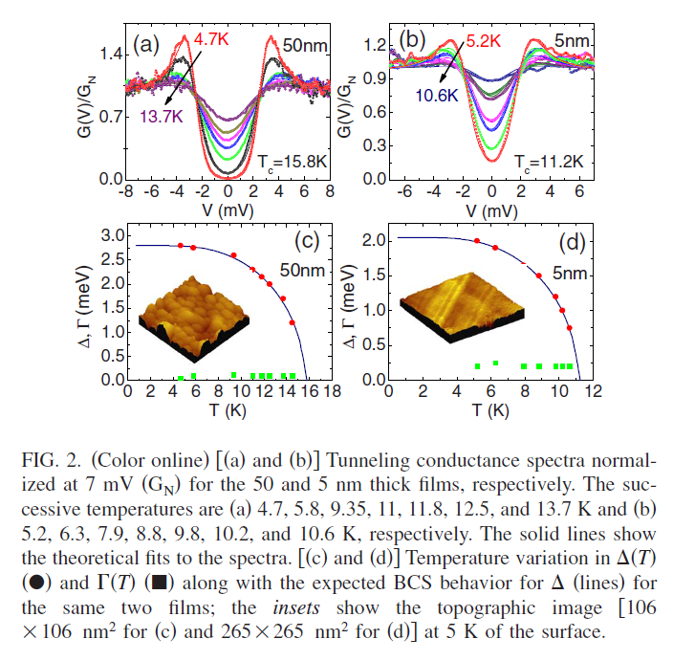
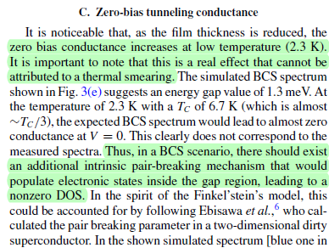
Smeared tunnelling spectra in disordered thin films
Fitting to Dynes formula

Slide 9
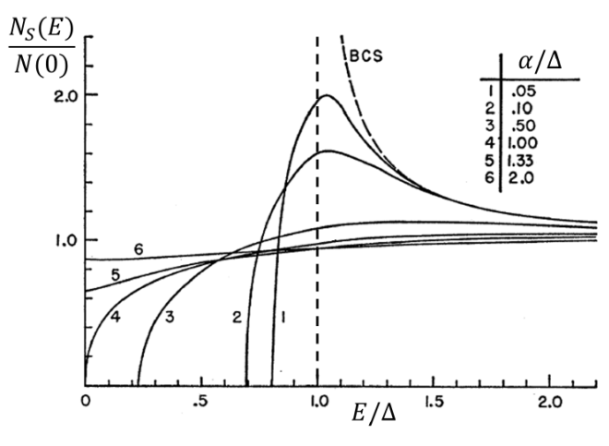
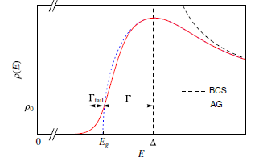
DOS – pair-breaking, disorder
Universal pair – breaking model
K. Maki
Prog. Teor. Phys. (Kyoto) 29, 333 (1963)
P. G. de Gennes
Phys. Kondens. Materie 3, 79 (1964)
S. Skalski, O. Betbeder-Matibet a P. R. Weis
Phys. Rev. 136, A1500 (1964)
Gapless superconductivity near
the critical pair breaking
Disorder with strong Coulomb interaction
M. Feigel’man, M. Skvortsov
Phys. Rev. Lett. 109, 147002 (1963)
The local pairing field fluctuates in the space
smearing the BCS coherence peak
subgap tail states

Slide 10
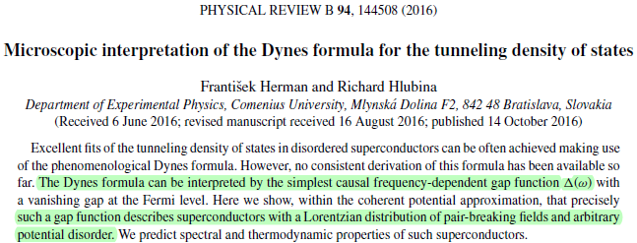

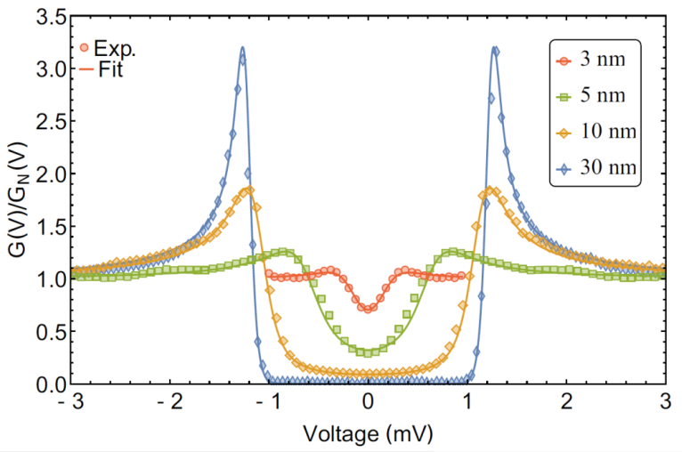

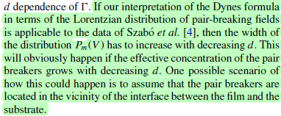
PHYSICAL REVIEW B 94, 144508 (2016)
Microscopic interpretation of the Dynes formula for the tunneling density of states
Lorentzian distribution of the pair-breaking potential V, width of the distribution Γ
microscopic interpretation of the phenomenological Dynes model
Validating this model –same film thickness + different substrates

Slide 11
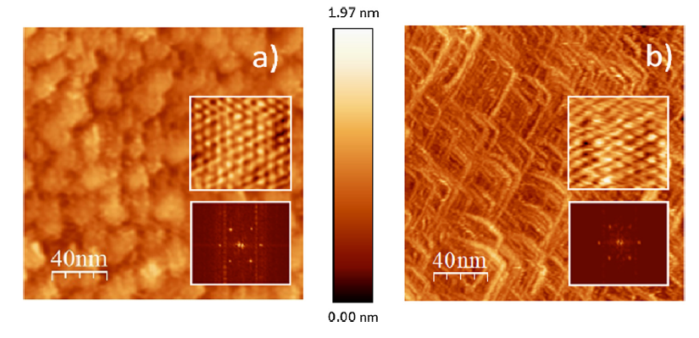

Aký je pôvod nárastu rozmazania?
MoC / Al₂O₃, MoC / Si – 3 nm thin films
MoC -3 nm films sputtered
simultaneously on different substrates:
c-cut saphire (Al₂O₃)
silicon (Si)
R_{N} = 1120 Ω
MoC/Si: T_{c} = 3.5 K
MoC/Al₂O₃: T_{c} = 2.5 K
MoC / Al₂O₃
MoC / Si
surface corrugation $\sim$0.7 nm

Slide 12
Aký je pôvod nárastu rozmazania?
MoC / Al₂O₃, MoC / Si – 3 nm thin films
MoC -3 nm films sputtered
Simultaneously to different substrates:
c-cut saphire (Al₂O₃)
(100) silicon (Si)
R_{N} = 1120 Ω
MoC/Si: T_{c} = 3.5 K
MoC/Al₂O₃: T_{c} = 2.5 K
MoC / Al₂O₃
MoC / Si
MoC thin films of the same thickness - DIFFERENT SUBSTRATES - DIFFERENT T_{C}
DIFFERENT PHASES? SAMPLE INHOMOGENEITY?

Slide 13
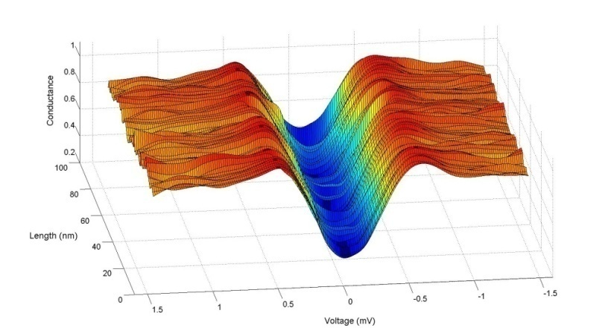
MoC / Al₂O₃, MoC / Si – 3 nm thin films
MoC -3 nm films sputtered
Simultaneously to different substrates:
c-cut saphire (Al₂O₃)
silicon (Si)
R_{N} = 1120 Ω
MoC/Si: T_{c} = 3.5 K
MoC/Al₂O₃: T_{c} = 2.5 K
MoC / Al₂O₃
MoC / Si
CITS studies – I-V measurements in 128 x 128 points of topography - homogeneous superconductivity

Slide 14
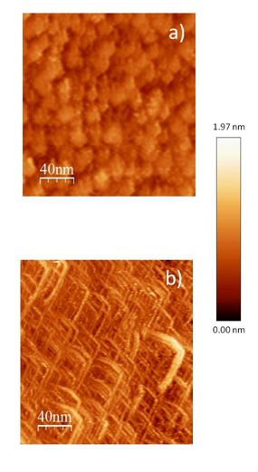
CITS – I-V measurements in 128 x 128 points of the topography
Fitting of 16384 I-V curves to Dynes formula
Statistical distribution of Δ and Γ values:
MoC / Al₂O₃
MoC / Si
Δ_{Si} = 0.66 meV
w_{Si} = 0.09 meV
Γ_{Si} = 0.2 meV
u_{Si} = 0.089 meV
Δ_{Al2O3} = 0.5 meV
w_{Al2O3} = 0.1 meV
Γ _{Al2O3} = 0.225 meV
u_{Al2O3} = 0.11 meV

Slide 15
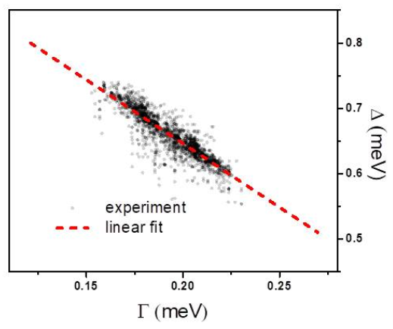
CITS – I-V measurements in 128 x 128 points of the topography
Fitting of 16384 I-V curves to Dynes formula
Statistical distribution of Δ and Γ values:
MoC / Al₂O₃
MoC / Si

Slide 16
CITS – I-V measurements in 128 x 128 points of the topography
Fitting of 16384 I-V curves to Dynes formula
Statistical distribution of Δ and Γ values:
MoC / Al₂O₃
MoC / Si
Δ_{Si} = 0.66 meV
w_{Si} = 0.09 meV
Γ_{Si} = 0.2 meV
u_{Si} = 0.089 meV
Δ_{Al2O3} = 0.5 meV
w_{Al2O3} = 0.1 meV
Γ _{Al2O3} = 0.225 meV
u_{Al2O3} = 0.11 meV
Δ_{Si} > Δ_{Al2O3} and Γ_{Si} < Γ_{Al2O3} due to different pair breaking
in different substrates?
if yes – thickness dependent pair-breaking
rough surfaces

Slide 17
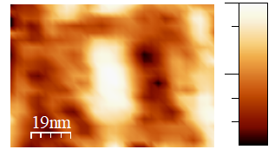
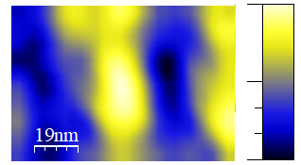
CITS - ROUGH surfaces:
The peak-VOLTAGE position map fits the surface
Topography at 0.5 K
Peak-position map at 0.5 K
MoC / Al₂O₃
1.7 nm
0.9 mV
0 nm
0.7 mV
MoC / Si
2 nm
1.1 mV
small cca. 10% variation of Δ observed in thicker areas with corrugation ~ 1 nm
0 nm
0.85 mV
How local Δ correlates with Γ ? − increase resolution

Slide 18
CITS – I-V measurements in 128 x 128 points of the topography
2 nm
MoC / Si
Zoom – protruding boomerang:
CITS + Fitting of 16384 I-V curves to Dynes formula
0 nm

Slide 19
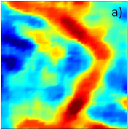
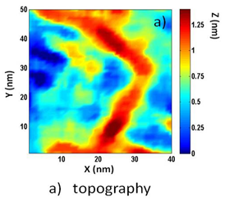
CITS – I-V measurements in 128 x 128 points of the topography
2 nm
MoC / Si
Zoom – protruding boomerang:
CITS + Fitting of 16384 I-V curves to Dynes formula
Topography vs. Gap-map vs. Gamma-map:
0 nm

Slide 20
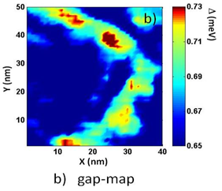
CITS – I-V measurements in 128 x 128 points of the topography
2 nm
MoC / Si
Zoom – protruding boomerang:
CITS + Fitting of 16384 I-V curves to Dynes formula
Topography vs. Gap-map vs. Gamma-map:
0 nm

Slide 21
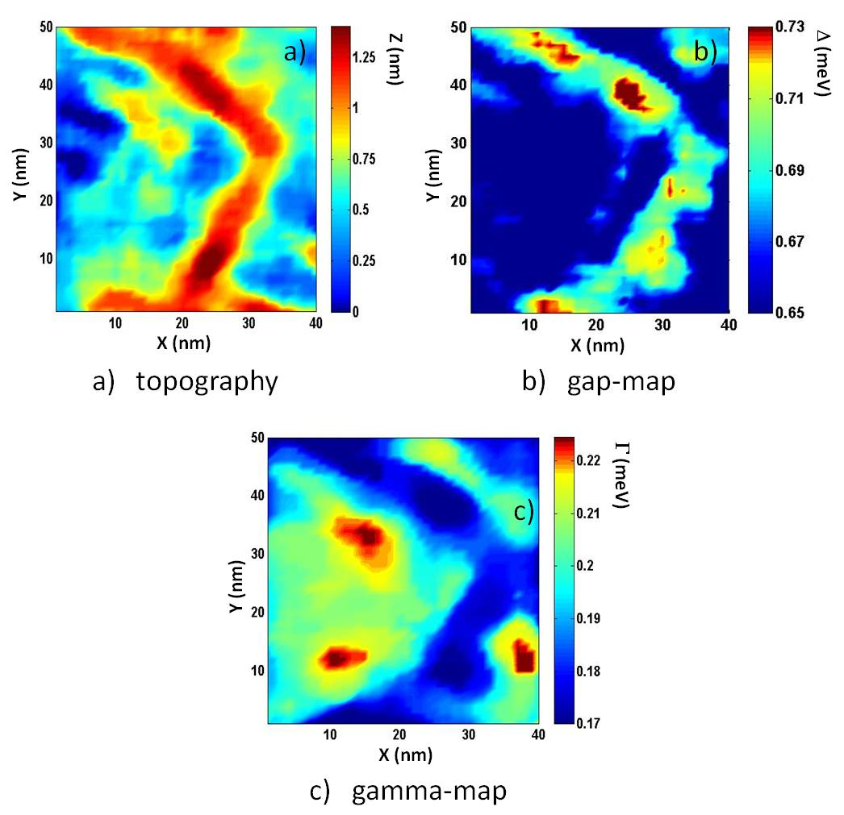
CITS – I-V measurements in 128 x 128 points of the topography
2 nm
MoC / Si
Zoom – protruding boomerang:
CITS + Fitting of 16384 I-V curves to Dynes formula
Topography vs. Gap-map vs. Gamma-map:
0 nm
Thinner sample – smaller gap Δ – higher Γsmearing – the interface is the source of pair-breaking

Slide 22
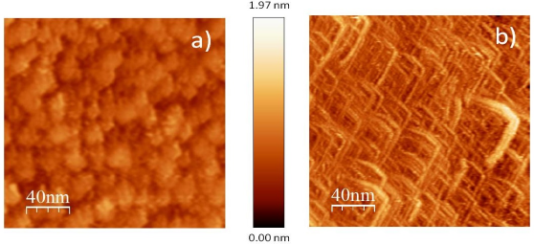
CONCLUSIONS
Aký je pôvod nárastu rozmazania?
MoC
films prepared simultaneously on Al₂O₃ and Si substrate:
MoC / Al₂O₃
MoC / Si
- Equal sheet resistance
different T_{c}
(equal disorder)
samples with the same disorder differ only in the substrate
– the source of pair breaking - interface
- Lowering the thickness in MoC/Al₂O₃ and MoC/Si -
suppressed Δ + increased Γ
MoC / Al₂O₃
MoC / Si
superconductivity is suppressed near the substrate
- Interface induced pair-breaking, proposed by Herman and Hlubina
source of pair breaking – uncompensated electron orbitals at the inteface?

Slide 23
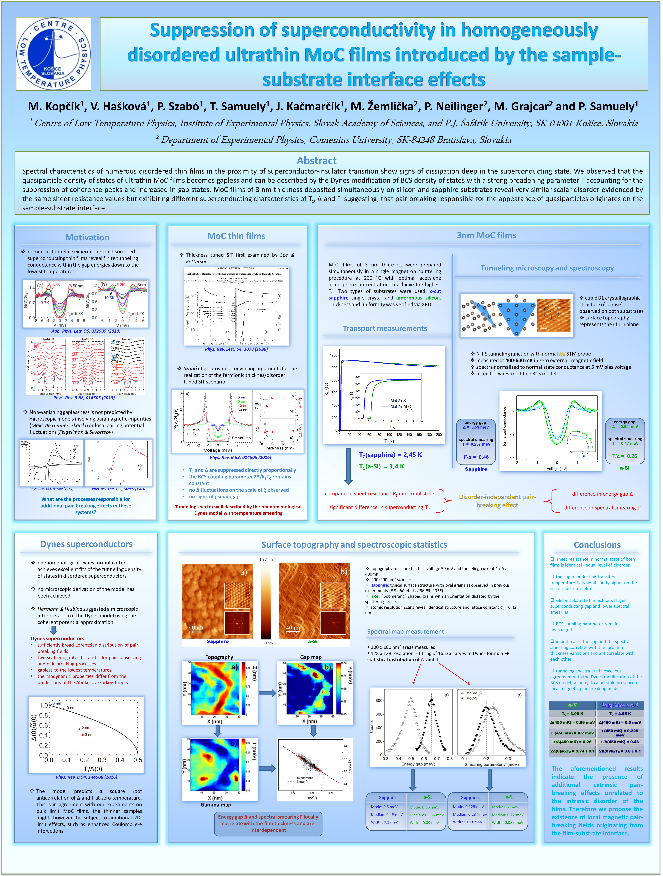
On the origin of the quasiparticle states in
the superconducting gap of homogeneously
disordered ultrathin films. MoC case.
Progress in Applied Surface, Interface
and Thin Film Science 2017
International Conference on Multi-Condensate Superconductivity and Superfluidity in Solids and Ultra-cold Gases
International Workshop on the Superconductor-Insulator Transition and Low-Dimensional Superconductors
Firenze, 20-23.11.2017
Trieste, 14-18.5.2018
Villard de Lans, 7-12.10.2018
Notes:
Sss

Slide 24
Thank you for your attention

