Slide 1
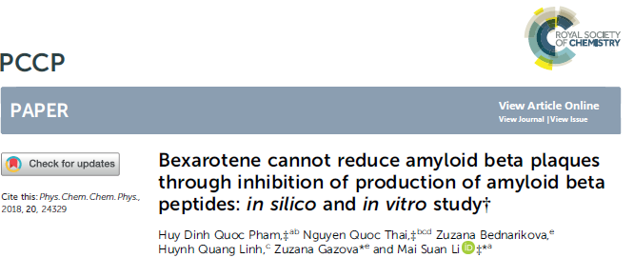
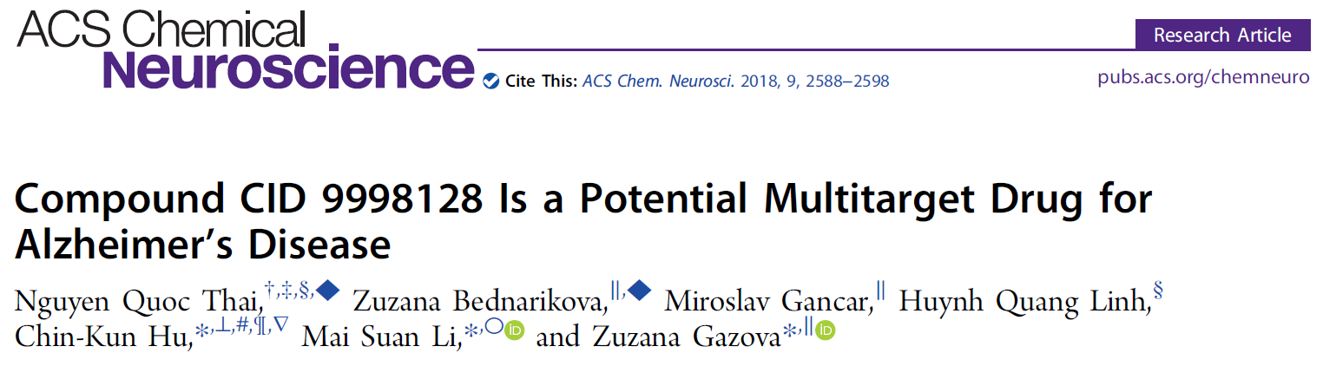

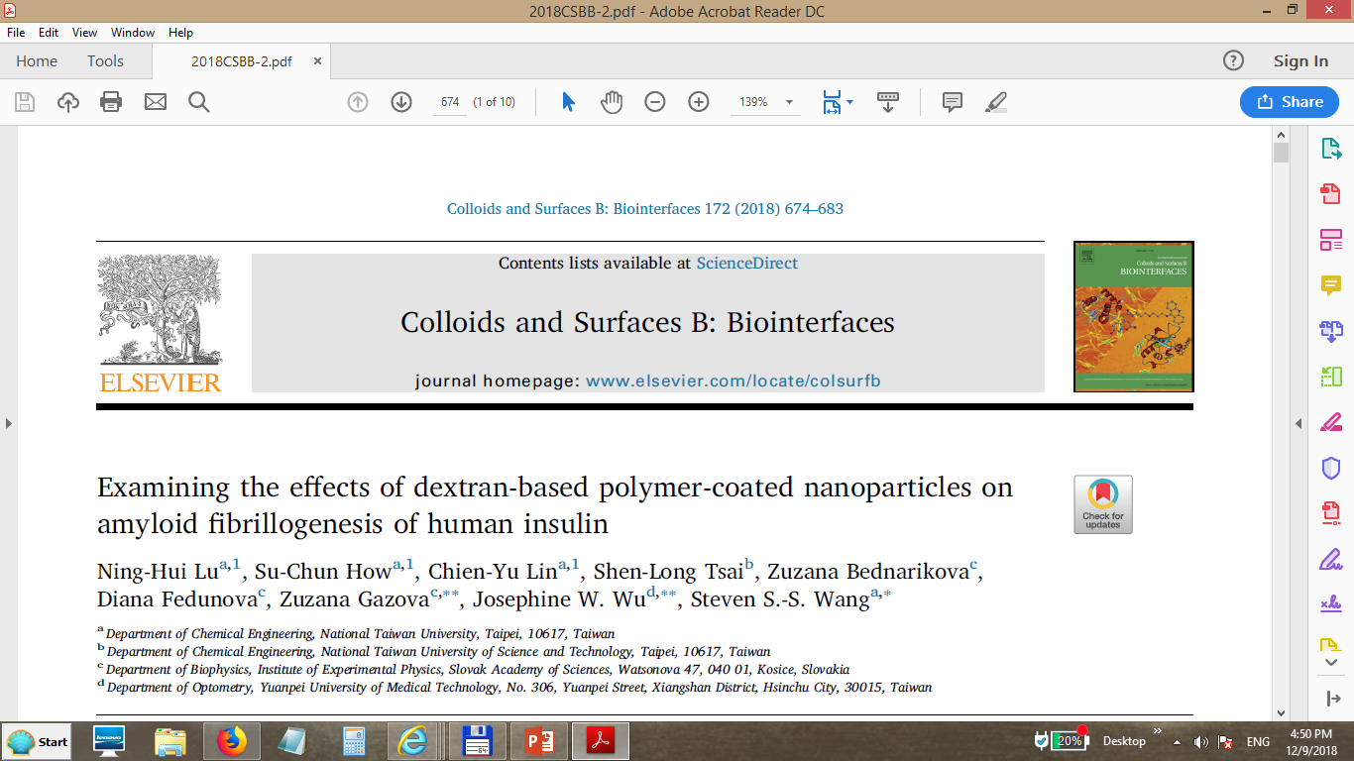
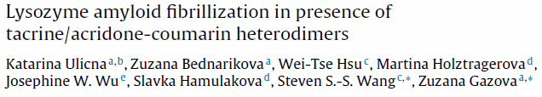
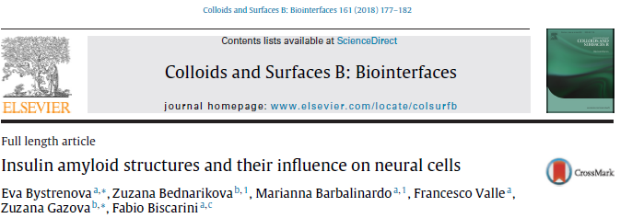
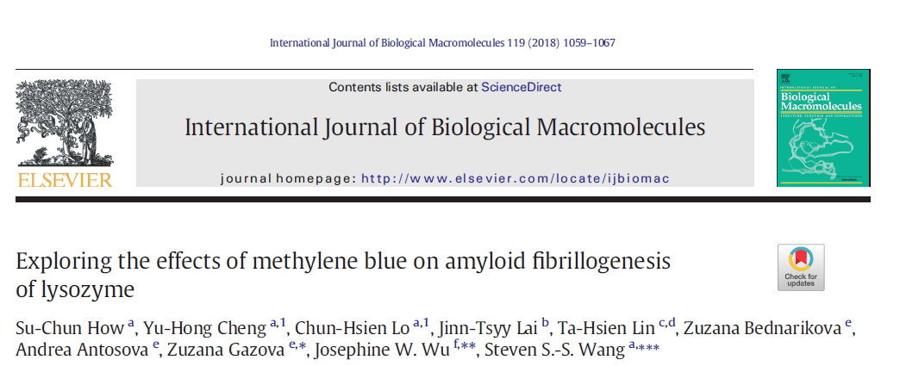
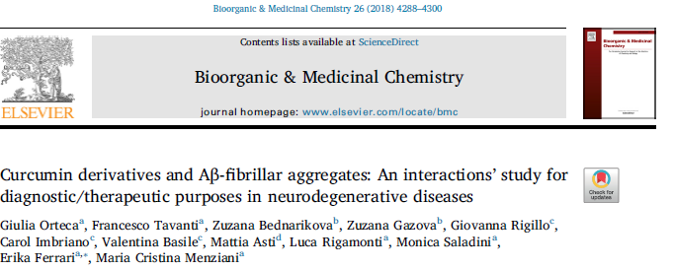
nominácia OBF – výsk. skupina: Amyloidná agregácia proteínov - základný výskum
Autori: Z. Gažová, Z. Bednáriková, M. Gančár, K. Uličná, A. Antošová, D. Fedunová
7 Q1
IF 3.906, Q1, 92 %
IF 3.997, Q1, 88%
IF 4.211, Q1, 85 %
IF 3.997, Q1, 88%
IF 3.997, Q1, 88%
IF 2.881, Q1,81%
IF 3.909, Q1, 84%
V 6-tich prácach je niekto z autorov prvým a/alebo korešpondenčným autorom.

Slide 2
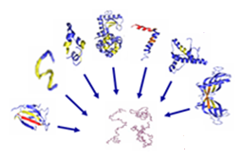
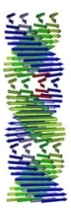
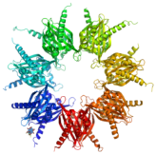
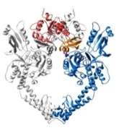
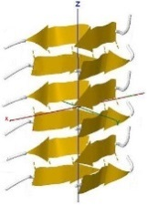
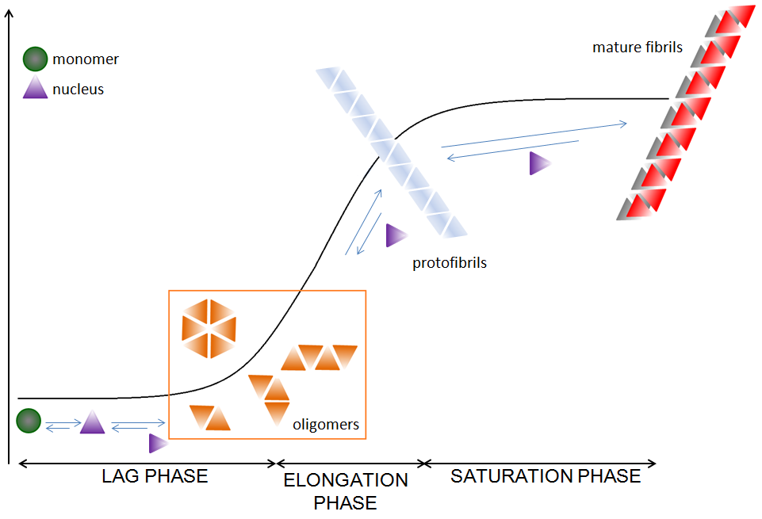
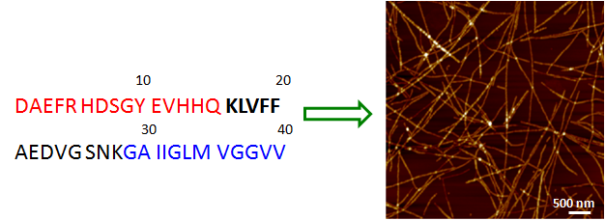
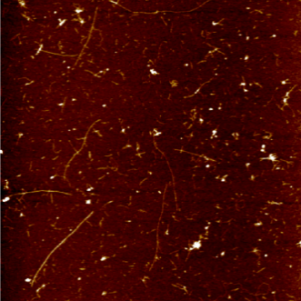
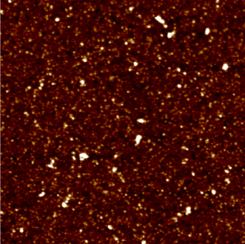
amyloid fibril-forming proteins/peptides
NATIVE PROTEINS
no smilarity in
sequence
structure
function
AMYLOID AGGREGATES
amyloid fibrils
similar structure
highly organized
SELF-ASSEMBLY
determined by the peptide bond
fibrils
protofibrils
nucleus
oligomers

Slide 3
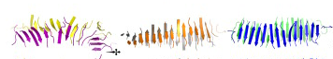
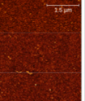
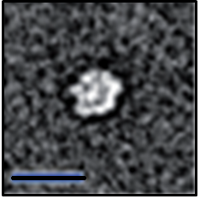
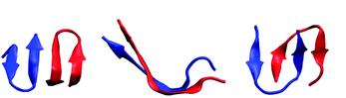
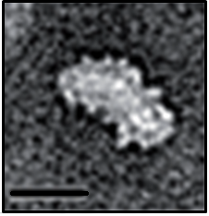
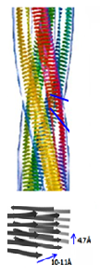
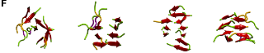
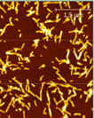
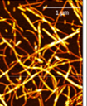
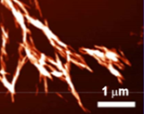
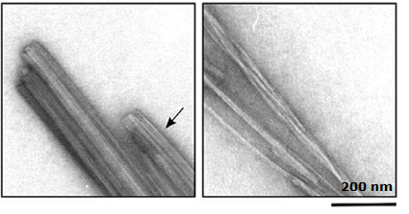
nucleus
oligomers
protofibrils
fibrils
polymorphism of aggregates vs. cytotoxicity
?
Polymorphism of amyloid aggregates and their distribution – modulate the amyloidosis

Slide 4
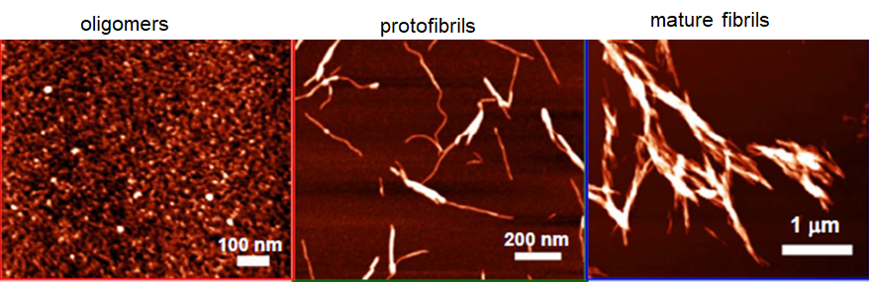
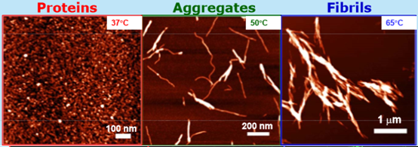
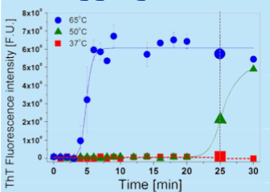
Important to understand the interactions of different amyloid forms with cells
Effect of structurally different amyloid assemblies on neural cells
Bystrenova, Bednarikova, Gazova et al. 2018,, 2018

Slide 5
24h
48h
correlation - number of cells (viability) vs. amyloid morphology/deposition
 | Control | Pre-fibrillar aggregates | Protofilaments | Mature fibrils
Area [µm² ] | 260 (± 187) | 410 (± 168) | 351(± 198) | 337 (± 159)
Perimeter [µm] | 134 (± 55) | 168 (±73) | 184 (± 61) | 167 (± 69)
Circularity | 0.18 (± 0.06) | 0.17 (± 0.05) | 0.14 (± 0.06) | 0.17 (± 0.07)
AR (Aspect ratio) | 2.1 (± 0.8) | 1.7(± 0.5) | 2.4 (± 1.0) | 2.11 (± 0.65)
Round | 0.55 (± 0.18) | 0.60 (± 0.15) | 0.49 (± 0.20) | 0.52 (± 0.16)
Solidity | 0.78 (± 0.06) | 0.77 (± 0.02) | 0.74 (± 0.09) | 0.76 (± 0.07)
Deposition of amyloid aggregates on neuroblastoma cells – progressive modification and decrease of the cell number correlate with the degree of fibrillization
Scanning probe microscopy - aggregates strongly interact with the cell membrane, forming a stiff encase → increased cell membrane stiffness → deficit in the metabolic exchanges between the cells and the environment
amyloid fibrils as a substrate alter neural cells growth.

Slide 6
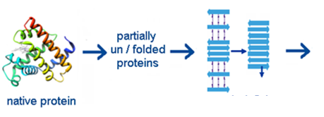
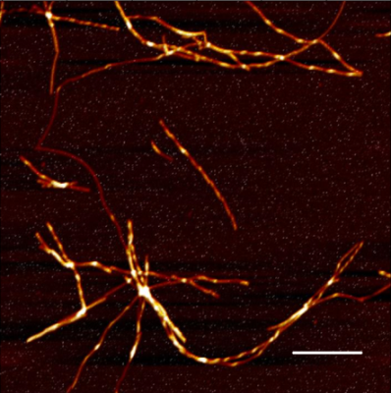
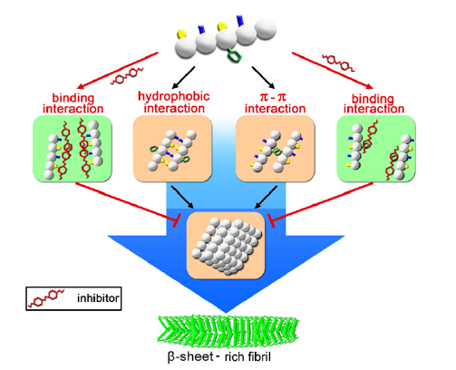
Amyloid-related diseases – no treatment
reduction of protein amyloid aggregates is beneficial
(cell and animal models)
Identification of the inhibitors of amyloid self-assembly
inhibitors
small molecules
heterodimers
nanoparticles
characterize the relationship between the physico-chemical properties of inhibitors and their anti-amyloid properties, determination of the inhibitor binding sites

Slide 7
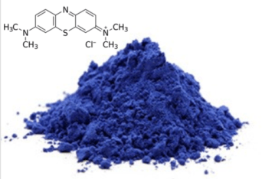
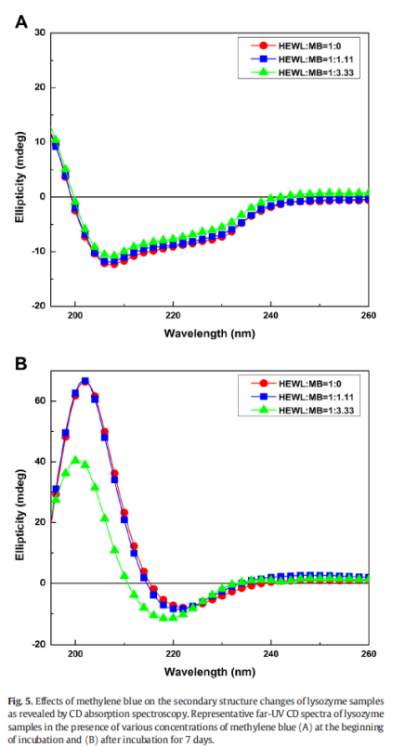
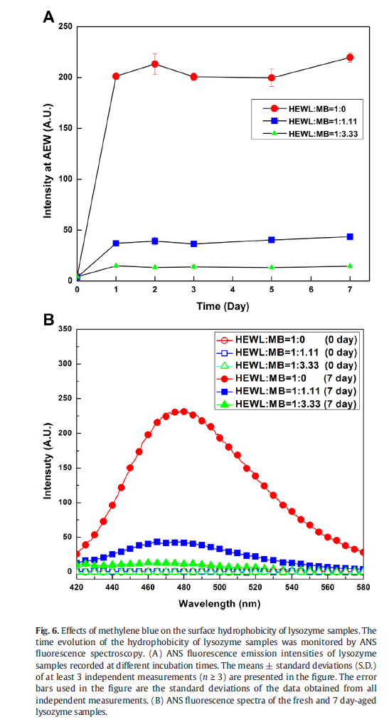
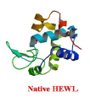
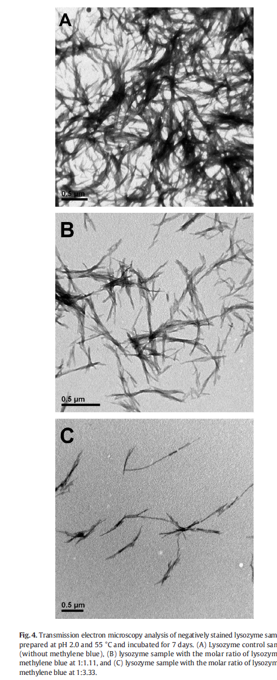
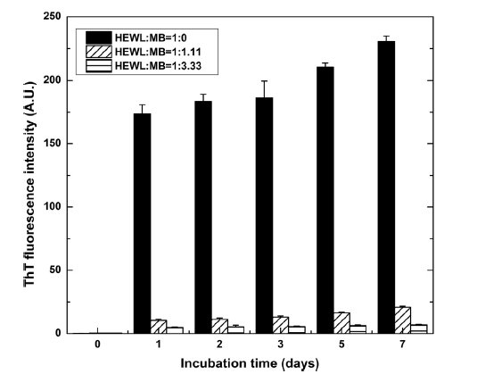
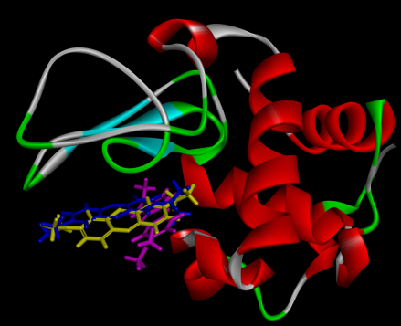
Inhibition/depolymerization of lysozyme fibrillization - methylene blue (MB)
Effect of methylene blue
on secondary structure and surface hydrophobicity (ANS)
0 days
Microscopy
A) LF without MB
Spectroscopic techniques
7 days
ThT fluorescence
B) Lysozyme to MB = 1:1.11
Molecular docking simulations
- binding to amyloidogenic sequence of lysozyme (residues 48-50 and 106-108)
stabilization of the native state of HEWL leading to inhibition
C) Lysozyme to MB = 1:3.33
-methylene blue decrease lysozyme fibrils formation
three docking poses of MB on lysozyme.

Slide 8
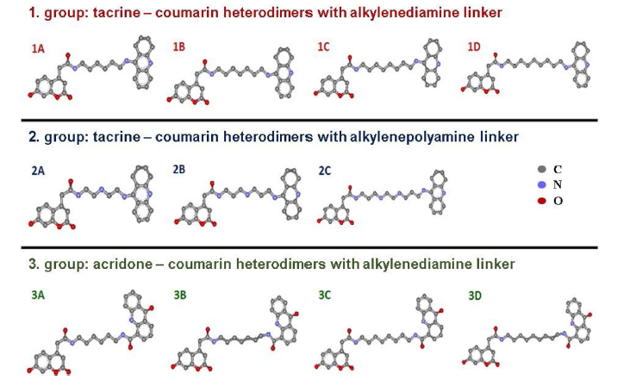
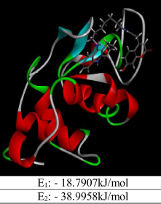
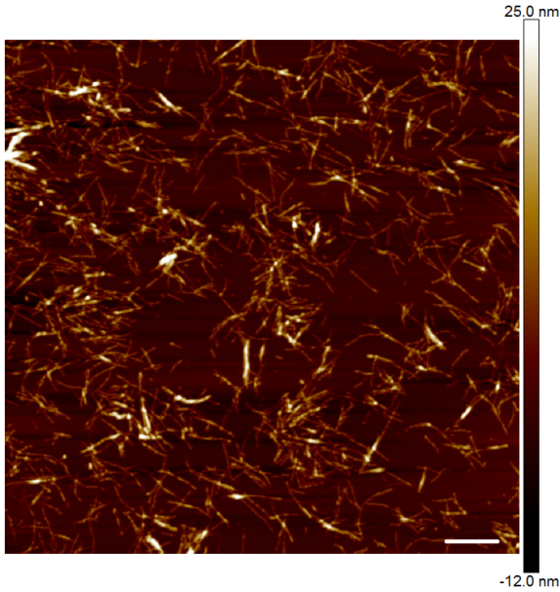
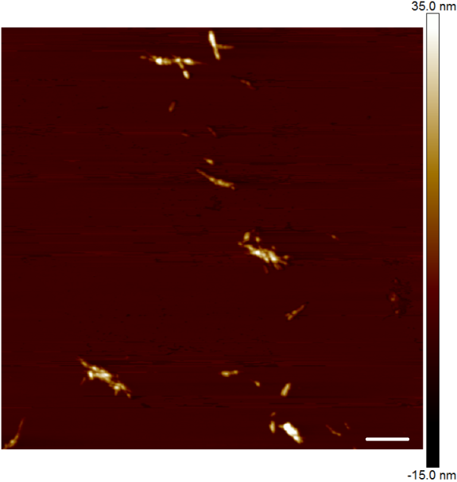
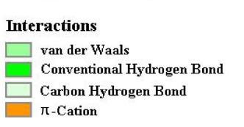
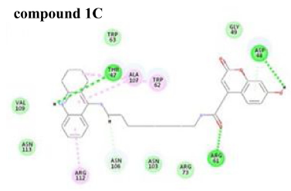
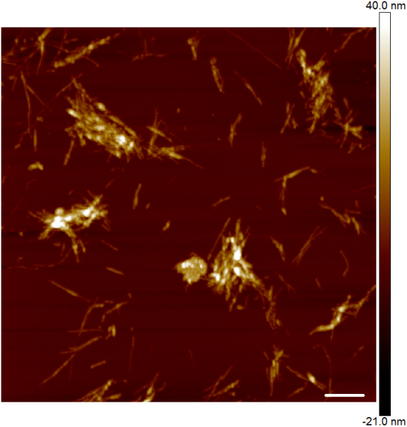
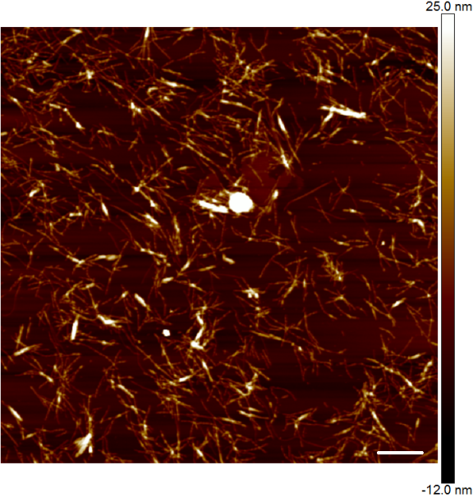
tacrine/acridone-coumarin heterodimers
Name | IC₅₀ (µmol.dm⁻³)
1A | 26,2
1B | 105,4
1C | 19,2
1D | 23,1
2A | 396,8
2B | 322,2
2C | N/A
3A | N/A
3B | N/A
3C | N/A
1.
2.
3.
A
LAF
B
1C
C
2B
D
3B
1 μm
Ulicna K., et al., Lysozyme amyloid fibrillization in presence of tacrine/acridone-coumarin heterodimers
Colloids and Surfaces B: Biointerfaces, 2018, 166, 108-118

Slide 9
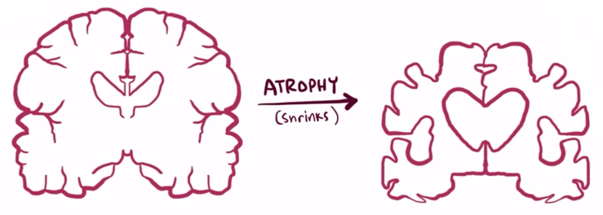
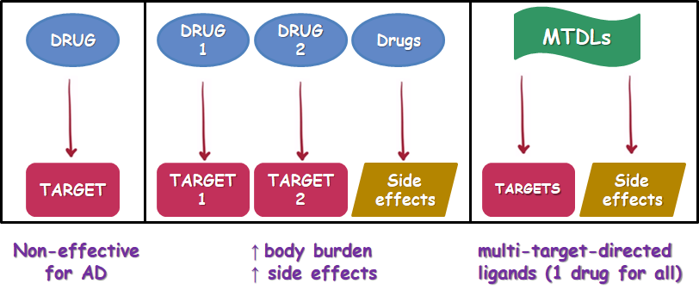




Alzheimer´s disease – multifactiorial diseases
Multi-target-directed ligands strategy
AD targets
searching for
multitarget compound
screening the large PubChem database for potential MTDLs candidates
rational design → combination of scaffolds with known beneficial activity against one of the AD targets (coumarin, tacrine, curcumin, quinazoline scaffolds)
Non-effective for AD
↑ body burden
↑ side effects
multi-target-directed ligands (1 drug for all)
multi-target-directed ligands

Slide 10







CID 9998128 hybrid molecule
quinazoline
Effect of CID 9998128 on Aβ42 amyloid aggregation, BACE1
Aβ₁₋₄₂ fibrils
Inhibition
Destruction
indazole
methylpyridine
CID 9998128 is a good candidate for AD treatment through preventing production of Aβ peptides and degrading their aggregates
for drug design, we predict that the chemical structure of potent AD multitarget inhibitors should not contain indazole
Thai, N. Q., Bednarikova, Z., Gancar, M., Linh, H. Q., Hu, C.-K., Li, M. S., Gazova, Z., 2018

Slide 11



Curcumin derivatives
Aβ₄₀ fibrils + curcuminoids
Atomic Force Microscopy
In silico calculation
high binding affinity – substituents on R, R¹ and R² positions
→ DC₅₀ ~ 0.3 - 2 µM
Important for activity:
- both aromatic rings
no substituents - very low intereference between amyloid fibrils and compounds
- methoxy-acetate/hydroxy substitution patern
- rigidity and length of linker
Orteca G., Tavanti F., Bednarikova Z., Gazova Z., Rigillo G., Imbriano C., Basile V., Asti M., Rigamonti L., Saladini M., Ferrari E., Menziani M.C. Bioorganic and Medicinal Chemistry, 2018, 26 (14), 4288-4300

Slide 12


Bexarotene
Cramer et al. 2012 : BEXAROTENE reduces Aβ plaques in AD mice by ~ 50% within just 72 h
? MECHANISM ?
Impact on proccesing of Aβ peptide
Impact on clearence of Aβ peptide
in vitro and in silico study
Pham H.D.Q., Thai N.Q., Bednarikova Z., Linh H.Q., Gazova Z., Li M.S. Physical Chemistry Chemical Physics, 2018, 20, 24329-24338

Slide 13






Binding of bexarotene to monomer
Interaction with β amyloid fibrils
Thioflavin T assay
Atomic force microscopy
Thioflavin T assay
Atomic force microscopy
Interaction with β-secretase
bexarotene weakly binds to BACE1, Aβ₁₋₄₂ peptide and amyloid fibrils
bexarotene tightly binds to RXR-α and PPAR-γ
major role in binding plays van der Waals interactions
Impact on processing of Aβ peptide
Impact on clearance of Aβ peptide

Slide 14











Dextran-based polymer-coated Fe₂O₃ nanoparticles - impact on amyloid fibrillogenesis of human insulin
insulin fibrillization
Injection-localized amyloidosis
Long-term storage and shipping
dextran Dex
carboxymethyl-dextran CM-Dex
diethylaminoethyl-dextran
DEAE-Dex
human insulin
DLS
ζ (mV)
r_{HYD} (nm)
DEAE-Dex
42.8 ± 1.4
309.1 ± 5.6
Dex
6.7 ± 0.1
246.0 ± 14.4
CM-Dex
21.4 ± 0.3
207.2 ± 10.6
pH 2.0: + charge
Lu, Bednarikova, Gazova et al. Colloids Surf B Biointerfaces. 172 (2018) 674-683

Slide 15

The best inhibitory potency was detected for the largest DEAE-Dex
nanoparticles (309.1 ± 15.6 nm).
all DEX polymers – no effect
only complexation of dextrans with maghemite core would possess inhibitory activity toward insulin fibril – van de Waals, H-bonds
Lu, Bednarikova, Gazova et al. Colloids Surf B Biointerfaces. 172 (2018) 674-683

Slide 16






Acknowledgements
Zuzana Bednáriková
Andrea Antošová
Diana Fedunová
Jozef Marek
CNR-Instituto per lo Studio dei Materiali Nanostrutturati, Bologna
Biophysics Department, Faculty of Medicine, UMF "Carol Davila"
Bucharest, Romania
Katarína Uličná
Miroslav Gančár
Academy of Science, Poland
Thank you for your attention

