Slide 1
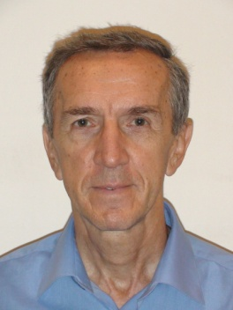
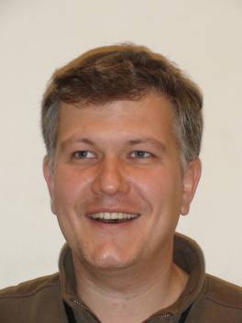
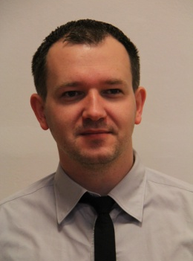
Laboratórium SCES v extrémnych podmienkach
OFNT ÚEF SAV, Park Angelinum 9
A |  |  | B | C |  |  |  |  |  | D | E | F | G | H | J | K | L
Skupina Meno, vek, FTE |  |  | celk WOS publ. | Počet WOS publikácií 2016, klasifikácia podľa SCIMAGO |  |  |  |  |  | Počet APVV A/B | Bilateral BAPVV/MAD | Počet COST ...iné | Počet EU 2020 R/P | Počet PhD | Celkový počet citácií | Počet citácii 2015 | h-index WOS
 |  |  |  | Q1 | Q2 | Q3 | Q4 | Σ | Q1P |  |  |  |  |  | ---------
SCES v extrémnych podmienkach Skupina celkovo |  |  | ---- | 3 | 2 (+2) | --- (+4) | --- | 5 (+6) | 1 | 0/2 | 0/1 | 0 | 0 | 1
FTE = 3.5 Skupina / FTE |  |  |  | 0.85 | 0.57 | --- | --- | 1.43 | 0.28
K. Flachbart | 64 | 1 | 141 | 3 | 2 | --- | --- | 5 | 1 | ------------ |  |  |  | 0 | 385 | 68 | 17
S. Gabáni | 42 | 1 | 86 | 2 | 2 | --- | --- | 4 | 1 |  |  |  |  | 1 | 234 | 63 | 12
E. Gažo | 55 | 0.5 | 40 | 1 | 0 | --- | --- | 1 | 1 |  |  |  |  | 0 | 1054 | 68 | 9
G. Pristáš | 35 | 1 | 40 | 2 | 0 | --- | --- | 2 | 1 |  |  |  |  | 0 | 152 | 16 | 5
doktorandi: M. Orendáč (Bc. 2013, Mgr. 2015, PhD. 2015-2019)
diplomanti: J. Kušnír (Bc. 2014, Mgr. 2016)

Slide 2
Vplyv tlaku a/alebo substitúcie na SCES SmB₆, HoB₁₂, MnSi, ... a SC YB₆, ZrB₁₂
medzinárodná spolupráca
Gabáni S. et al., Philosophical Magazine 96 (2016) 3274-3283, (Q1) - SmB₆
Nishiyama K. et al., Physical Review B 93 (2016) 121111®, (Q1) - SmB₆
Sluchanko N.E. et al.,Physical Review B 93 (2016) 085130, (Q1)
Demishev S.V. et al., JETP Letters 103 (2016) 321-327, (Q2)
Khoroshilov A.L. et al., J. of Low Temperature Physics 185 (2016) 522-530, (Q2)
Gabáni S. et al., J. of Low Temperature Physics (2017), (Q2), on-line (2016)
Orendáč M. et al., J. of Low Temperature Physics (2017), (Q2), on-line (2016)
Orendáč M. et al., Acta Physica Polonica (2017), (Q3) - prijaté
Pristáš G. et al., Acta Physica Polonica (2017), (Q3) - prijaté
Sluchanko N. et al., Acta Physica Polonica (2017), (Q3) - prijaté
printed
accepted

Slide 3
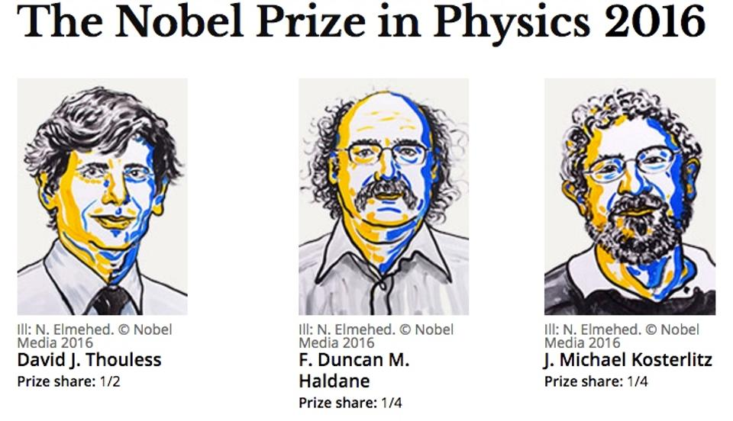
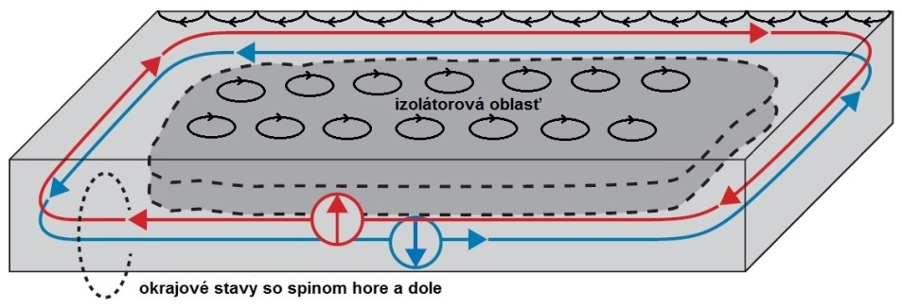
Vplyv substitúcie a tlaku na (Topologický?) Kondov Izolátor SmB₆
Gabáni S., Orendáč M., Pristáš G., Gažo E., Diko P., Piovarči S., Glushkov V., Sluchanko N., Levchenko A., Shitsevalova N., Flachbart K.: Transport properties of variously doped SmB₆ Philosophical Magazine 96 (2016) 3274-3283
Nishiyama K., Mito T., Pristáš G., Koyama T., Ueda K., Kohara T., Gabáni S., Flachbart K., Fukazawa H., Kohori Y., Takeshita N., Shitsevalova N., Ikeda H.: High-pressure induced modification in the hybridization gap of the intermediate valence compound SmB₆ Physical Review B 93 (2016) 121111®

Slide 4
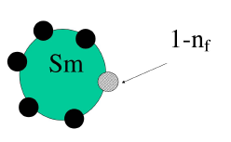
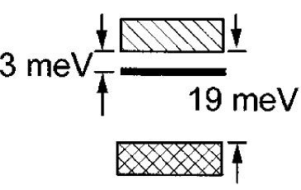
SmB₆
Intermediate-Valence system with narrow Gap(s)
and Residual Conductivity ⇒ what is ORIGIN???
τ ∼ 10⁻¹³ s (NMR)
Sm²⁺ ⇔ Sm³⁺ + e⁻
(1-n_{f}) n_{f}
J=0 J=5/2
Small gap(s) 2-20 meV detected:
ρ, C, NMR, ESR, neutrons, optic, ...
2 different ground states
2 different energy scales
Vainstein et al., SSP (1965)
Gorshunov et al., PRB (1999)

Slide 5
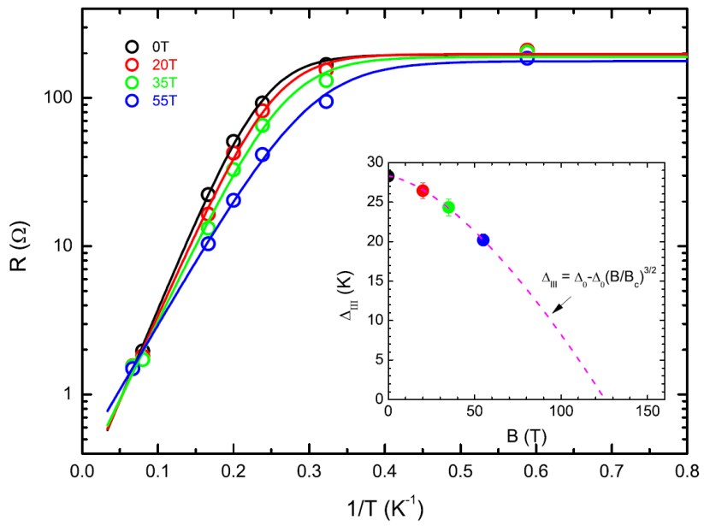
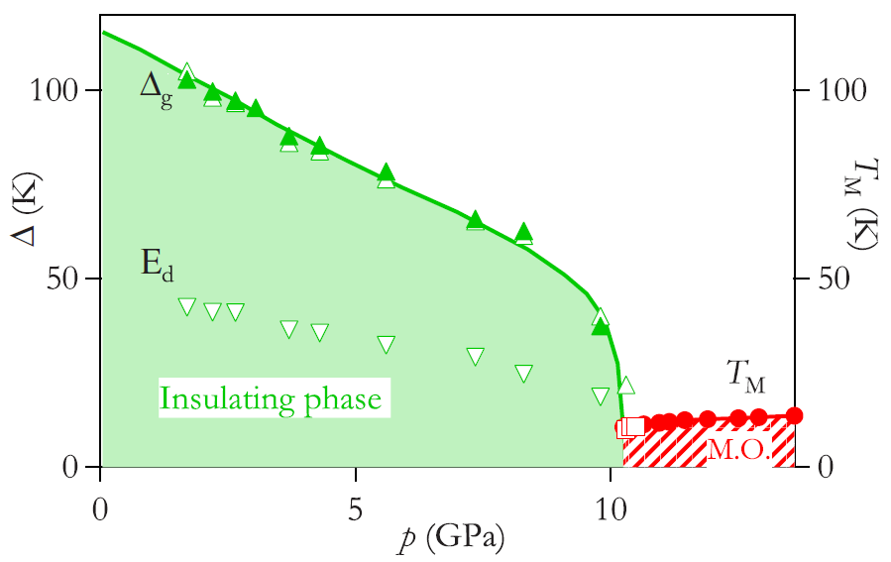
Effect of field, pressure, substitution,...,
on energy Gap
?
is maintained
up to B_{c} ≈ 120 T?
is maintained
up to p_{c} ≈ 4-10 GPa
is maintained
up to x(M²⁺, M³⁺) ≈ ? %
Chen et al., PRB (2015)
Gabáni et al., PRB (2003)
Derr et al. PRB (2008)
challenge from Farkašovský et al.?

Slide 6
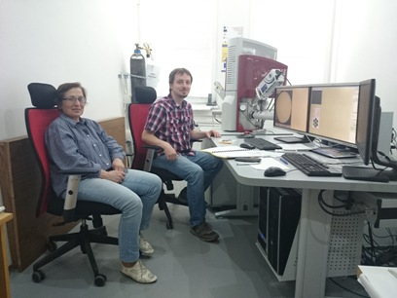
Effect of substitution
Sm ↔ La³⁺, Yb²⁺, Sr²⁺, Eu²⁺, vacancy
on electronic structure of SmB₆
SmB₆, LaB₆, CaB₆
Sm_{1-x}La_{x}B₆:
x = 0.045
x = 0.065
x = 0.115
x = 0.15
x = 0.20
x = 0.25
x = 0.30
x = 0.52
x = 0.64
R(T, H)
C(T)
M(T)
TESCAN
Sm_{1-x}Eu_{x}B₆:
x = 0.005
x = 0.02
x = 0.05
Sm_{1-x}Yb_{x}B₆:
x = 0.005
x = 0.01
x = 0.0024-0.024
Sm_{1-x}Sr_{x}B₆:
x = 0.005
Shitsevalova, Diko, Piovarči, Gabáni (8/2015 and 10/2016)
Sm_{1-x}B₆:
x = 0.03, 0.05, 0.08, 010, 0.15, 0.20

Slide 7
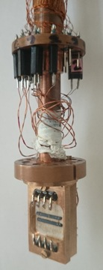
Effect of Sm ↔ La³⁺ on R(T) SmB₆
5K
15K
50K
H
I // [001]
Residual (surface/in-gap states)
Bad metal
⇒ ρ(T) ∝ exp(Δ/kT)

Slide 8
Effect of Sm ↔ La³⁺ on activation energy SmB₆
W(T) = d(lnρ(T))/d(1/k_{B}T)
50K
15K
Bad metal
Residual (surface/in-gap states)
E_{a} ≈
≈ E_{g}
disappears at x(La) = 4.5 % !

Slide 9
Effect of Sm ↔ La³⁺, Yb²⁺, Sr²⁺, Eu²⁺, vacancy
on energy gap SmB₆
Gabáni S. et al., Philosophical Magazine 96 (2016) 3274-3283

Slide 10
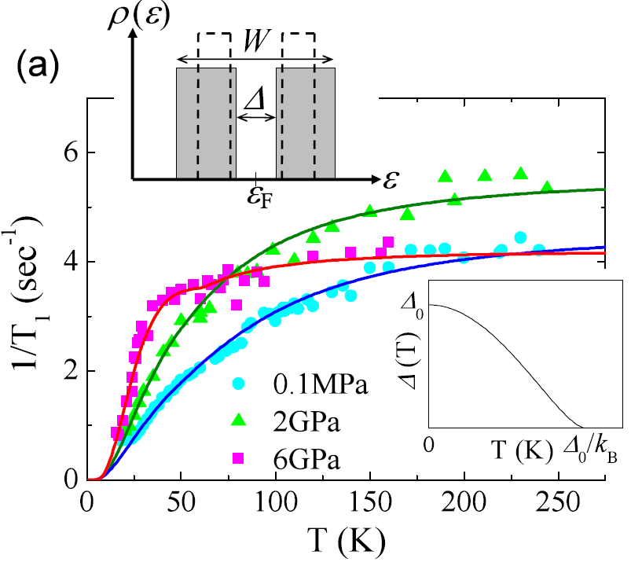
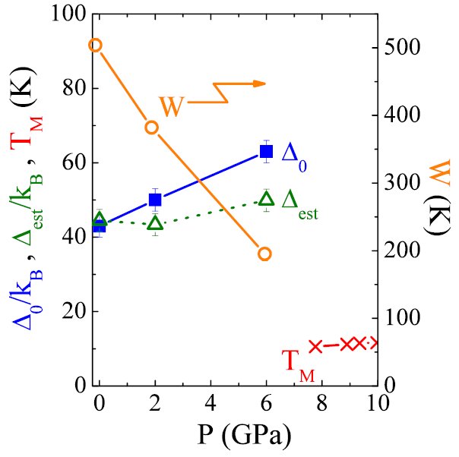
Effect of pressure on energy Gap(s)
is maintained
up to p_{c} ≈ 4-10 GPa
Gabáni et al., PRB (2003)
Derr et al. PRB (2008)
Nishiyama K. et al., Physical Review B 93 (2016) 121111®

Slide 11
