Slide 1
Adsorpcia magnetitu na amyloidných fibrilách
Súťaž mladých
RNDr. Jozefína Majorošová
Košice 2016

Slide 2
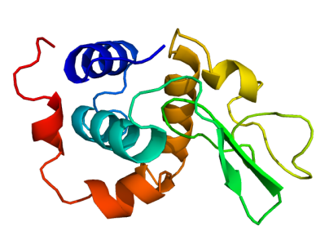
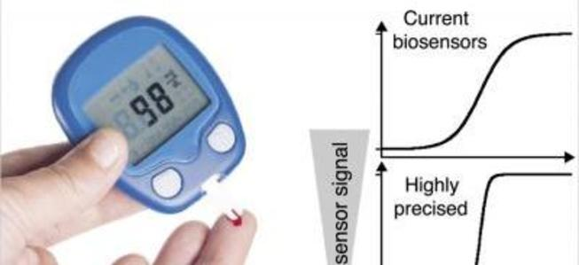
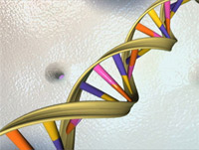
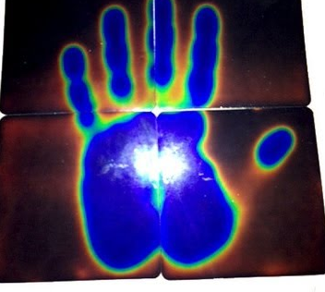
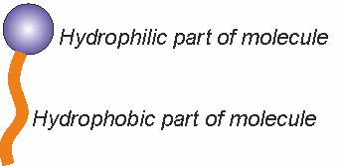
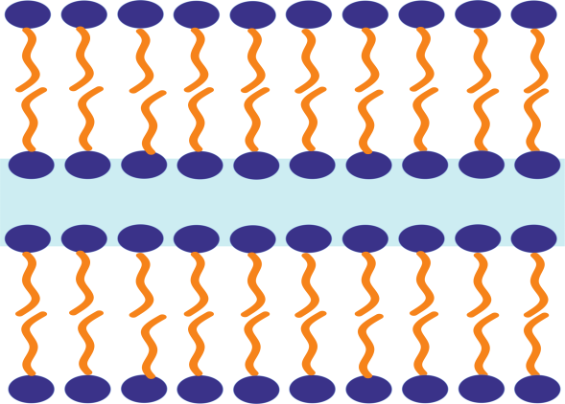
Lyotropic liquid crystal
Suitable concentration and temperature LLC phase
Main components:
amphiphilic molecules and solvent

Slide 3
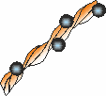
Motivation
Center of our interest: Liquid Crystals (LC) doped with magnetic nanoparticles
Corrigan et al., Jacs Communications 2006:
preformed amyloid fibrils of hen lysozyme (LAF) can form liquid crystal phases
J.J. Vallooran et al. Advanced Materials 23, 3932 (2011) :
usage of magnetic particles can facilitate lyotropic LC alignment
M. Zaman et al. International Journal of Nanomedicine, 9 (2014), 899-912 :
some minimal (critical) concentration (c_{c}) exists at which the amyloid fibrils order to pure biological LC
Aim: explore the interactions of biological LC with magnetic nanoparticles
Schematic picture of LAFdoped with MNPs

Slide 4
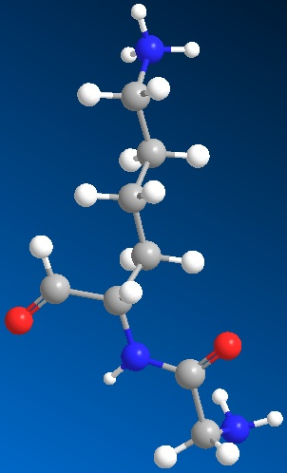
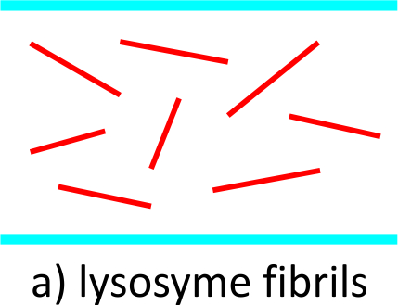
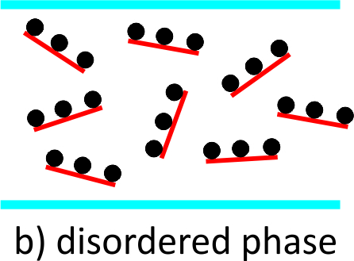
Experiment
There is opportunity to further fibrils ordering into the liquid crystal phase by applying external magnetic field.
Lysozyme from Hen egg white
Aim:
Order fibrils under c_{c} using
MNP and external magnetic field.
Interaction of MNPs
with LAF
c<c_{c}
Mezophase of biological LC.

Slide 5
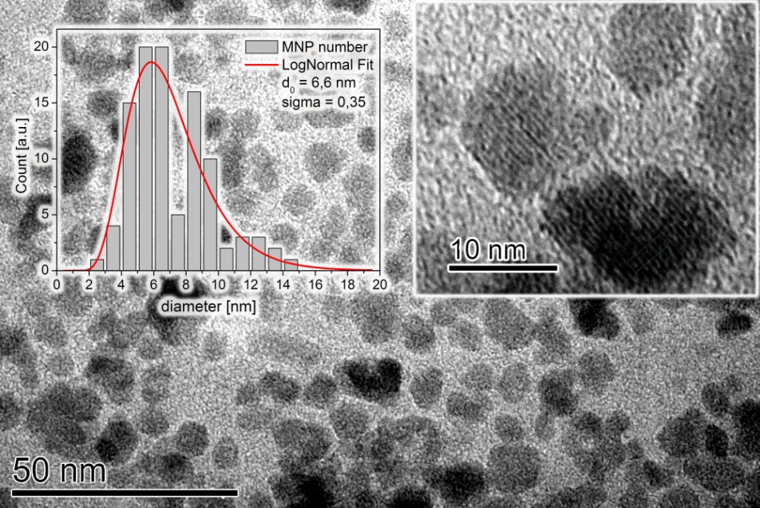
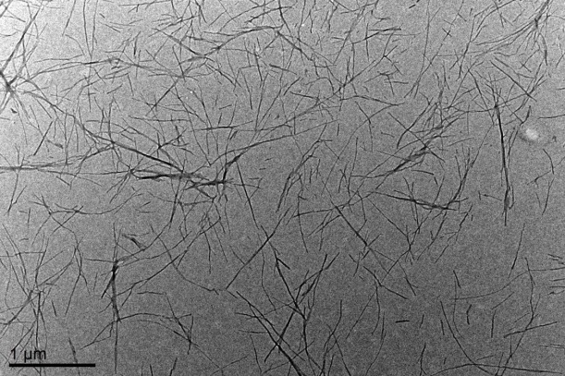
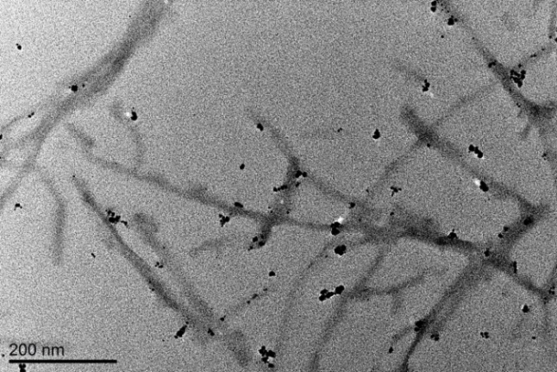
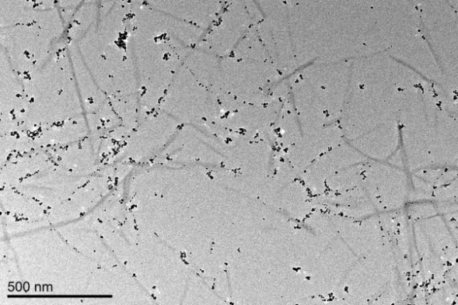
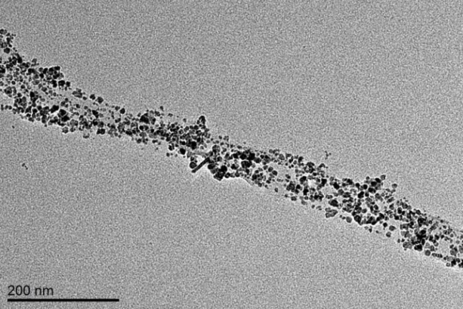
Results: TEM
Magnetic fluid
Lysozyme amyloid fibrils LAF
Mixture of MNPs and LAF:
c_{MNP} =0.5 mg/mL c_{MNP} =2.5 mg/mL c_{MNP} = 5 mg/mL
The measurenments: in cooperation with co-authors from Faculty of Physics, Adam Mickiewicz University, Poznań, Poland

Slide 6
Results: SAXS
The measurenments: in cooperation with co-authors from Hamburg, Helmholtz-Zentrum Geesthacht, Germany
Nativ protein
Effect of MNPs concentration
Od c_{MNP} =2,5mg/ml alongated asocciations

Slide 7
Results: SAXS
The measurenments: in cooperation with co-authors from Hamburg, Helmholtz-Zentrum Geesthacht, Germany
Cross-section pair distribution function
Radial contrast of scattering length density profile

Slide 8
Results: Faraday rotation
Fe₃O₄ concentration | Fe₃O₄ Volume fraction | Saturation FR [◦ mL/mg m] | V_{sp} [◦ mL/m T mg]
0,5 | 1 × 10−4 | −59 ± 4 | −271 ± 84
2,5 | 5 × 10−4 | −64 ± 1 | −571 ± 51
5 | 1 × 10−3 | −70 ± 1 | −771 ± 54
The measurenments: in cooperation with co-authors from Faculty of Physics, Adam Mickiewicz University, Poznań, Poland

Slide 9
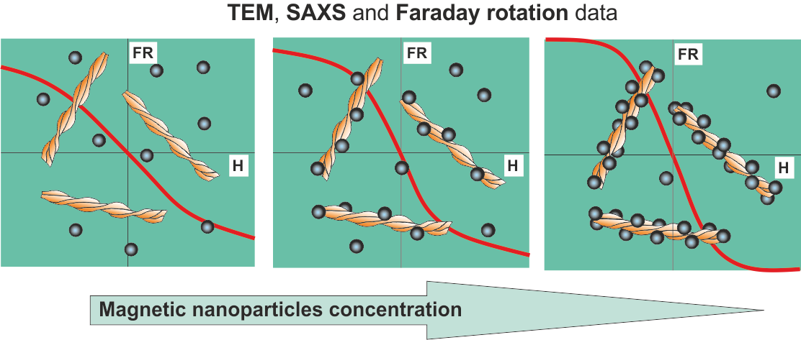
Summary
syntetized biohybrid
Adsorbtion of MNP on LAF
Critical concentration
ability to further fibrils ordering into the LCphase by applying external magnetic field.
J. Majorošová et al. Col. Surf. B (2016).

Slide 10
Acknowledgement
doc. RNDr. Peter Kopčanský, CSc.
RNDr. Natália Tomašovičová, CSc.
RNDr. Zuzana Gažová, PhD.
RNDr. Katarína Šipošová PhD.
RNDr. Milan Timko, CSc.
PhD. Vasil M. Garamus
Dr. Viktor I. Petrenko
Dr. Mikhail V. Avdeev
PhD. Marceli Koralewský
Dr. Błażej Leszczynski
Dr. Stanislaw Jurga
Dr. Chin-Kun Hu
Dr. Shura Hayryan

Slide 11
Thank you for attention !

Slide 12
AFM
C_{lyzosyme}= 10mg/ml
100 nm
1μm
100 nm

Slide 13
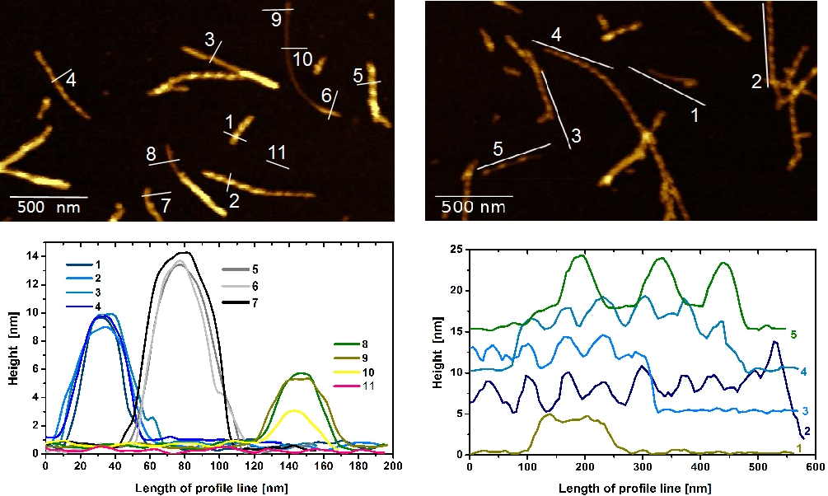
AFM
The measurenments: in cooperation with M. Baťková, IEP SAS Košice

Slide 14
Future plans
Data processing from SAXS and SANS
Order lysozyme amyloid fibrils in magnetic field to prepare lyotropic liquid crystal SANS Budapešť, SANS (Grenoble)
Study the interaction of LAF with nanoparticles of different shapes.
Doping the lysozyme amyloid fibrils with spindle nanoparticles

