Slide 1
Lock-in efekt v supravodivom Cu_{x}TiSe₂ RNDr. Zuzana Medvecká
Prof. Thierry Klein
Matière Condensée - Basses Températures
Institute NÉEL, CNRS/UGA
Grenoble, France
RNDr. Zuzana Vargaeštoková, PhD
Oddelenie fyziky nízkych teplôt
Ústav experimentálnej fyziky, SAV
Košice, Slovensko
Notes:
Hello, my name is Zuzana Medvecka and
I will talk mostly about the Local magnetometry on Cu_{x}TiSe₂
and briefly mention our progress on scanning Hall probe microscope.

Slide 2
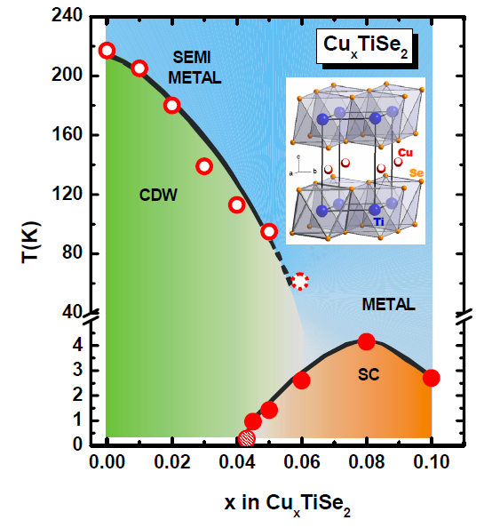
Študovaný materiál: Cu_{x}TiSe₂
supravodivosť (SC)
a vlny nábojovej hustoty (CDW)
Aký je vzťah medzi CDW a SC?
Aký je charakter supravodivosti v Cu_{x}TiSe₂?
Rôzne metódy dávajú rôzne výsledky.
E. Morosan, Nat. Phys. 2, 544 (2006)
Lokálne magnetické merania na Cu_{x}TiSe₂ RNDr. Zuzana Medvecká, OFNT 1/9
Notes:
TiSe₂ doped with copper has a layered structure and you can see its phase diagram here, copper doping versus crtitical temperature.
What is interesting here, is the coexistence of superconductivity and charge density wave state.
With copper intercalation the CDW is suppressed and SC state emerges.
These could suggest that these two correlated electron systems affect each other but it is not clear.
What is happening around the superconducting dome is not clear and might be interesting to study.

Slide 3
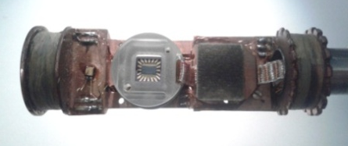
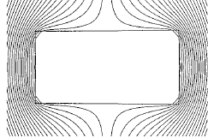
Lokálne magnetické Hallovské merania
- Hallovské sondy: rozmery 10μm x 10μm
V_{Hall} ~ B
- B ~ počet vírov vo vzorke
H_{a} < H_{p}
SONDA
B = 0
Poľová závislosť magnetickej indukcie
Lokálne magnetické merania na Cu_{x}TiSe₂ RNDr. Zuzana Medvecká, OFNT 2/9
Notes:
Then we did these local measurements in differrent field orientations ...
and we found a lock-in effect. These means that superconducting vortices stay locked parallel with the planes, even then when the field is not parallel with the planes any more.
A possible explanation is that there is some layered structure where vortices could pin and get locked on it.
We take a model that could decribe it and we adjusted it to our conditions to fit the data. And we found a very good agreement.
So from the data and theory we constructed this phase diagram of vortex structure where you can see different phases such as Meissner state or lock-in phase.
And we compared the data from 3 samples with different doping and found that the strength of the lock-in is also independent of the doping which is similar to heat capacity and Hc1 measurement. These data will be published and these data are already published.

Slide 4
Lokálne magnetické Hallovské merania
- Hallovské sondy: rozmery 10μm x 10μm
V_{Hall} ~ B
- B ~ počet vírov vo vzorke
H_{a} < H_{p}
Meissnerov
stav, B=0
SONDA
B = 0
Poľová závislosť magnetickej indukcie
Lokálne magnetické merania na Cu_{x}TiSe₂ RNDr. Zuzana Medvecká, OFNT 2/9
Notes:
Then we did these local measurements in differrent field orientations ...
and we found a lock-in effect. These means that superconducting vortices stay locked parallel with the planes, even then when the field is not parallel with the planes any more.
A possible explanation is that there is some layered structure where vortices could pin and get locked on it.
We take a model that could decribe it and we adjusted it to our conditions to fit the data. And we found a very good agreement.
So from the data and theory we constructed this phase diagram of vortex structure where you can see different phases such as Meissner state or lock-in phase.
And we compared the data from 3 samples with different doping and found that the strength of the lock-in is also independent of the doping which is similar to heat capacity and Hc1 measurement. These data will be published and these data are already published.

Slide 5
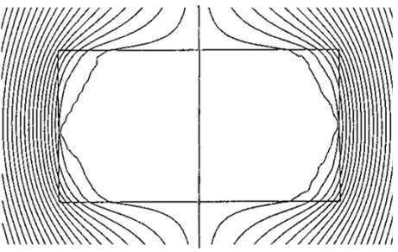
Lokálne magnetické Hallovské merania
- Hallovské sondy: rozmery 10μm x 10μm
V_{Hall} ~ B
- B ~ počet vírov vo vzorke
H_{a} = H_{p}
H_{p}
- penetračné pole
Meissnerov
stav, B=0
Víry v SC
B > 0
SONDA
B > 0
Poľová závislosť magnetickej indukcie
Lokálne magnetické merania na Cu_{x}TiSe₂ RNDr. Zuzana Medvecká, OFNT 2/9
Notes:
Then we did these local measurements in differrent field orientations ...
and we found a lock-in effect. These means that superconducting vortices stay locked parallel with the planes, even then when the field is not parallel with the planes any more.
A possible explanation is that there is some layered structure where vortices could pin and get locked on it.
We take a model that could decribe it and we adjusted it to our conditions to fit the data. And we found a very good agreement.
So from the data and theory we constructed this phase diagram of vortex structure where you can see different phases such as Meissner state or lock-in phase.
And we compared the data from 3 samples with different doping and found that the strength of the lock-in is also independent of the doping which is similar to heat capacity and Hc1 measurement. These data will be published and these data are already published.

Slide 6
Lokálne magnetické Hallovské merania
- Hallovské sondy: rozmery 10μm x 10μm
V_{Hall} ~ B
- B ~ počet vírov vo vzorke
H_{a} = H_{p}
H_{p}
- penetračné pole
Meissnerov
stav, B=0
Víry v SC
B > 0
SONDA
B > 0
Poľová závislosť magnetickej indukcie
Lokálne magnetické merania na Cu_{x}TiSe₂ RNDr. Zuzana Medvecká, OFNT 2/9
Notes:
Then we did these local measurements in differrent field orientations ...
and we found a lock-in effect. These means that superconducting vortices stay locked parallel with the planes, even then when the field is not parallel with the planes any more.
A possible explanation is that there is some layered structure where vortices could pin and get locked on it.
We take a model that could decribe it and we adjusted it to our conditions to fit the data. And we found a very good agreement.
So from the data and theory we constructed this phase diagram of vortex structure where you can see different phases such as Meissner state or lock-in phase.
And we compared the data from 3 samples with different doping and found that the strength of the lock-in is also independent of the doping which is similar to heat capacity and Hc1 measurement. These data will be published and these data are already published.

Slide 7
Lokálne magnetické Hallovské merania v Cu_{x}TiSe₂
H
H
θ_{H}
VZORKA
VZORKA
B
c
B
c
ab
ab
SONDA
SONDA
B^{c}
θ_{H} = 90°
Pre rôzne θ_{H}
H_{p}
H_{p}
H_{k}
Poľová závislosť magnetickej indukcie
- malý nárast pri H_{p}, prudký nárast pri H_{k}
- výraznejšie pre malé uhly
Lokálne magnetické merania na Cu_{x}TiSe₂ RNDr. Zuzana Medvecká, OFNT 3/9
Notes:
Then we did these local measurements in differrent field orientations ...
and we found a lock-in effect. These means that superconducting vortices stay locked parallel with the planes, even then when the field is not parallel with the planes any more.
A possible explanation is that there is some layered structure where vortices could pin and get locked on it.
We take a model that could decribe it and we adjusted it to our conditions to fit the data. And we found a very good agreement.
So from the data and theory we constructed this phase diagram of vortex structure where you can see different phases such as Meissner state or lock-in phase.
And we compared the data from 3 samples with different doping and found that the strength of the lock-in is also independent of the doping which is similar to heat capacity and Hc1 measurement. These data will be published and these data are already published.

Slide 8
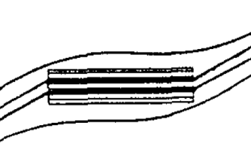
Lock-in efekt
víry ostávajú zachytené paralelne s rovinami, aj keď magnetické pole nie je paralelné s ab
H_{k} ...kritické pole pre lock-in efekt
H_{p}
H_{k}
H_{a} < H_{p}
H_{p} < H_{a} < H_{k}
H_{k} < H_{a}
B^{c}
B^{c}
B^{c}
Meissnerov stav
- ideálny diamagnet
Lock-in efekt
- víry parallelne s ab
Schodíková štruktúra
Lokálne magnetické merania na Cu_{x}TiSe₂ RNDr. Zuzana Medvecká, OFNT 4/9

Slide 9
Lock-in efekt
víry ostávajú zachytené paralelne s rovinami, aj keď magnetické pole nie je paralelné s ab
H_{k} ...kritické pole pre lock-in efekt
H_{p}
H_{k}
H_{a} < H_{p}
H_{p} < H_{a} < H_{k}
H_{k} < H_{a}
B^{c}
B^{c}
B^{c}
Meissnerov stav
- ideálny diamagnet
Lock-in efekt
- víry parallelne s ab
Schodíková štruktúra
Lokálne magnetické merania na Cu_{x}TiSe₂ RNDr. Zuzana Medvecká, OFNT 4/9

Slide 10
Lock-in efekt
víry ostávajú zachytené paralelne s rovinami, aj keď magnetické pole nie je paralelné s ab
H_{k} ...kritické pole pre lock-in efekt
H_{p}
H_{k}
H_{a} < H_{p}
H_{p} < H_{a} < H_{k}
H_{k} < H_{a}
B^{c}
B^{c}
B^{c}
Meissnerov stav
- ideálny diamagnet
Lock-in efekt
- víry parallelne s ab
Schodíková štruktúra
Lokálne magnetické merania na Cu_{x}TiSe₂ RNDr. Zuzana Medvecká, OFNT 4/9

Slide 11
Lock-in efekt
víry ostávajú zachytené paralelne s rovinami, aj keď magnetické pole nie je paralelné s ab
H_{k} ...kritické pole pre lock-in efekt
H_{p}
H_{k}
H_{a} < H_{p}
H_{p} < H_{a} < H_{k}
H_{k} < H_{a}
B^{c}
B^{c}
B^{c}
Meissnerov stav
- ideálny diamagnet
Lock-in efekt
- víry parallelne s ab
Schodíková štruktúra
Lokálne magnetické merania na Cu_{x}TiSe₂ RNDr. Zuzana Medvecká, OFNT 4/9

Slide 12
Lock-in efekt
Vysokoteplotné supravodiče - vrstevnatá štruktúra
- vysoká anizotropia Γ
- víry sa zmestia medzi roviny ( ξ_{c} << s )
- v YBa₂Cu₃O₇ len pre θ_{H} < 2°
<ψψ>
s
ξ_{c}
<ψψ>
Cu_{x}TiSe₂: - anizotropia malá ( Γ=1.7 )
- víry ( ξ_{c} =12nm ) sú väčšie ako medzirovinná vzdialenosť ( s=0.6nm )
→ neočakávame lock-in efekt
Lokálne magnetické merania na Cu_{x}TiSe₂ RNDr. Zuzana Medvecká, OFNT 5/9

Slide 13
Orientácia vírov, θ_{B}
H
θ_{H}
VZORKA
B^{c} = B sin θ_{B}
B^{ab}
c
SONDA
B^{ab} = B cos θ_{B}
B^{c} / B^{ab} = tan θ_{B}
B
ab
SONDA
B^{c}
Zložky indukcie B s rastúcim poľom
Lokálne magnetické merania na Cu_{x}TiSe₂ RNDr. Zuzana Medvecká, OFNT 6/9
Notes:
Then we did these local measurements in differrent field orientations ...
and we found a lock-in effect. These means that superconducting vortices stay locked parallel with the planes, even then when the field is not parallel with the planes any more.
A possible explanation is that there is some layered structure where vortices could pin and get locked on it.
We take a model that could decribe it and we adjusted it to our conditions to fit the data. And we found a very good agreement.
So from the data and theory we constructed this phase diagram of vortex structure where you can see different phases such as Meissner state or lock-in phase.
And we compared the data from 3 samples with different doping and found that the strength of the lock-in is also independent of the doping which is similar to heat capacity and Hc1 measurement. These data will be published and these data are already published.

Slide 14
Orientácia vírov, θ_{B}
H
θ_{H}
VZORKA
B^{c} = B sin θ_{B}
B^{ab}
c
B^{c} / B^{ab} = tan θ_{B}
SONDA
B=0
B^{ab} = B cos θ_{B}
ab
SONDA
B^{c}
Zložky indukcie B s rastúcim poľom
Lokálne magnetické merania na Cu_{x}TiSe₂ RNDr. Zuzana Medvecká, OFNT 6/9
Notes:
Then we did these local measurements in differrent field orientations ...
and we found a lock-in effect. These means that superconducting vortices stay locked parallel with the planes, even then when the field is not parallel with the planes any more.
A possible explanation is that there is some layered structure where vortices could pin and get locked on it.
We take a model that could decribe it and we adjusted it to our conditions to fit the data. And we found a very good agreement.
So from the data and theory we constructed this phase diagram of vortex structure where you can see different phases such as Meissner state or lock-in phase.
And we compared the data from 3 samples with different doping and found that the strength of the lock-in is also independent of the doping which is similar to heat capacity and Hc1 measurement. These data will be published and these data are already published.

Slide 15
Orientácia vírov, θ_{B}
H
θ_{H}
VZORKA
B^{c} = B sin θ_{B}
B^{ab}
c
B^{c} / B^{ab} = tan θ_{B}
SONDA
B
B^{ab} = B cos θ_{B}
ab
SONDA
B^{c}
Zložky indukcie B s rastúcim poľom
Lokálne magnetické merania na Cu_{x}TiSe₂ RNDr. Zuzana Medvecká, OFNT 6/9
Notes:
Then we did these local measurements in differrent field orientations ...
and we found a lock-in effect. These means that superconducting vortices stay locked parallel with the planes, even then when the field is not parallel with the planes any more.
A possible explanation is that there is some layered structure where vortices could pin and get locked on it.
We take a model that could decribe it and we adjusted it to our conditions to fit the data. And we found a very good agreement.
So from the data and theory we constructed this phase diagram of vortex structure where you can see different phases such as Meissner state or lock-in phase.
And we compared the data from 3 samples with different doping and found that the strength of the lock-in is also independent of the doping which is similar to heat capacity and Hc1 measurement. These data will be published and these data are already published.

Slide 16
Orientácia vírov, θ_{B}
H
θ_{H}
VZORKA
B^{c} = B sin θ_{B}
B^{ab}
c
SONDA
B^{ab} = B cos θ_{B}
B^{c} / B^{ab} = tan θ_{B}
B
ab
SONDA
B^{c}
Zložky indukcie B s rastúcim poľom
Lokálne magnetické merania na Cu_{x}TiSe₂ RNDr. Zuzana Medvecká, OFNT 6/9
Notes:
Then we did these local measurements in differrent field orientations ...
and we found a lock-in effect. These means that superconducting vortices stay locked parallel with the planes, even then when the field is not parallel with the planes any more.
A possible explanation is that there is some layered structure where vortices could pin and get locked on it.
We take a model that could decribe it and we adjusted it to our conditions to fit the data. And we found a very good agreement.
So from the data and theory we constructed this phase diagram of vortex structure where you can see different phases such as Meissner state or lock-in phase.
And we compared the data from 3 samples with different doping and found that the strength of the lock-in is also independent of the doping which is similar to heat capacity and Hc1 measurement. These data will be published and these data are already published.

Slide 17
Orientácia vírov, θ_{B}
H
θ_{H}
VZORKA
B^{c} = B sin θ_{B}
B^{ab}
c
SONDA
B^{ab} = B cos θ_{B}
B^{c} / B^{ab} = tan θ_{B}
B
ab
SONDA
B^{c}
B^{c} sin θ_{Η}
tan θ_{B}
=
B^{ab} cos θ_{Η}
tan θ_{H}
Zložky indukcie B s rastúcim poľom
Poľová závislosť orientácie vírov
Lokálne magnetické merania na Cu_{x}TiSe₂ RNDr. Zuzana Medvecká, OFNT 6/9
Notes:
Then we did these local measurements in differrent field orientations ...
and we found a lock-in effect. These means that superconducting vortices stay locked parallel with the planes, even then when the field is not parallel with the planes any more.
A possible explanation is that there is some layered structure where vortices could pin and get locked on it.
We take a model that could decribe it and we adjusted it to our conditions to fit the data. And we found a very good agreement.
So from the data and theory we constructed this phase diagram of vortex structure where you can see different phases such as Meissner state or lock-in phase.
And we compared the data from 3 samples with different doping and found that the strength of the lock-in is also independent of the doping which is similar to heat capacity and Hc1 measurement. These data will be published and these data are already published.

Slide 18
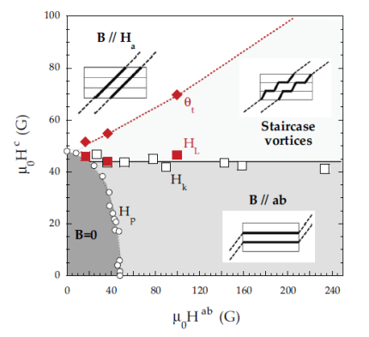
Meranie vs. model
Blatterov model - v materiáli existuje štruktúra, kde sú víry zachytené
- len pre malé uhly a izotrópny supravodič
- model bol rozšírený pre ľubovoľný uhol θ_{H}
našli sme numerické riešenie pre rôzne anizotropie γ
Poľová závislosť orientácie vírov, porovnané dáta s modelom
Fázový diagram vírovej štruktúry
v Cu_{x}TiSe₂
Lokálne magnetické merania na Cu_{x}TiSe₂ RNDr. Zuzana Medvecká, OFNT 7/9
Notes:
Then we did these local measurements in differrent field orientations ...
and we found a lock-in effect. These means that superconducting vortices stay locked parallel with the planes, even then when the field is not parallel with the planes any more.
A possible explanation is that there is some layered structure where vortices could pin and get locked on it.
We take a model that could decribe it and we adjusted it to our conditions to fit the data. And we found a very good agreement.
So from the data and theory we constructed this phase diagram of vortex structure where you can see different phases such as Meissner state or lock-in phase.
And we compared the data from 3 samples with different doping and found that the strength of the lock-in is also independent of the doping which is similar to heat capacity and Hc1 measurement. These data will be published and these data are already published.

Slide 19
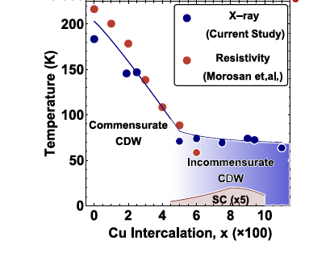
Diskusia
E. Morosan, Nat. Phys. 2, 544 (2006)
A. Kogar, arXiv:1608.05957v1 (2016)
Domény v CDW/defekty vo vrstvení - každých 22 vrstiev ~ ξ_{c}
- možné vysvetlenie pre lock-in efekt
Lokálne magnetické merania na Cu_{x}TiSe₂ RNDr. Zuzana Medvecká, OFNT 9/10
Notes:
Then we did these local measurements in differrent field orientations ...
and we found a lock-in effect. These means that superconducting vortices stay locked parallel with the planes, even then when the field is not parallel with the planes any more.
A possible explanation is that there is some layered structure where vortices could pin and get locked on it.
We take a model that could decribe it and we adjusted it to our conditions to fit the data. And we found a very good agreement.
So from the data and theory we constructed this phase diagram of vortex structure where you can see different phases such as Meissner state or lock-in phase.
And we compared the data from 3 samples with different doping and found that the strength of the lock-in is also independent of the doping which is similar to heat capacity and Hc1 measurement. These data will be published and these data are already published.

Slide 20
Ďakujem za Vašu pozornosť.
Zoznam publikácií s výsledkami
Z. Medvecká, T. Klein, V. Cambel, J. Šoltýs, G. Karapetrov, F. Levy-Bertrand, B. Michon, C. Marcenat,
Z. Pribulová, P. Samuely:
Observation of a transverse Meissner effect in Cu_{x}TiSe₂ single crystals ,
Phys. Rev. B 93, 100501(R) (2016).
Z. Pribulová, Z. Medvecká, J. Kačmarčík, V. Komanický, T. Klein, P. Husaníková, V. Cambel, J. Šoltýs,
G. Karapetrov, P. Samuely:
Local Magnetometry of Cu_{0.064}TiSe₂ ,
Acta Physica Polonica 126, 370 (2014).
Comparison of the lock-in efect in different Cu_{x}TiSe₂ single crystals - pripravujeme
Magnetic and thermodynamic properties of Cu_{x}TiSe₂ single crystals - pripravujeme
RNDr. Zuzana Medvecká, OFNT
medvecka@saske.sk

Slide 22
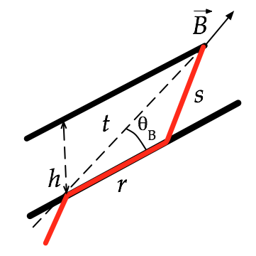
Blatterov model
- lock-in efekt kvôli združeným rovinám
- vír ušetrí energiu tým, že čiastočne orientuje
jadro v rovine, ale stratí na elastickej energii
- energia víru viazaného na rovinu:
- celková Gibbsova energia pre systém vírov:
... počet vírov; interakčná energia
... viazanie vo vrstve
... anizotropia
- minimalizujeme g vzhľadom na θ_{B} :
rozšírenie na ľubovoľný uhol
numerické riešenie
pre anizotropný supravodič ( Γ = 1.7 )
Medvecká et al., PRB 100501 (R) (2016)
Blatter et al., Rev. Mod. Phys. 66, 1125 (1994)

Slide 23
Porovnanie na 3 vzorkách
lock-in efekt porovnaný v 3 vzorkách s rôznym dopovaním Cu a geometriou
Vzorka 1: Tc=2,8 K x= 0,06 geometria: d/2w= 0,12
Vzorka 2: Tc=4,1 K x= 0,08 d/2w= 0,3
Vzorka 3: Tc=3,8 K x= 0,085 d/2w= 0,12
d/2w... pomer hrúbky a šírky vzorky
Uhlové závislosti:
H_{p} - penetračné pole
H_{k} - kritické pole pre lock-in
H_{c1} - dolné krit. mag. pole
H_{L} - kritické pole pre lock-in
Započítame
geometriu
vzorky
lock-in pozorovaný do najvyšších uhlov pre vzorku 2, ktorá najmenej deformuje pole
sila lock-in efektu sa nemení s dopovaním
Lokálne magnetické merania na Cu_{x}TiSe₂ RNDr. Zuzana Medvecká, OFNT 6/8
Notes:
Then we did these local measurements in differrent field orientations ...
and we found a lock-in effect. These means that superconducting vortices stay locked parallel with the planes, even then when the field is not parallel with the planes any more.
A possible explanation is that there is some layered structure where vortices could pin and get locked on it.
We take a model that could decribe it and we adjusted it to our conditions to fit the data. And we found a very good agreement.
So from the data and theory we constructed this phase diagram of vortex structure where you can see different phases such as Meissner state or lock-in phase.
And we compared the data from 3 samples with different doping and found that the strength of the lock-in is also independent of the doping which is similar to heat capacity and Hc1 measurement. These data will be published and these data are already published.

Slide 24
Porovnanie na 3 vzorkách
lock-in efekt porovnaný v 3 vzorkách s rôznym dopovaním Cu a geometriou
Vzorka 1: Tc=2,8 K x= 0,06 geometria: d/2w= 0,12
Vzorka 2: Tc=4,1 K x= 0,08 d/2w= 0,3
Vzorka 3: Tc=3,8 K x= 0,085 d/2w= 0,12
d/2w... pomer hrúbky a šírky vzorky
Uhlové závislosti:
H_{c1} - dolné krit. mag. pole
H_{L} - kritické pole pre lock-in
Sila lock-in efektu sa nemení s dopovaním
Lokálne magnetické merania na Cu_{x}TiSe₂ RNDr. Zuzana Medvecká, OFNT 8/9
Notes:
Then we did these local measurements in differrent field orientations ...
and we found a lock-in effect. These means that superconducting vortices stay locked parallel with the planes, even then when the field is not parallel with the planes any more.
A possible explanation is that there is some layered structure where vortices could pin and get locked on it.
We take a model that could decribe it and we adjusted it to our conditions to fit the data. And we found a very good agreement.
So from the data and theory we constructed this phase diagram of vortex structure where you can see different phases such as Meissner state or lock-in phase.
And we compared the data from 3 samples with different doping and found that the strength of the lock-in is also independent of the doping which is similar to heat capacity and Hc1 measurement. These data will be published and these data are already published.

