Slide 1



Prehľad činnosti OFMJ a dosiahnuté výsledky
v roku 2016

Slide 2
Základné údaje OFMJ
Personálne zloženie:
15 vedeckí pracovníci
4 + 2 PhD študenti
2 VŠ pracovník
Výskumné smery:
Technologické laboratórium - Zlúčeniny f-kovov
2. Transport elektrického náboja a tunelové javy v tuhých látkach, AFM
3. NANOFLUID - MNPs, Magnetické kvapaliny, LC + Ferronematics, Feritín

Slide 3
OFMJ 2016
Publikačná aktivita: 19 CC 12 prijatých do CC 3 Non CC
Konferenčné príspevky: 32
Pozvané prednášky: 7
Plenárne prednášky: 2
Notes:
3

Slide 4
OFMJ - NANOFLUID
A |  |  | B | C |  |  |  |  |  | D | E | F | G | H | J | K | L
Skupina Meno, vek, FTE |  |  | celk WOS publ. | Počet WOS publikácií 2016, klasifikácia podľa SCIMAGO |  |  |  |  |  | Počet APVV A/B | Bilateral BAPVV/MAD | Počet COST ...iné | Počet EU 2020 R/P | Počet PhD | Celkový počet citácií | Počet citácii 2015 | h-index WOS
NANOFLUID |  |  |  | Q1 | Q2 | Q3 | Q4 | S | Q1P |  |  |  |  |  | ---------
Skupina celkovo |  |  | ---- | 8 | 2 | - | - | 10 | 4 | 2/2 |  | 2 | - | 6+2
FTE = 10 Nanofluid / FTE |  |  |  | 0.8 | 0.2 | --- | ---
M. Timko | 62 | 1 | 212 | 6 | 2 | - | - | 8 | 1 | ------------ |  |  |  | 1 | 1058 | 136 | 17
P.Kopčanský | 61 | 1 | 229 | 3 | 1 | - | - | 4 | - |  |  |  |  | 2 | 988 | 139 | 17
M. Koneracká | 48 | 1 | 130 | - | - | - | - | - | - |  |  |  |  | 1 | 872 | 85 | 17
 |  |  |  |  |  |  |  |  |  |  |  |  |  | 1 | 380 | 25 | 12
V. Závišová | 48 | 1 | 82 | - | - | - | - | - | -
M. Molčan | 31 | 1 | 17 | 2 | 1 | - | - | 3 | 1 |  |  |  |  | - | 12 | 2 | 3
N.Tomašovičová | 51 | 1 | 86 | 2 | - | - | - | 2 | 1 |  |  |  |  | 1+2 | 349 | 61 | 12
M. Rajňak | 29 | 1 | 21 | - | - | - | - | - | - |  |  |  |  | - | 58 | 12 | 4
L. Balejčíková | 29 | 1 | 12 | - | - | - | - | - | - |  |  |  |  | ´- | 51 | 11 | 4
M. Kubovčíková | 41 | 1 | 24 | 3 | - | - | - | 3 | - | ------------ |  |  |  | - | 36 | 10 | 5
V.Gdovinová D | 27 | 1 | 5 | 1 | - | - | - | 1 | - |  |  |  |  | - | 1 | 0 | 1
J.Majorošová D | 34 | 1 | 4 | 1 | - | - | - | 1 | 1 |  |  |  |  | - | 1 | 1 | 1
Notes:
4

Slide 5
Publikácie
Skumiel, Andrzej; Leszczynski, Blazej; Molcan, Matus; Timko Milan, The comparison of magnetic circuits used in magnetic hyperthermia JOURNAL OF MAGNETISM AND MAGNETIC MATERIALS Volume: 420 Pages: 177-184 2016 IF=2.357, Q1P
Majorosova, Jozefina; Petrenko, Viktor I.; Siposova, Katarina, Timko, Milan, Tomasovicova, Natalia, Garamus, Vasil M., Koralewski, Marceli, Avdeev, Mikhail V., Leszczynski, Blazej, Jurga, Stefan, Gazova, Zuzana, Hayryan, Shura, Hu, Chin-Kun, Kopcansky, Peter, , On the adsorption of magnetite nanoparticles on lysozyme amyloid fibrils, COLLOIDS AND SURFACES B-BIOINTERFACES Volume: 146 Pages: 794-800 2016, IF=4.269, Q1P
Molcan, Matus; Gojzewski, Hubert; Skumiel, Andrzej; Dutz, Silvio, Kovac, Jozef, Kubovcikova, Martina ; Kopcansky, Peter, Vekas, Ladislau, Timko, Milan, , Energy losses in mechanically modified bacterial magnetosomes JOURNAL OF PHYSICS D-APPLIED PHYSICS Volume: 49 Issue: 36 Article Number: 365002 Published: SEP 14 2016, IF=2.77, Q1P
N.Tomašovičová, J. Kováč, Y. Raikher, N. Éber, T. Tóth-Katona, V. Gdovinová, J. Jadzyn, R. Pinčák, P. Kopčanský Biasing a ferronematic – a new way to detect weak magnetic field, SOFT MATTER 12 (2016) IF=3.798, Q1P
Jozefczak, A.; Kaczmarek, K.; Hornowski, Kubovcikova, M., Rozynek, Z., Timko, M., Skumiel, A., Magnetic nanoparticles for enhancing the effectiveness of ultrasonic hyperthermia APPLIED PHYSICS LETTERS Volume: 108 Issue: 26 Article Number: 263701 Published: JUN 27 2016, IF=3.142, Q1
Kudelcik, Jozef; Hardon, Stefan; Bury, Peter; Kopcansky, Peter ; Timko, Milan Acoustic spectroscopy of magnetic fluids based on transformer oil JOURNAL OF INTELLIGENT MATERIAL SYSTEMS AND STRUCTURES Volume: 27 Issue: 7 Pages: 935-943 Published: APR 2016, IF=2.1, Q1
Studenyak, I. P.; Demko, P. Yu.; Studenyak, V. I., Maior, M. M., Il'kovic, S., Reiffers, M., Timko, M, Size effect on heat capacity and phase transitions in Cu6PS5I superionic conductors JOURNAL OF ALLOYS AND COMPOUNDS Volume: 656 Pages: 439-442 Published: JAN 25 2016, IF=3.014
Musatov, Andrey, Siposova, Katarina, Kubovcikova, Martina, Lysakova, Veronika, Varhac, Rastislav, Functional and structural evaluation of bovine heart cytochrome c oxidase incorporated into Bicelles,. BIOCHIMIE, Volume: 121, Pages: 21-28, DOI: 10.1016/j.biochi.2015.11.018, Published: FEB 2016, IF=3.01, Q1
Notes:
5

Slide 6
Publikácie
Jozefczak, Arkadiusz; Hornowski, Tomasz; Krol, Anita, Molcan, Matus, Leszczynski, Blazej, Timko, Milan, The Effect of Sonication on Acoustic Properties of Biogenic Ferroparticle Suspension ARCHIVES OF ACOUSTICS Volume: 41 Issue: 1 Pages: 161-168 Published: 2016, IF=0.66, Q2
. P. Studenyak, V. Y. Izai, V. I. Studenyak, O. V. Kovalchuk, T. M. Kovalchuk, P., Kopčanský, M. Timko, N. Tomašovičová, V. Zavisova, J. Miskuf & I. V. Oleinikova Influence of Cu6PS5І superionic nanoparticles on the dielectric properties of 6СВ liquid crystal, Liquid Crystals LIQUID CRYSTALS, (2016):, IF=2.2, Q2
10 CC akceptované pre rok 2017
Projekty:
3x VEGA (2/1)
4xAPVV (2/2)
2X COST RADIOMAG, NANOUPTAKE
Patenty:
Method of electrical conductivity increase of 6СНВТ nematic liquid crystal by introduction of nanoparticles Cu₆PS₅I superionic conductor: patent of Ukraine №111241, MPK G01R 3/00, G02F 1/13 (2016.01) / I.P. Studenyak, O.V. Kovalchuk, A.V. Bendak, V.І. Studenyak, P. Kopčanský, M. Timko. – №u201603325; Decl. 31.03.2016; Publ. 10.11.2016, Bull. №21. – 2 p.
Method of electrical conductivity increase of nematic liquid crystal by superionic conductor nanoparticles doping, - patent of Ukraine №106745, MPK G02F 1/13 (2006.01) / I.P. Studenyak, O.V. Kovalchuk, A.V. Bendak, І.O. Pal, P. Kopčanský, M. Timko. – Decl. 10.05.2016; Publ. 10.05.2016, Bull. №9, 3p.
Notes:
6

Slide 7
Zhrnutie
Najcitovanejší autor oddelenia: P.Kopčanský, 139 citácií/2015
Autor s najväčším počtom publikácií, M. Timko 8 CC publikácií/2016
Popularizácia Noc výskumníkov v Optime 30.9.2016 http://www.nocvyskumnikov.sk/program/mesto-kosice/atrium-optima.html
Návrh oddelenia na najlepší výsledok ústavu v kategóriách: vedecká práca, aplikácia, medzinárodná spolupráca:
Vedecká práca: Feronematiká – nový spôsob detekcie slabého magnetického poľa
Medzinárodná spolupráca: Magnetické nanočastice – efektívne zvýšenie efektu ultrazvukovej hypertermie
Notes:
7

Slide 8
OFMJ – Technologické Laboratórium
A |  |  | B | C |  |  |  |  |  | D | E | F | G | H | J | K | L
Skupina Meno, vek, FTE |  |  | celk WOS publ. | Počet WOS publikácií 2016, klasifikácia podľa SCIMAGO |  |  |  |  |  | Počet APVV A/B | Bilateral BAPVV/MAD | Počet COST ...iné | Počet EU 2020 R/P | Počet PhD | Celkový počet citácií | Počet citácii 2015 | h-index WOS
 |  |  |  | Q1 | Q2 | Q3 | Q4 | S | Q1P |  |  |  |  |  | ---------
Technologické laboratórium Skupina celkovo |  |  | ---- | 1 |  | 3 |  |  | 1 | 0 | 4/1 | 0/1 | 0 | 2
FTE = 3,2 Skupina / FTE |  |  |  | 0,31 |  | 0,93 | ---
Marian Mihalik | 60 | 1 | 2 | 1 | 0 | 3 | 0 | 3 | 1 | ------------ |  |  |  | 1 |  | 22 | 12
M. Zentková | 51 | 1 | 2 | 1 | 0 | 3 | 0 | 3 | 1 |  |  |  |  | 1 |  | 6 | 7
Matúš Mihalik | 36 | 1 | 2 | 1 | 0 | 3 | 0 | 3 | 1 |  |  |  |  | - |  | 7 | 6
M. Vavra | 35 | 0,2 | 0/1 | 0 | 0/1 | 0 | 0 | 0/1 | 0 |  |  |  |  | - |  | 16 | 8
Notes:
8

Slide 9
Publikácie
GABÁNI, Slavomír - MIHALIK, Marián - PRISTÁŠ, Gabriel - ZENTKOVÁ, Mária. Fyzika a technika vysokých tlakov II. Košice : Ústav experimentálnej fyziky SAV, 2016. 99 s. ISBN 978-80-89656-14-1. Typ: BCI
MIHALIK, Marián - JAGLIČIC, Z. - FITTA, Magdalena - KAVEČANSKÝ, Viktor - CSACH, Kornel - BUDZIAK, A. - BRIANČIN, Jaroslav - ZENTKOVÁ, Mária - MIHÁLIK, Matúš. Structural and magnetic study of PrMn1-xFexO3 compounds. In Journal of Alloys and Compounds, 2016, vol. 687, p. 652-661. (3.014 - IF2015). (2016 - Current Contents, WOS, SCOPUS). ISSN 0925-8388. Typ: ADCA
ZENTKOVÁ, Mária - MIHALIK, Marián - MIHÁLIK, Matúš - SIRENKO, V. - EREMENKO, V.V. - BALBASHOV, A.M. - KVETKOVÁ, Lenka - KOVAĽ, Vladimír - VÝROSTKOVÁ, Anna - BRIANČIN, Jaroslav - WANG, X. - KAMENEV, K.V. Preparation and physical properties of M-type hexaferrite SrCo2Ti2Fe8O19. In Ferroelectrics, 2016, vol. 499, p. 1-8. (0.491 - IF2015). ISSN 0015-0193. Typ: ADCA
MOLČANOVÁ, Zuzana - MIHALIK, Marián - ZENTKOVÁ, Mária - KAVEČANSKÝ, Viktor - BRIANČIN, Jaroslav - WOCHOWSKI, Konrad. Magneto-crystalline Anisotropy and non-Fermi-liquid Behavior in CeNi1-xCoxGe2. In Physics Procedia, 2015, vol. 75, p. 292-295. (2015 - SCOPUS). ISSN 1875-3892. Typ: ADMB
MIHALIK, Matúš - SIRENKO, Valentyna - BALBASHOV, Anatolij Mikhailovich - EREMENKO, Victor – MIHALIK, Marián, ZENTKOVÁ, Mária. The Magnetic Properties of Single Crystal SrCo2Ti2Fe8O19 Compound, In Physics Procedia, 2015, vol. 75, p. 259-265. (2015 - SCOPUS). ISSN 1875-3892. Typ: ADMB
PAUKOV, M.- HAVELA, L- KIM-NGAN, N.T.H. - BUTURLIM, V. - TKACH, I. - DROZDENKO, D.- Mašková, S. - SOWA, S. - MOLČANOVÁ, Z. - MIHALIK, M. – KRUPSKA, M. Variations of magnetic properties of UH₃ with modified structure and composition, Journal of Science: Advanced Materials and Devices, 1 (2016) 185-192
PROJEKTY:
2XVEGA
4xBilaterálne projekty SAV (PL, PT, SR)
Notes:
9

Slide 10
OFMJ – Elektrický transport a AFM
A |  |  | B | C |  |  |  |  |  | D | E | F | G | H | J | K | L
Skupina Meno, vek, FTE |  |  | celk WOS publ. | Počet WOS publikácií 2016, klasifikácia podľa SCIMAGO |  |  |  |  |  | Počet APVV A/B | Bilateral BAPVV/MAD | Počet COST ...iné | Počet EU 2020 R/P | Počet PhD | Celkový počet citácií | Počet citácii 2015 | h-index WOS
 |  |  |  | Q1 | Q2 | Q3 | Q4 | S | Q1P |  |  |  |  |  | ---------
Elektrický transport a AFM Skupina celkovo |  |  | ---- | 1 | 0 | 0 | 1 | 2 | 1 | 1 | 0 | 0 | 0 | 0
Skupina /FTE=2 |  |  |  | 0,5 | 0 | --- | 0,5 | 0,5 | 0,5
I. Baťko | 53 | 1 | 55 | 1 | 0 | 0 | 1 | 2 | 1 | ----------- |  |  |  | 0 | 125 | 11 | 8
M. Baťková | 48 | 1 | 27 | 1 | 0 | 0 | 1 | 2 | 1 |  |  |  |  | 0 | 37 | 8 | 4
Notes:
10

Slide 11
Publikácie
1.Magnetic properties and loss separation in FeSi/MnZnFe2O4 soft magnetic composites
By: Lauda, M.; Fuezer, J.; Kollar, P. M. Strečková, R. Bureš, J. Kováč, M. Baťková, I.Baťko.
JOURNAL OF MAGNETISM AND MAGNETIC MATERIALS Volume: 411 Pages: 12-17 Published: AUG 1 2016
2.Electrical Conduction of Ti/TiOx/Ti Structures at Low Temperatures and High Magnetic Fields
I. Batko, M.Batkova Eur. Phys. J. Appl. Phys., 73 3 (2016) 30301, DOI: 10.1051/epjap/2016150567
3.Memristive behavior of Nb/NbOx/Nb structures prepared by local anodic oxidation
I. Batko, M.Batkova, Materials Today: Proceedings 3 (2016) pp. 803-809
Accepted for publication:
1. Interaction of magnetic nanoparticles with lysozyme amyloid fibrils
V.Gdovinová, N.Tomašovičová, I.Batko, M. Batková, L. Balejčíková, V.M. Garamus, V.I. Petrenko, M.V. Avdeev, P. Kopčanský
Journal of Magnetism and Magnetic Materials, in press http://dx.doi.org/10.1016/j.jmmm.2016.09.035
2. Influence of Pressure on the Electrical Transport Properties of Carbon-doped EuB6 by G. PRISTÁŠ, S. GABÁNI, I. BAŤKO, M. BAŤKOVÁ, MAT. ORENDÁČ, E. GAŽO,V. FILIPOV, E. KONOVALOVA, P. DIKO, K. FLACHBART
accepted for publication in Acta Physica Polonica A.
zaslané:
1. Imaging of Magnetic Domain Structure in FeSi/Mn0.8Zn0.2Fe2O4 Composite using Magnetic Force Microscopy
M. Streckova, I. Batko, M. Batkova, R. Bures, M. Faberova, R. Dzunda, H. Hadraba, I. Kubena Acta Physica Polonica
2. Effect of valence fluctuations on the ground state properties of SmB6
M. Batkova, I. Batko, Solid Strate Communications
PROJEKTY:
2XVEGA
1xAPVV (PF UPJŠ)
Notes:
11

Slide 12
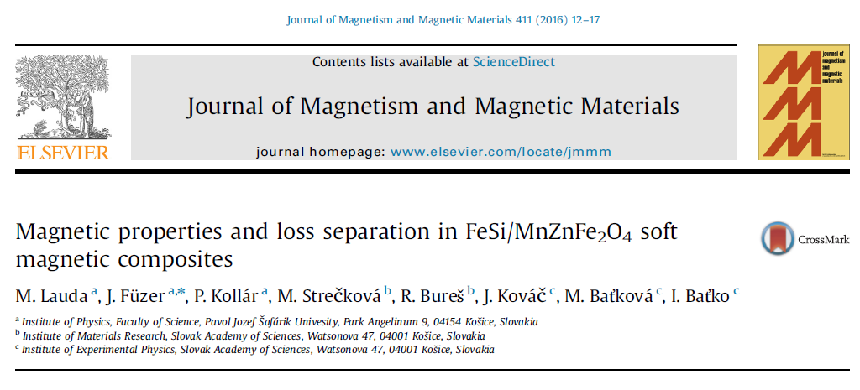
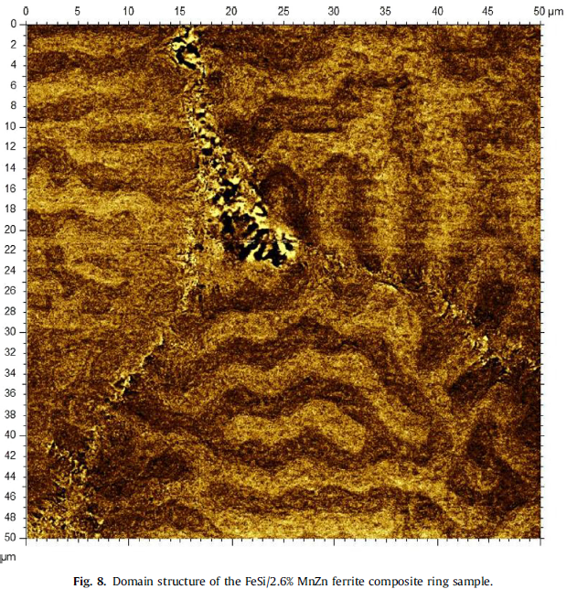
MFM štúdie magneticky mäkkého kompozitu FeSi/MnZnFe2O4
Vzorky pripravila Dr. Strečková, ÚMV
Študovaná problematika má pokračovanie v APVV projekte MACOMA, ktorého financovanie začalo v roku 2016 (zodp. rieš. Prof. Kollár, za ÚEF SAV Dr. Baťková)
Výsledky MFM štúdií ukázali, že:
FeSi zrná kompozitného systému obsahujú niekoľko domén podobných doménam v čistom FeSi materiáli (doménová štruktúra zrna sa v kompozite nenarušila)
Oblasti MnZn feritu medzi FeSi zrnami majú svoju vlastnú doménovú štruktúru s dvoma orientáciami vektora magnetizácie (svetlé a tmavé oblasti v MFM snímke)

Slide 13
Výsledok z oblasti medzinárodnej spolupráce

Slide 14
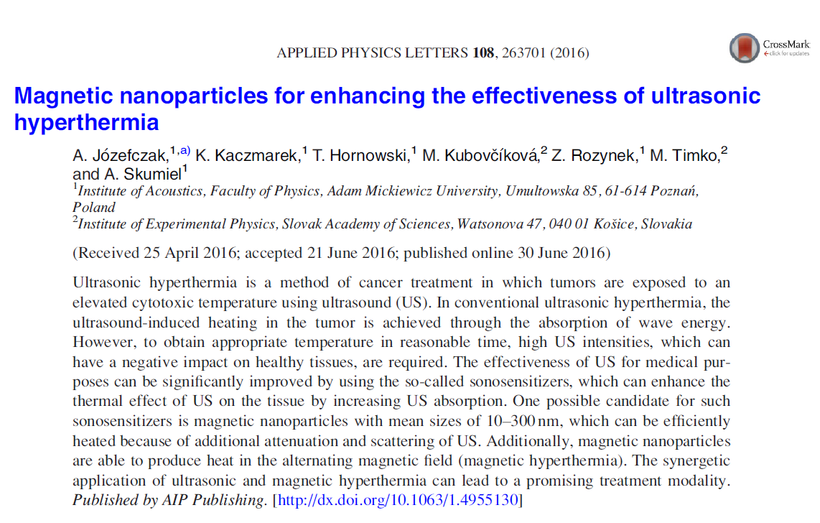
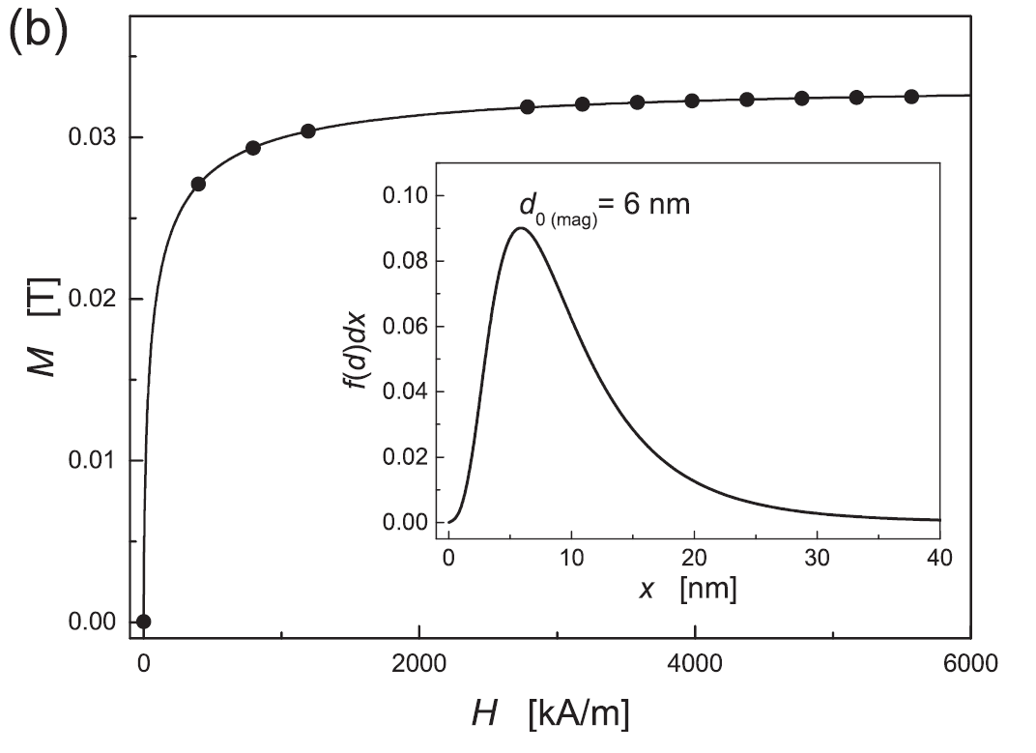
Magnetite NPs
Concentration NPs 70 mg/ml
D = 6 nm

Slide 15
Termočlánky T1 1/3 a T2 2/3 vzorky
Tissue-mimicking phantom – agar solution
Rýchlosť zvuku 1540 m/s
Hustota 1.0 g/cm3
Koeficient útlmu 0,5 dB/cm/MHz
Vzorky
3% - 10% agar
8 a 16 mg/ml
A block diagram of the experimental set-up for ultrasonic hyperthermia.
Pyrometer images of agar gel with magnetic nanoparticles before (a), (b) and during (c), (d) hyperthermia. The images in panels (b)–(d) were obtained by blending visible images with the respective infrared heat maps.

Slide 16
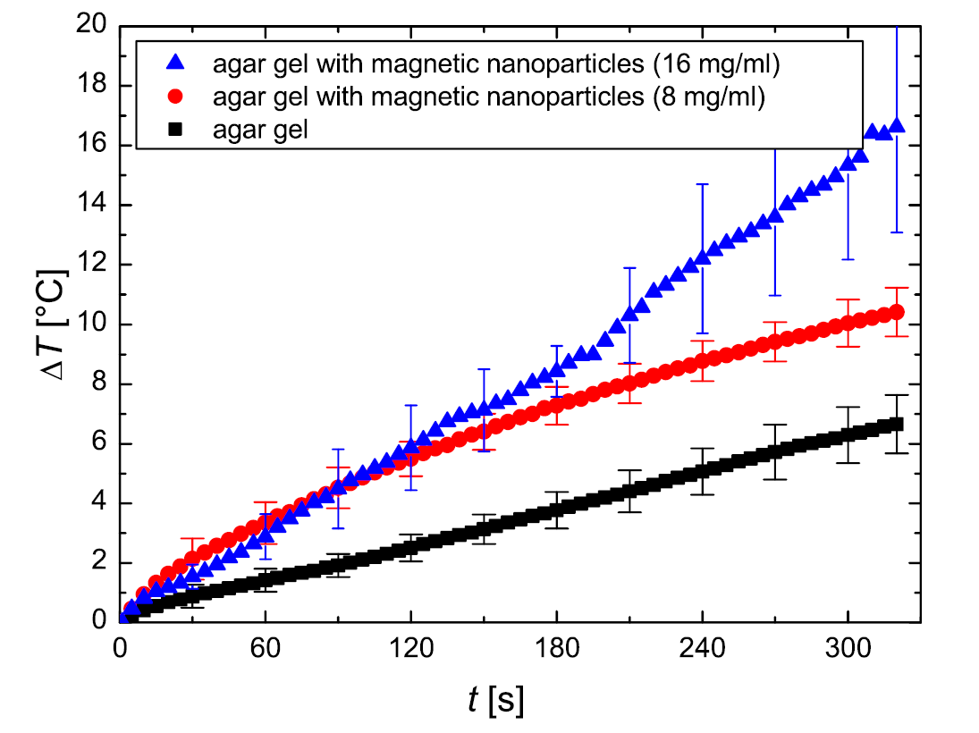
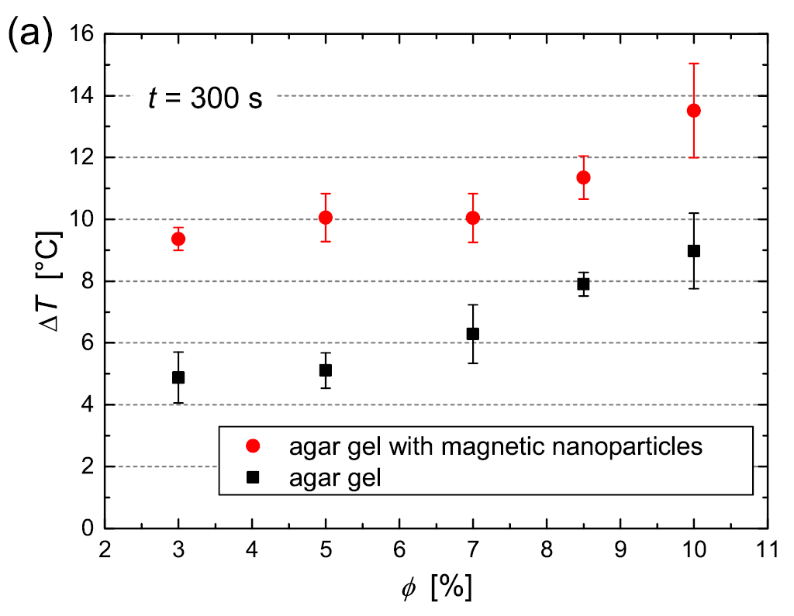
Hyperthermia curve obtained for agar gel (black squares) and agar gel with magnetic nanoparticles with concentration of 8 mg/ml (red circles) and 16 mg/ml (blue triangles). In both samples, the concentration of agar was 7%.
The difference in temperatures
measured by sensors placed at two heights on the sample

Slide 17
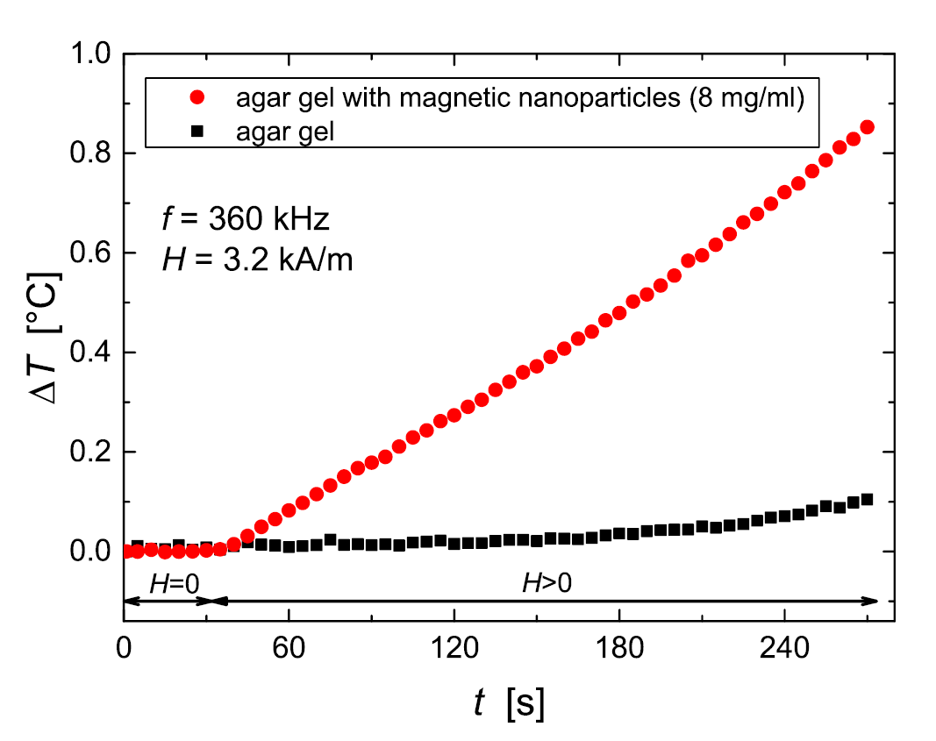
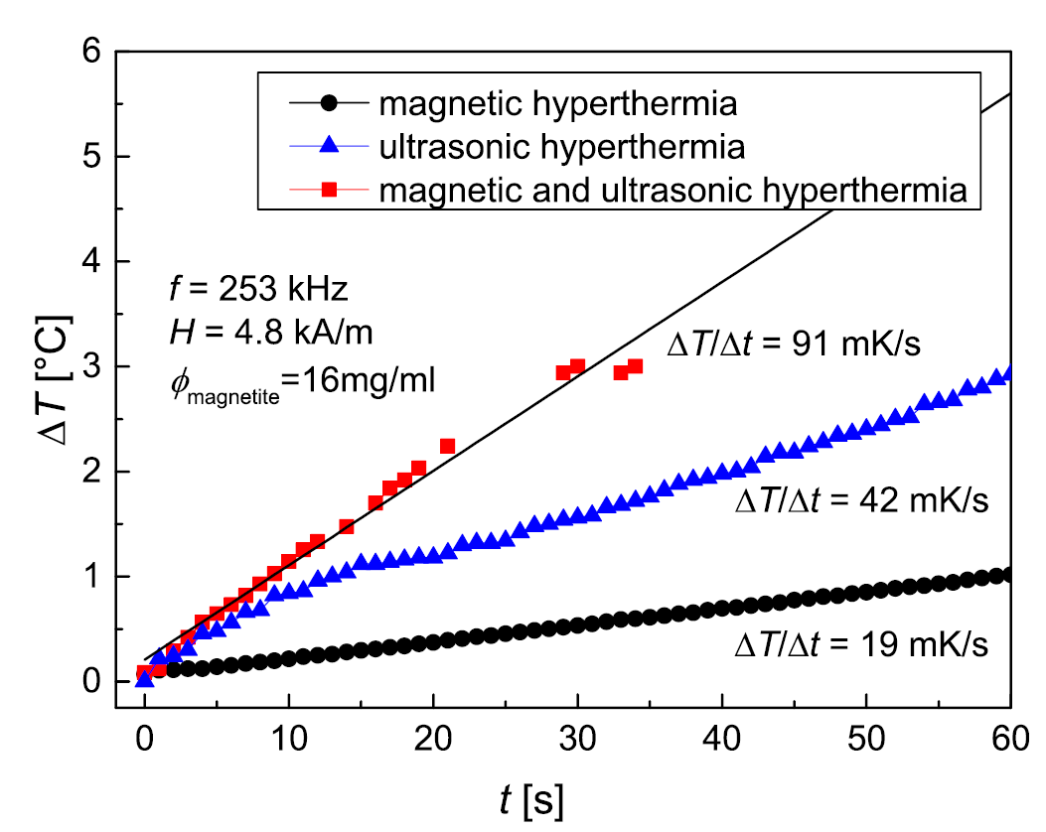
The recorded temperature change under the influence of the AMF for pure agar gel (black squares) and agar gel with magnetic nanoparticles (red circles). In both samples, the concentration of agar was 7%.
Temperature change achieved through the synergetic application of ultrasonic and magnetic hyperthermia

Slide 18
Conclusion
the obtained experimental results demonstrate that magnetic nanoparticles are promising sonosensitizers for ultrasound-induced hyperthermia,
presence of magnetite nanoparticles in the tissue-mimicking phantom increases the absorption of ultrasound energy and increase temperature
this allows us to use lower doses of ultrasound, that is, with a lower intensity and shorter duration of the US treatment, and still achieve the therapeutic goal
magnetic nanoparticles can also be used for magnetic hyperthermia—they produce heating of the sample when exposed to the alternating magnetic field.
thus, magnetic hyperthermia and ultrasonic hyperthermia may work synergistically, rather than independently, to produce a more efficient (faster and better controlled reaching of the therapeutic temperature) and safer (lower intensities of US wave and less magnetic material) treatment with minimum side effects.

Slide 19
Výsledok z oblasti základného výskumu

Slide 21
Sample: calamitic thermotropic liquid crystals n-hexylcyanobiphenyl (6CB)
T_{IN} = 302 K.
Fe₃O₄
d = 20 nm
f = 10⁻⁴
magnetic particles were coated with oleic acid and dissolved in chloroform.
ac magnetic field of 1 Oe is applied at the frequency of f = 650 Hz
H_{dc}= 0 Oe
H_{dc}= 20 kOe

