Slide 1
Analýza biomedicínskych obrazov
Výskumné témy a projekty
Tomori, Nikorovič, (Keša, Valušová, Antalík) – APVV Mikromanipulácia a mikrorobotika
Tomori,, Nikorovič, Hrmo, (Gál, Gargalík) – VEGA Biomechanika a virtuálna rehabilitácia.
(Demjén, Marek, Gažová) - VEGA Analýza obrazu v mikroskopii
Ostatné projekty:
ŠF – 26220220005, 26220120021, 26220120033, 26220220061, Nanofluid, malé kapacity krátku dobu
Steel Park - popularizačný

Slide 2
Publikácie
CC
Tonar, Z., T. Kubikova, C. Prior, E. Demjen, V. Liska, M. Kralickova and K. Witter (2015). "Segmental and age differences in the elastin network, collagen, and smooth muscle phenotype in the tunica media of the porcine aorta." Ann Anat 201: 79-90.
Dancakova, L., Vasilenko, T., Kovac, I., Jakubcova, K., Holly, M., Revajova, V., Sabol, F., Tomori, Z., Iversen, M., Gal, P., and Bjordal, J.M.: ‘Low-level laser therapy at 810 nm improves skin wound healing in streptozotocine-induced diabetic rats.’, Photomed. Laser Surg., 2014, 32, (4), pp. 198–204
Navarro, R., Juhas, S., Keshavarzi, S., Juhasova, J., Motlik, J., Johe, K., Marsala, S., Scadeng, M., Lazar, P., Tomori, Z., Schulteis, G., Beattie, M., Ciacci, J.D., and Marsala, M.: ‘Chronic Spinal Compression Model in Minipigs: A Systematic Behavioral, Qualitative, and Quantitative Neuropathological Study’, J. Neurotrauma, 2012, 29, (3), pp. 499-513
Hashim, A., Molcan, M., Kovac, J., Varchulova, Z., Gojzewski, H., Makowski, M., Kopcansky, P., Tomori, Z., and Timko, M.: ‘The Influence of Morphology on Magnetic Properties of Magnetosomes’, Acta Phys. Pol. A, 2012, 121, (5-6), pp. 1250-1252
Gojzewski, H., Makowski, M., Hashim, A., Kopcansky, P., Tomori, Z., and Timko, M.: ‘Magnetosomes on surface: an imaging study approach’, Scanning, 2012, 34, (3), pp. 159-169
Tomori, Z., Keša, P., Nikorovič, M., Kaňka, J., Jákl, P., Šerý, M., Bernatová, S., Valušová, E., Antalík, M., and Zemánek, P.: ‘Holographic Raman tweezers controlled by multi-modal natural user interface’, Journal of Optics, 2016, 18, (1), pp. 015602 (IF 2.059) – published 18. November 2015.
WOS, SCOPUS
Tomori, Z., Vanko, P., and Vaitovic, B.: ‘Using of low-cost 3D cameras to control interactive exhibits in science center.’, in Sincak, P., Hartono, P., Vircíkova, M., Vascák, J., and Jaksa, R. (Eds.): ‘Emergent Trends in Robotics and Intelligent Systems: Where Is the Role of Intelligent Technologies in the Next Generation of Robots?’ (Springer, 2015), pp. 273-283
Tomori, Z., Kanka, J., Kesa, P., Jakl, P., Sery, M., Bernatova, S., Antalik, M., and Zemanek, P.: ‘Natural user interface as a supplement of the holographic Raman tweezers’. Proc. Optical Trapping and Optical Micromanipulation XI, San Diego, CA, USA, September 16 2014 pp. Pages
Gargalík, R., and Tomori, Z.: ‘Control of depth-sensing camera via plane of interaction’, in CEUR Workshop Proceedings, 2014, pp. 34-39.
F. Sabol, N. Bobrov, M. Novotný, T. Vasilenko, Š. Mozeš, Z. Ševčíková, A. Molčányová, R. Tkáčová, Z. Tomori, and P. Gál: ‘Skin wound healing in obese and lean male adolescent rats submitted to pre-weaning litter size manipulation’, Folia Biologica (Prague), 2014, 60, pp. 21-27
Tomori, Z., Gargalik, R., and Hrmo, I.: ‘Active segmentation in 3D using Kinect sensor’. Proc. 20th International Conference in Central Europe on Computer Graphics, Visualization and Computer Vision, WSCG 2012 - Conference Proceedings 2012 pp. 163-168

Slide 3
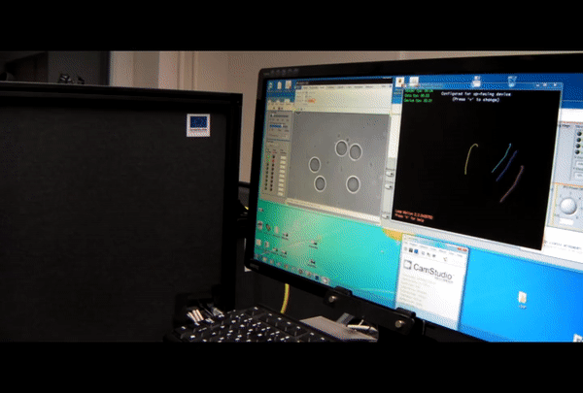
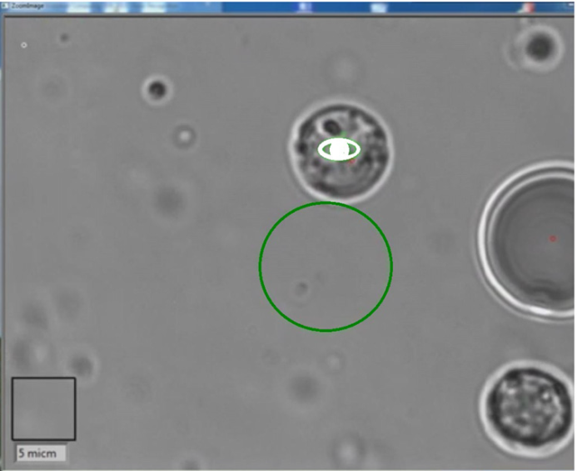
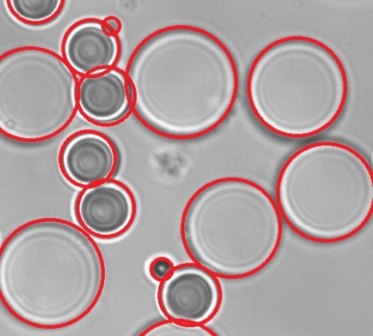
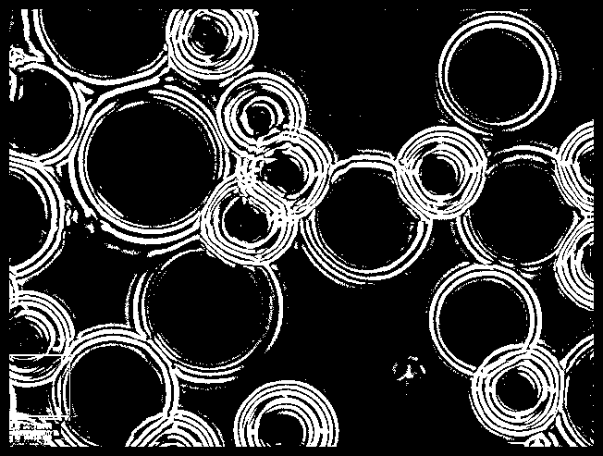
Mikromanipulácia a mikrorobotika (výsledky)
Vylepšené ovládanie optickej pinzety
Polohou prstov ruky v 3D
Hlasovými povelmi
Pohľadom (eye tracking)
Dotykovou obrazovkou cez sieť
Podanie patentu (prebieha)
Publikácia J. Optics (IF 2.05) + 4 iné
Symetry Radius Transform

Slide 4
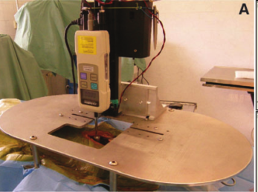
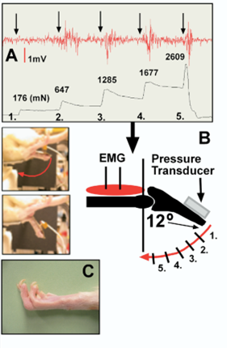
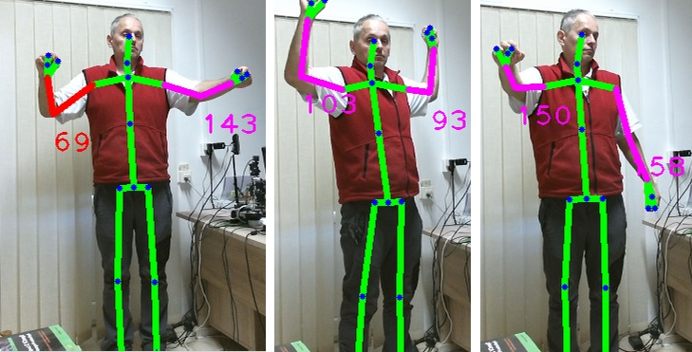
Biomechanika (výsledky)
Kontaktné merania (miecha, rany, uhol)
Bezkontaktné 3D meranie uhlov
Navarro, R., Juhas, S., Keshavarzi, S., Juhasova, J., Motlik, J., Johe, K., Marsala, S., Scadeng, M., Lazar, P., Tomori, Z., Schulteis, G., Beattie, M., Ciacci, J.D., and Marsala, M.: ‘Chronic Spinal Compression Model in Minipigs: A Systematic Behavioral, Qualitative, and Quantitative Neuropathological Study’, J. Neurotrauma, 2012, 29, (3), pp. 499-513 (IF 4.32)
Dancakova, L., Vasilenko, T., Kovac, I., Jakubcova, K., Holly, M., Revajova, V., Sabol, F., Tomori, Z., Iversen, M., Gal, P., and Bjordal, J.M.: ‘Low-level laser therapy at 810 nm improves skin wound healing in streptozotocine-induced diabetic rats.’, Photomed. Laser Surg., 2014, 32, (4), pp. 198–204 (IF 1.58) +4 menšie članky a príspevky

Slide 5
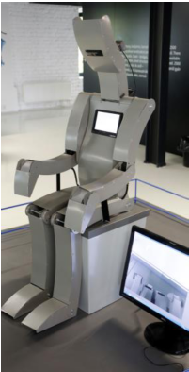
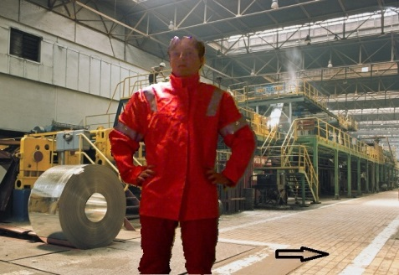
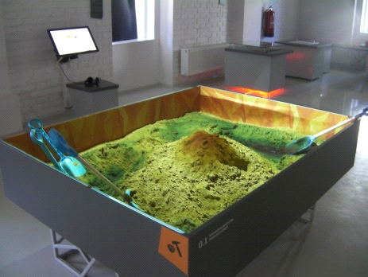
Popularizácia
Steel Park (Cena SAV za popularizáciu)
4x Piknik Naukowy - Varšava (100 tisíc ľudí)
Noc výskumníka (2x prednáška, 4x exponáty)
3x Deň otvorených dverí
Tomori, Z., Vanko, P., and Vaitovic, B.: ‘Using of low-cost 3D cameras to control interactive exhibits in science center.’, in Sincak, P., Hartono, P., Vircíkova, M., Vascák, J., and Jaksa, R. (Eds.): ‘Emergent Trends in Robotics and Intelligent Systems: Where Is the Role of Intelligent Technologies in the Next Generation of Robots?’ (Springer, 2015), pp. 273-283 +4 menšie članky a konferenčné príspevky

Slide 6
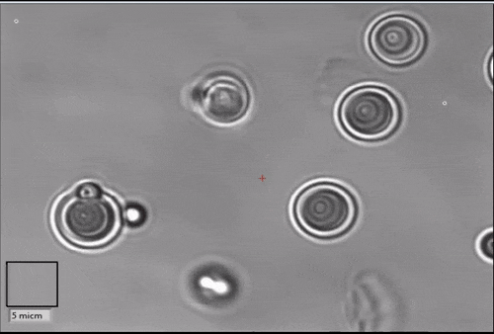
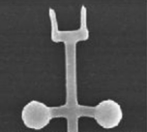
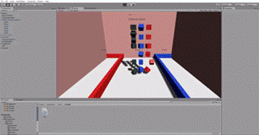
Vízia umelá inteligencia, počítačové videnie, strojové učenie, virtuálna realita
Mikromanipulácia
Mikrorobotika
Nanorobotika
(VEGA, APVV)
Path planning
Biomechanika
Virtuálna rehabilitácia
„Seriózne“ hry
(VEGA, RIS3?)
Virtual „Box and Blocks“

Slide 7
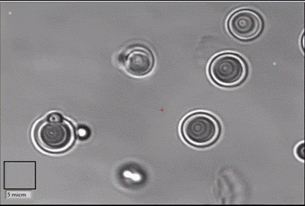
Vízia umelá inteligencia, počítačové videnie, strojové učenie, virtuálna realita
Mikromanipulácia
Mikrorobotika
Nanorobotika
(VEGA, APVV)
Path planning
Biomechanika
Virtuálna rehabilitácia
„Seriózne“ hry
(VEGA, RIS3?)
Virtual „Box and Blocks“

